Slide 1
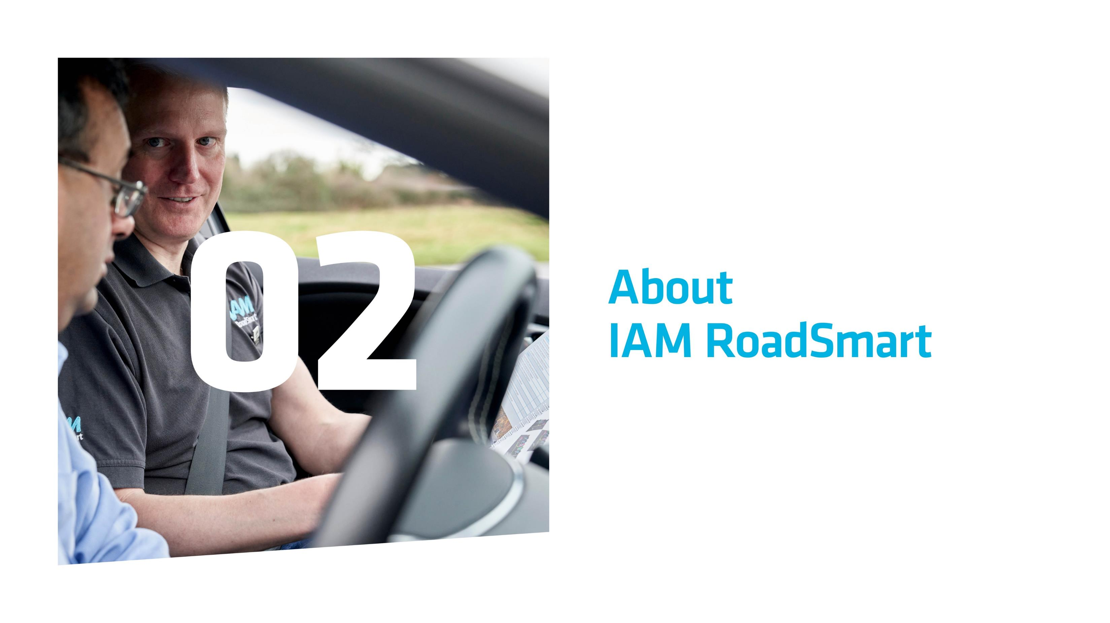
Notes:
Please explain that this is an introductory slide for the next part of the presentation where you’ll explain a little about RoadSmart – who we are and what we do. Let your audience know that they’ll see a short video, and then find out about this history of the organisation, the work it does, the courses it offers and the details of the local group.

Slide 2

Notes:
Who are IAM RoadSmart? Video (auto play)
This slide can be skipped if you don’t have facilities (or don’t want) to play the video. If you don’t want to show it, we suggest you delete this slide from the copy of the slide deck before you make your presentation please, so you don’t have to ‘skip’ past anything in front of the audience.
Suggested ‘script’ to explain the video to the audience if you are using it:
“This video will give you an outline of what IAM RoadSmart does, from helping drivers - and motorcycle riders - to progress their skills, to campaigning at a national level.”

Slide 3
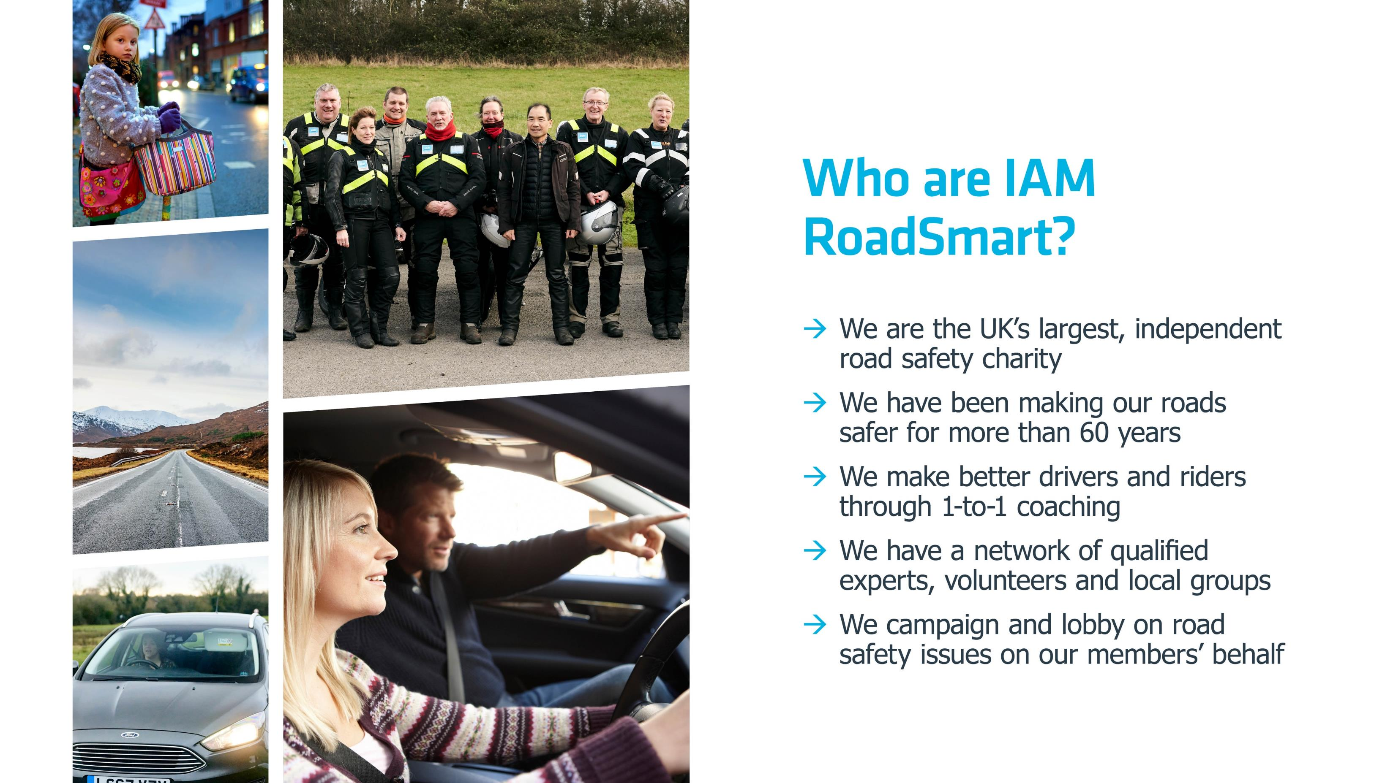
Notes:
If the video has been shown, then please clarify for the group that some of the highlights from the film are shown on this slide, so this is essentially a recap.
Where the video has not been shown, in this slide we summarise key facts about IAM RoadSmart to emphasise our scale, heritage and mission etc. Please run through each of the bullets in turn. The following are additional facts around each of the bullets that you may want to add in as you talk them through, in order to add substance to each of the points raised.
- We have almost 85,000 members and cover the whole of the UK. We even have some members overseas.
- We were established in 1956 and have been working to improve road safety standards as our key mission since then.
- Our Advanced Driving and Riding courses are accredited by the DVSA and recognised as the gold standard in driving and riding standards.
- We have c. 10,000 active volunteers across the country – including our Observers who deliver all our Advanced courses. They give up their time and share their expertise so generously as an expression of their wholehearted commitment to improving road safety in the UK. They are the life-blood of everything we do. The Observers work with their local group across the UK, with c. 180 different groups in existence.
- You’ll often find us commenting on key road safety issues in the media. In 2019 we received over 5,000 pieces of media coverage, for example, over 500 of them on TV.

Slide 4
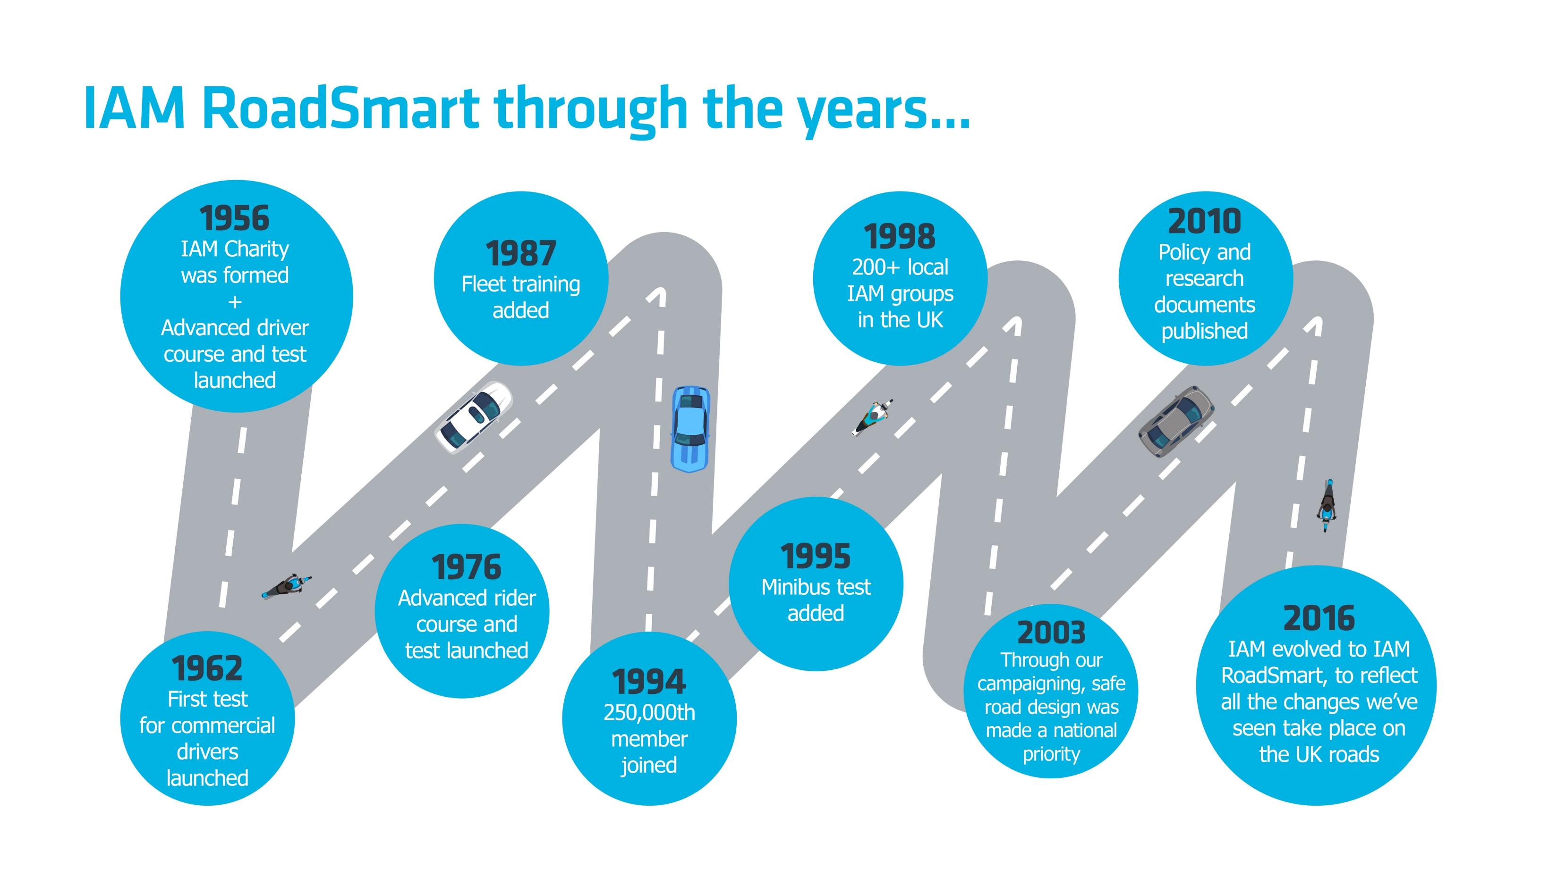
Notes:
We are constantly evolving to make sure we reflect not just the changes that have taken place on the UK roads over the past 60+ years, but also to reflect the needs of the UK’s drivers and riders. This slide demonstrates some key milestones to indicate our heritage, progress and influence.

Slide 5

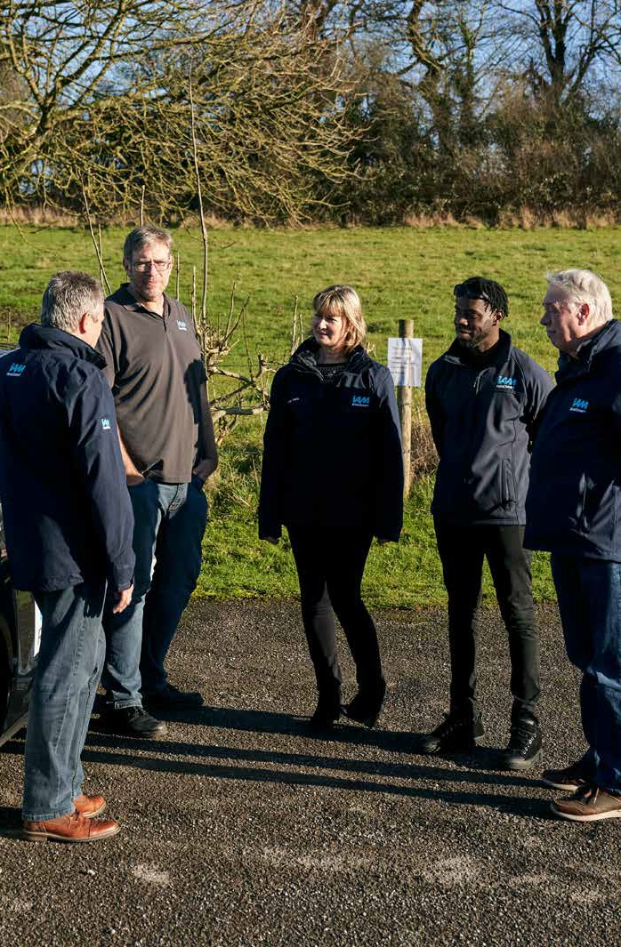
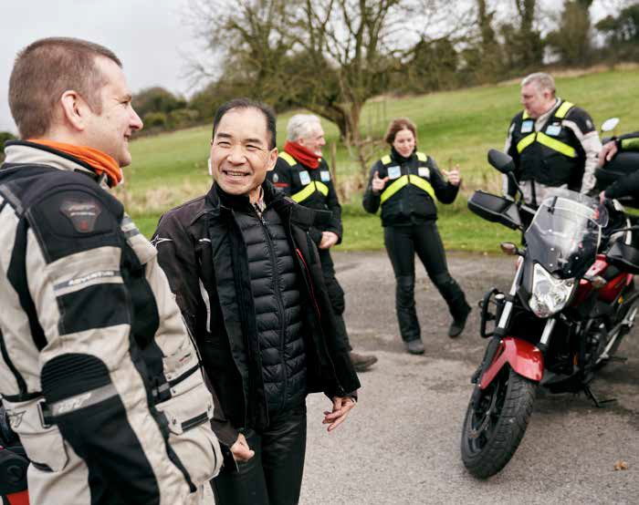
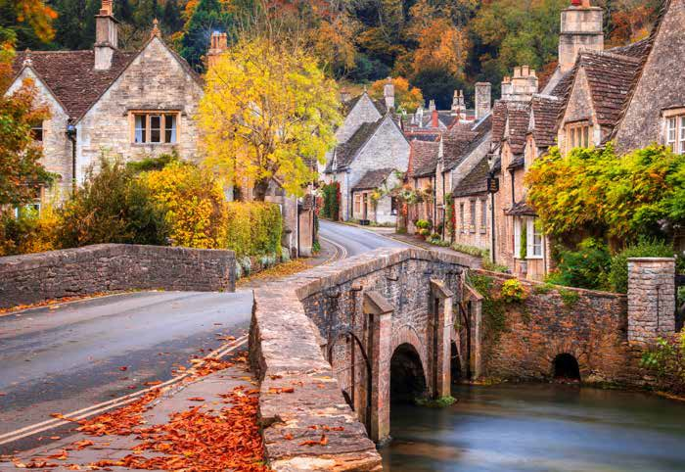
Name
Group Name–replace copy
Size
Group Size–replace copy
Area
Area served–replace copy
History
Brief history–replace copy, replace copy, replace copy, replace copy, replace copy, replace copy.
Highlight
Group highlight, proudest moment, newsworthy event–replace copy, replace copy, replace copy, replace copy, replace copy, replace copy.
Notes:
This slide allows you to introduce your local group to the audience, to help the people you are talking to understand they can be part of a community of drivers and/or riders in their local area, not just a distant, national organisation.
Please add in relevant text where shown on the slide, to bring this point to life. If possible, you can also add local pictures.
You can then talk through each of the points in turn.

Slide 6
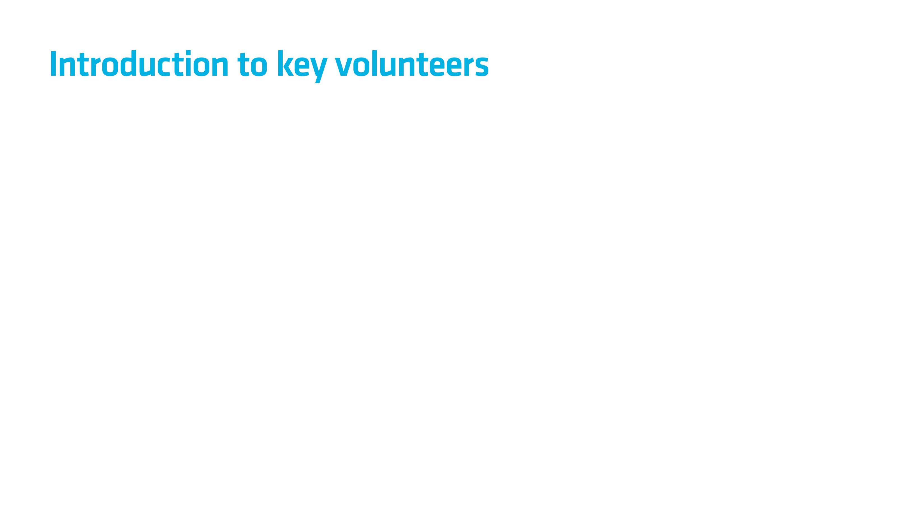
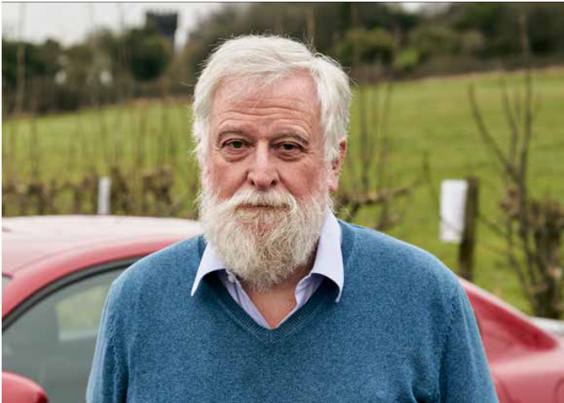
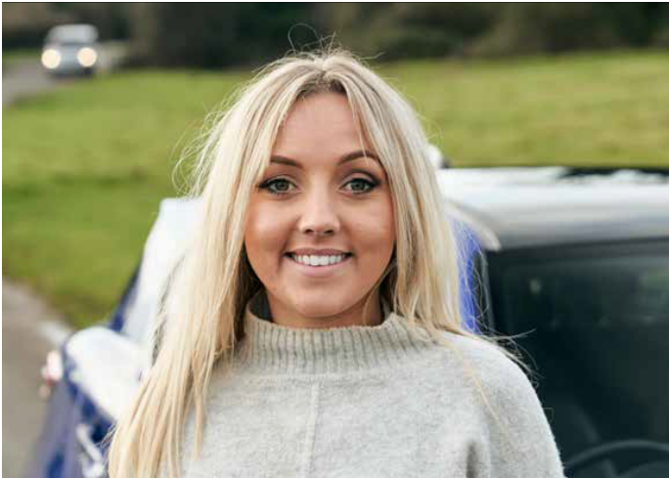
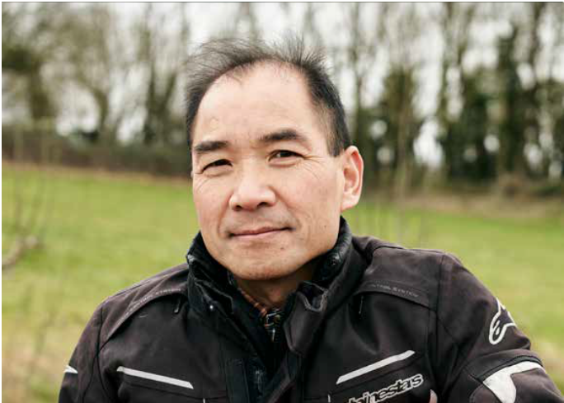
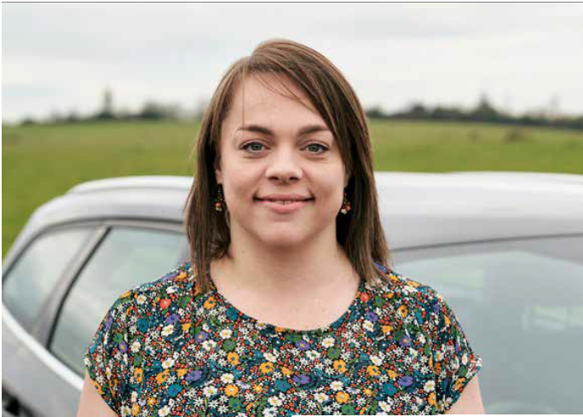
Name Name
Role as key volunteer and any other info and any other info
Name Name
Role as key volunteer and any other info and any other info
Name Name
Role as key volunteer and any other info and any other info
Name Name
Role as key volunteer and any other info and any other info
Notes:
In this slide, you can add in details of key group contacts with whom the audience will likely engage if they were to become an Associate and/or take part in a Taster session etc. Please add in relevant names, images and text where shown, and then talk through each of the contacts in turn.
If this slide is not relevant for your presentation, you can delete it.

Slide 7

Notes:
On this slide, we cover IAM RoadSmart’s work in lobbying government (central, regional and local) and the media etc. on road safety issues, and on our members’ behalf. Please run through the points below as necessary.
The IAM RoadSmart team is widely respected throughout the road safety industry for our expertise and experience. We are regularly asked to consult and advise all the major players, including the Government, on all aspects of road safety.
We research our members views on road safety through regular surveys and lobby decision makers to ensure their voices are heard.
We are trusted advisors not only to government, but also to the media and are often invited to discuss key issues in the press and on air.
If you were to join the IAM RoadSmart community, you could contribute to this and play your part in helping to improve road safety standards in the UK by making sure they key issues are considered in policy making etc.

Slide 8
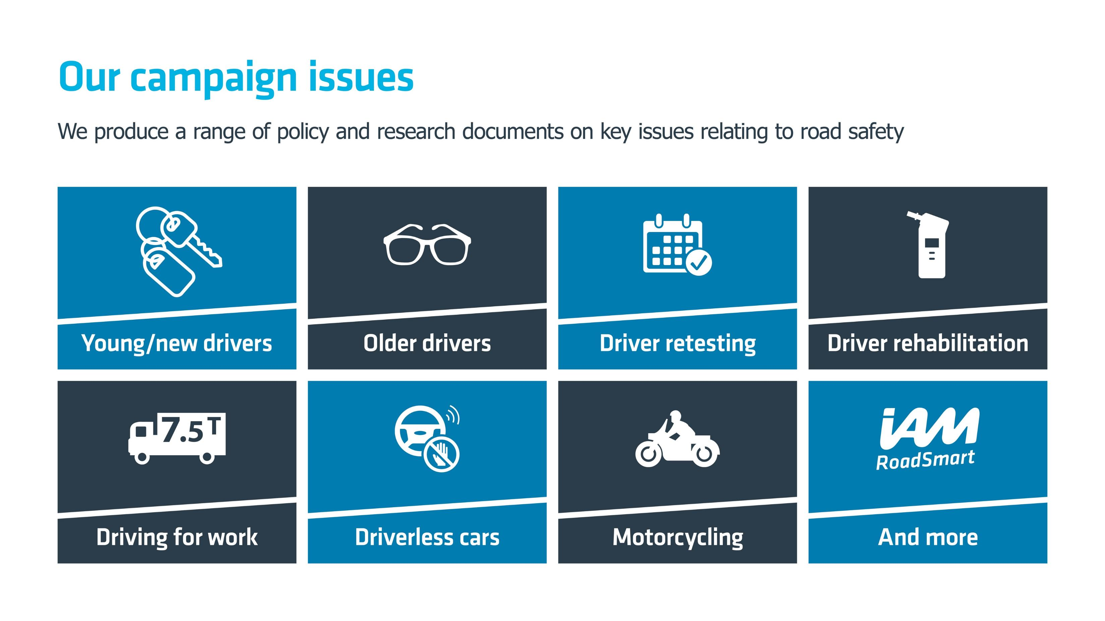
Notes:
On this slide, we list some of the key policy issues on which we publish papers, research and statements in order to influence road safety regulation etc. in the UK. Please run through each of them in turn.
If you feel you need further details in advance of your presentation to familiarise yourself with the work of IAM RoadSmart’s policy team, and in order to be explain these points in more detail if you need to, please visit www.iamroadsmart.com/media-and-policy/research-and-policy for further details.

Slide 9

Notes:
Here we list some of the regulatory and trade bodies with whom we regularly work. Many members of the general public – and therefore potentially some of your audience - will likely not know these organisations, but the slide is included as an illustration of our scale and impact. Please list the organisations in turn as necessary.
If you feel you would like to find out more about each of these organisations, links to their websites are below for your information:
Department for Transport: https://www.gov.uk/government/organisations/department-for-transport
Highways England: https://www.gov.uk/government/organisations/highways-england
FIA Action for Road Safety: https://www.fia.com/fia-action-road-safety
Road Safety Scotland: https://roadsafety.scot/
PACTS: http://www.pacts.org.uk/
Transport Focus: https://www.transportfocus.org.uk/

Slide 10
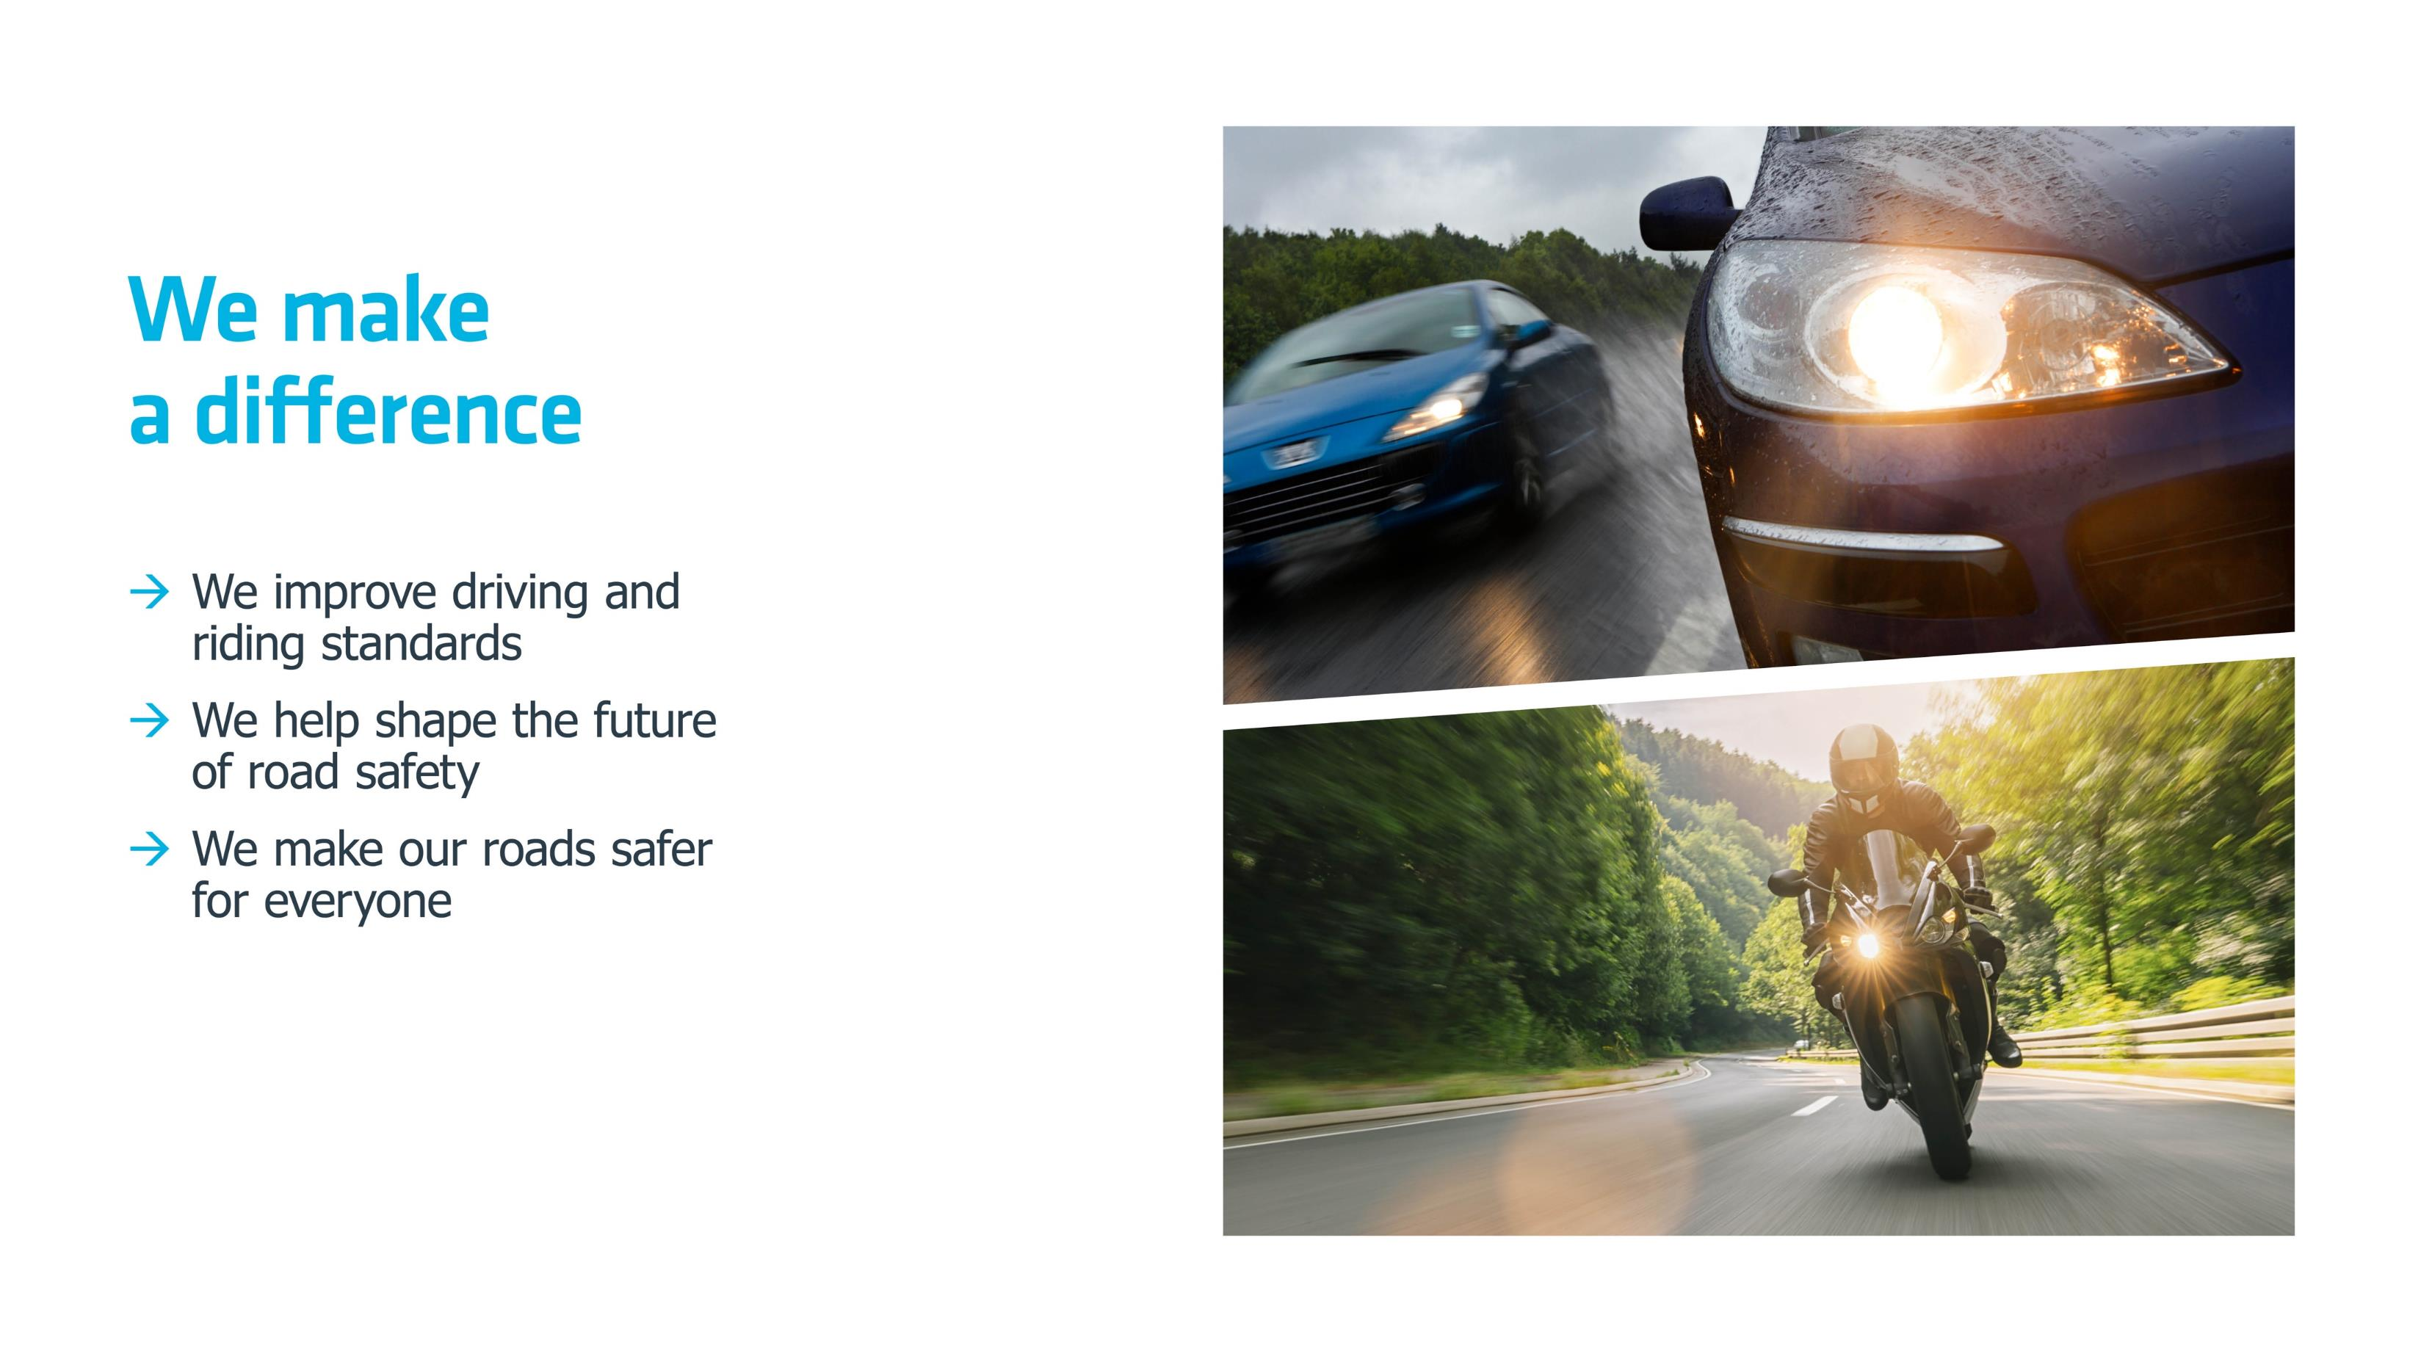
Notes:
Our work nationally and locally in lobbying Government and the media etc, and making recommendations on key road safety issues, has a real impact. This slide lists the ways in which we – and our members – help make a positive change to road safety. Please go through them to explain to the audience how, if they were to join our community, they could play their part in improving road safety for all.

Slide 11
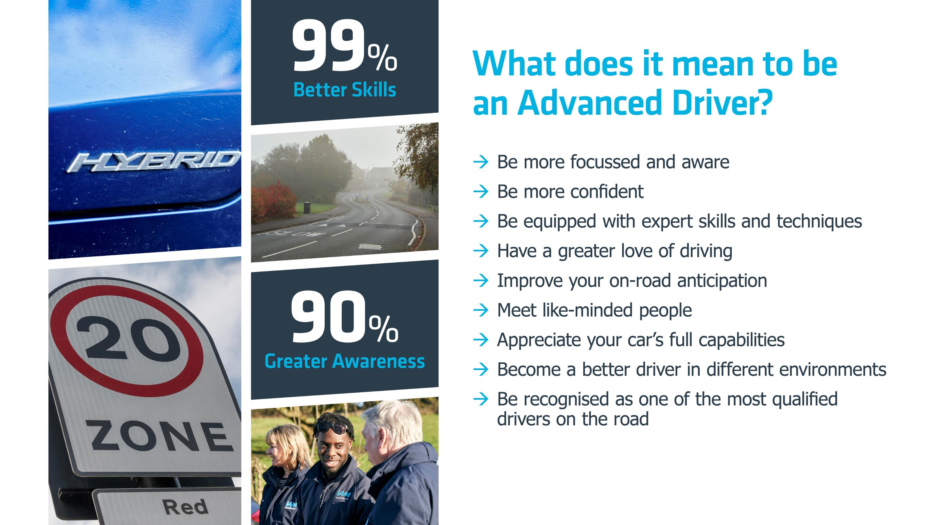
Notes:
In this slide we highlight the benefits of Advanced Driving on individuals, rather than society at large.
The ‘call-out facts’ on this slide relate to feedback where people who have just finished their Advanced courses are asked how they felt about what they have learned. Responses include that 99% believed they had better skills as drivers by the end of their coaching, and 90% felt they had significantly greater awareness of risks and hazards on the road, and were therefore safer on the road. This hugely positive feedback is indicative of the real benefit people feel from taking our courses.

Slide 12
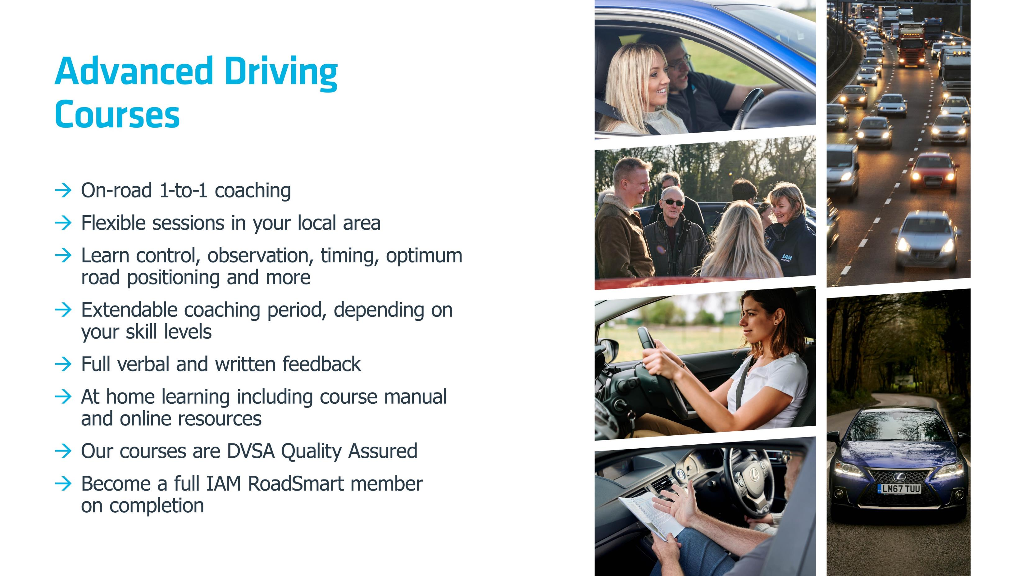
Notes:
In this slide we cover how our Advanced Driving courses work, so that members of the audience an get an understanding of – if they were to buy a course – what would be involved.
Please talk through each of the points in turn on the slide, or – if you prefer – use the guide script below. Then you may want to mention – if it is appropriate to the occasion – the price of the Advanced course (£149 in April 2020) and where people can book (online at www.iamroadsmart.com/courses or via 020 8996 9600) should they want to enrol.
Suggested ‘script’ for Advanced Driver courses (this can be tailored to match your own group’s offering):
“If you enrol on an Advanced Driver course, you will benefit from a series of 1-2-1 coaching sessions. Each session is with an Advanced Driving expert – one of our volunteer Observers - and takes place in a location convenient to you. It will be held in your own car. Each session will be for about 2 hours and you’ll focus on specific skills such as control, observation, timing, optimum road positioning, ability to deal with unpredictable roads and other road users’ behaviour etc. Throughout your course, you will also have access to at-home resources to top-up your learning, such as a course manual and online tips and advice, and feedback is given after every session. Courses generally last c. 3-6 months, depending on your skill level and the frequency of your coaching sessions. When you’re ready, you’ll take the Advanced Driving test and become a qualified Advanced Driver and member of IAM RoadSmart. At this point, as well as feeling more confident and safer on the road, you can often receive insurance benefits. And, if you drive for a living, you can add your Advanced Driver qualification to your CV.”

Slide 13
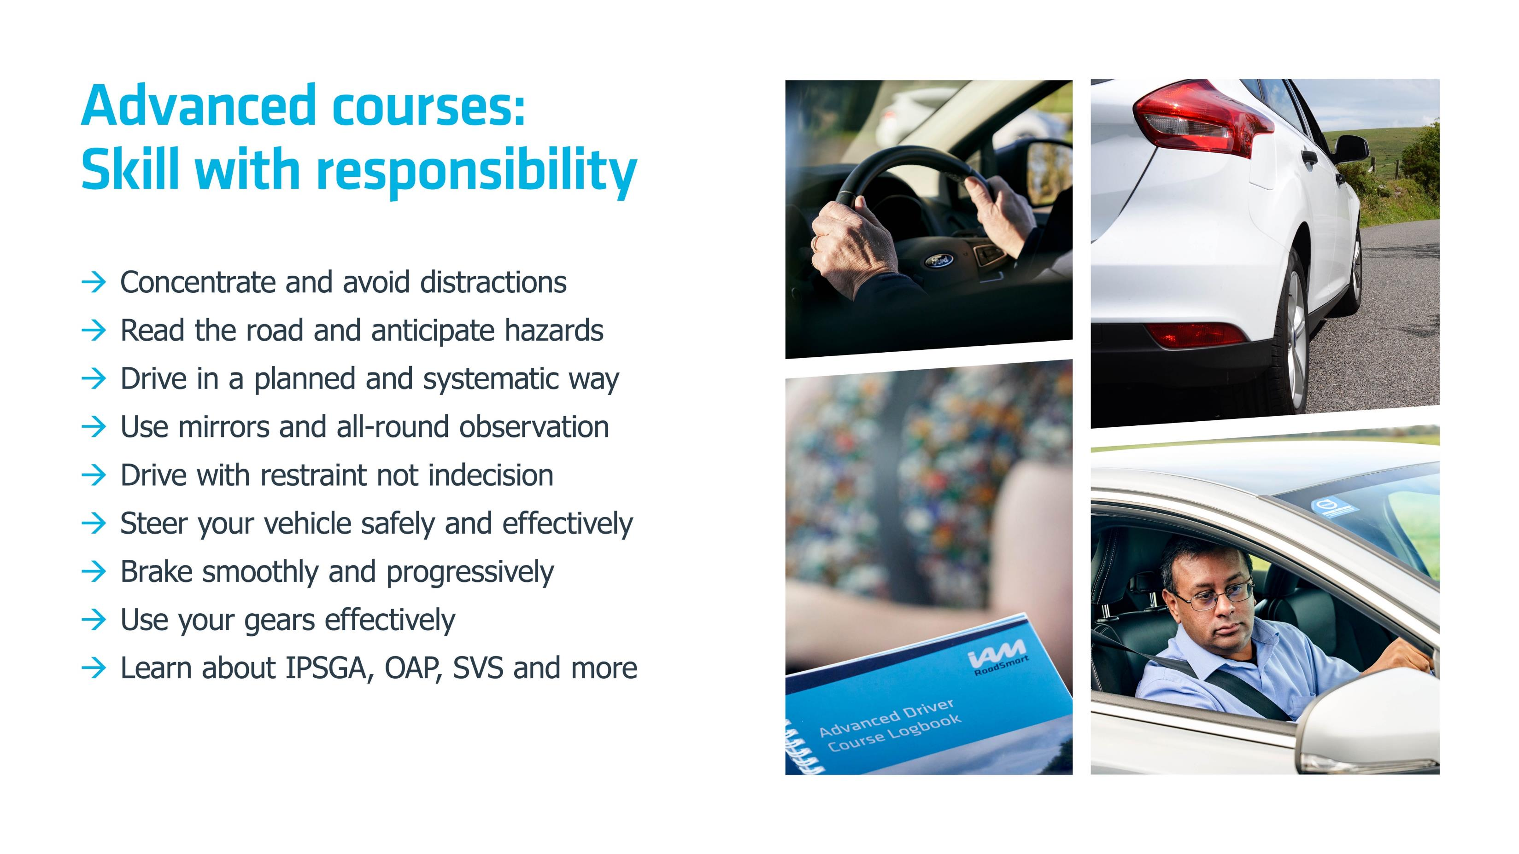
Notes:
This is a summary of the skills that your audience can expect to pick up and develop if they undertake an Advanced Driving course. Talk through each of the points.

Slide 14
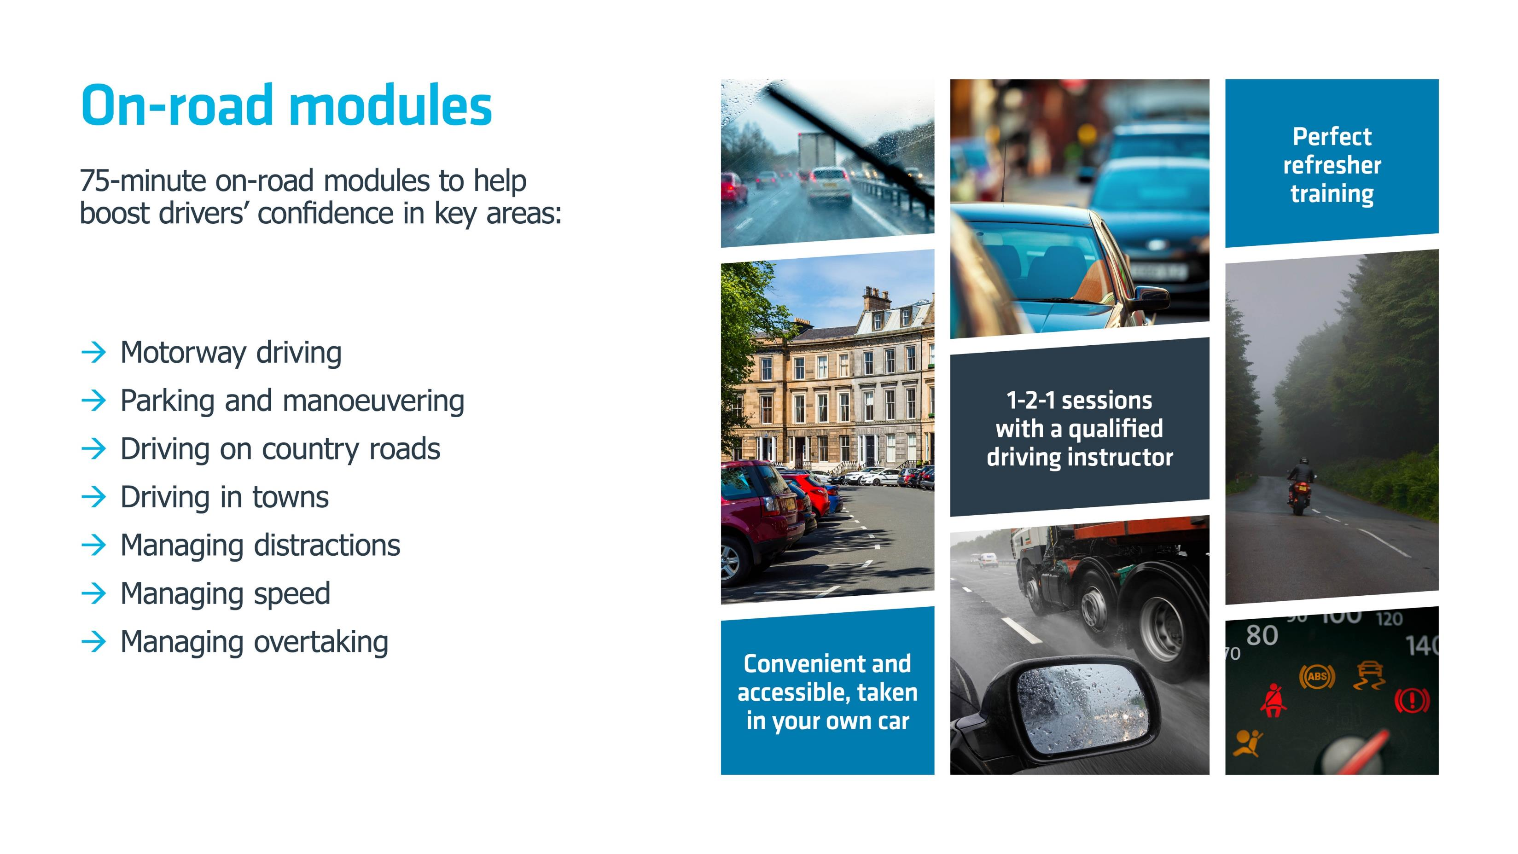
Notes:
Here we summarise our on-road modules, which – although they’re not delivered by local groups - are designed to be of benefit to individuals who feel they would benefit from some refresher training, perhaps in key areas where they know they are not so-strong, but who are not, at the moment, ready for an Advanced course. Please feel free to run through the bullets in turn or use the ‘script’ following if you prefer.
“If you feel like you could benefit from some refresher training to help improve your driving and keep you and any passengers safe on the road, but you are not ready just now to become an Advanced Driver, we also offer on-road modules. These 75-minute sessions are perfect for boosting confidence or brushing up sills in areas where you have less experience. Maybe you’re a new driver or someone who never got the chance to learn about motorways for example? In which case our Motorway Driving module would be perfect. Or perhaps you're an experienced driver who feels you need some tips on parking and manoeuvring? We can also help with that. You can see the list of course offered on this slide. Each module costs £49 and is taken in your own car, near your own home, so you’ll know the roads and area. If you’d like more details you can visit www.iamroadsmart.com/on-road for more details.”

Slide 15
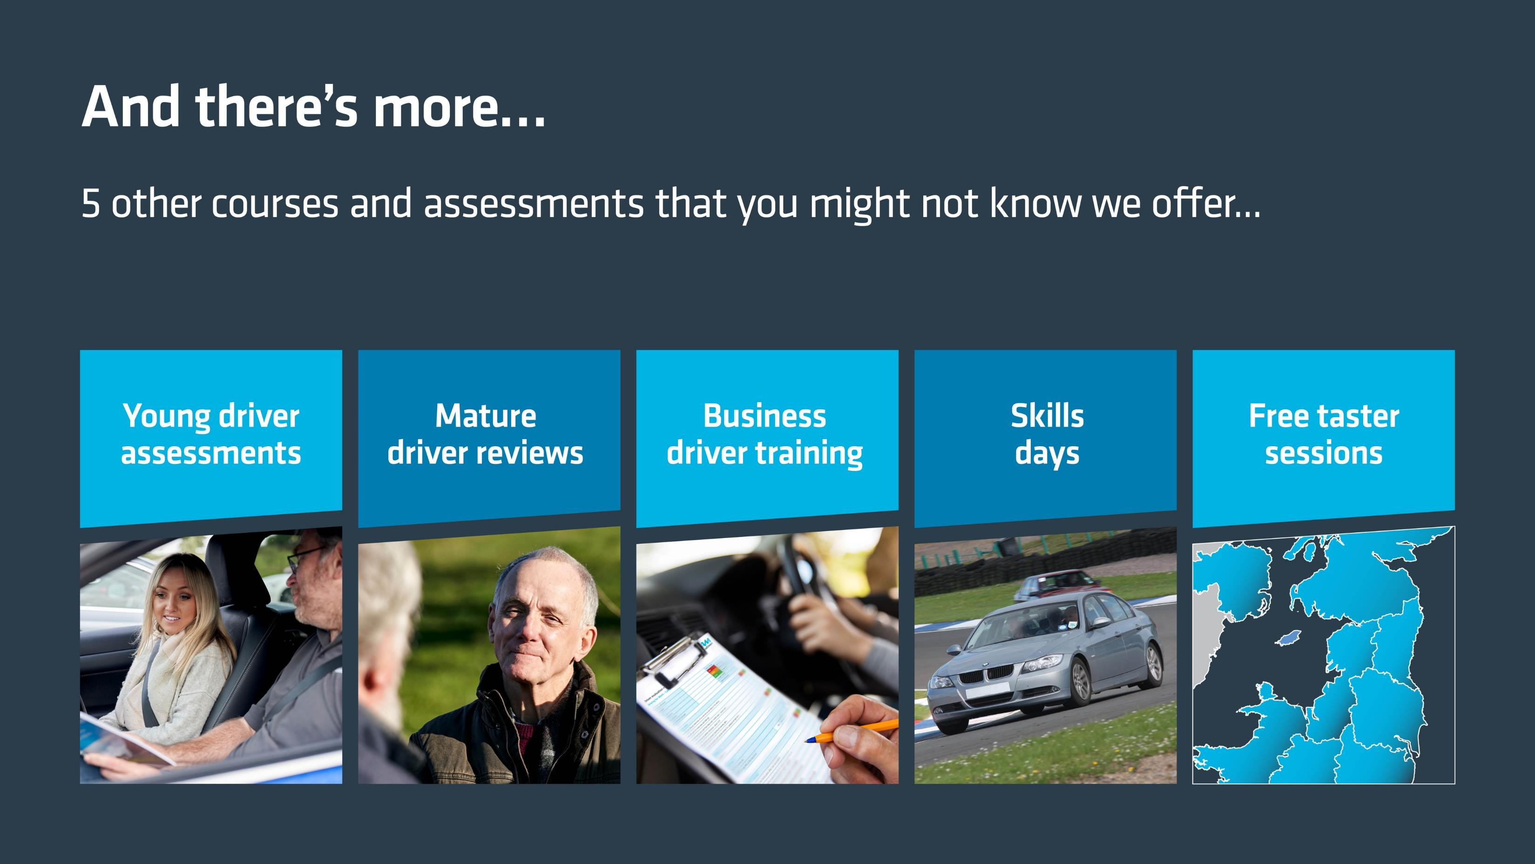
Notes:
In this slide we cover some of IAM RoadSmart’s other courses and products which – although they’re not delivered by local groups - the audience may not know we offer. This slide does not go in to too much detail, as they are not the main focus of this presentation – which is about Advanced Driving and Riding – but it would be helpful to paint a picture of all that we do, so the audience has an understanding of our breadth and range.
Please run through the points in turn, or use this loose ‘script’ if you prefer:
“In addition to Advanced courses and on-road modules, IAM RoadSmart also offers a range of additional services to help drivers and riders of all levels of expertise to be safer and more skilled.
They are ideal for those who realise they may need some support or advice, but who are not, as it stands, immediately interested in Advanced Driving or Riding.
For example, we offer Younger Driver Assessments which give younger drivers between 17 and 25 – those who are statistically most at risk on our roads – an independent view of their driving capability from an expert. It’s ideal both for those who need a confidence book and perhaps a refresher in certain areas, but also for those who perhaps have a passion for driving and who want their abilities rated, or who require some training before being allowed on to a company car scheme. The Assessments cost £45 and are taken in the driver’s own car in a convenient location.
We also offer Mature Driver Reviews. These 60-minute sessions offer those who are seeking a second opinion on their continuing capability behind the wheel as they get older a trusted, independent view of whether they are still safe to drive. During the session, one of our qualified experts takes the older driver out in their own car, on familiar roads, to assess their driving style and to watch out for any areas where skills could do with some sharpening. After the review, drivers not only get a verbal report on their skills but also a written account of the session, which includes pointers to improvement. It’s a completely personal report, shared with no one else. Those who have completed one of our Mature Driver Reviews tell us that having an expert to judge their driving skills gives them renewed confidence at the wheel and a real sense of achievement. Session costs £49.
IAM RoadSmart also offers commercial driver training for businesses, and works with some of the biggest commercial fleets in the country. We offer in-car 1-2-1 training, classroom courses and e-learning opportunities and we advise fleet managers, HR managers, health & safety practitioners and many others who have responsibility for colleagues who drive for work. In any one year we will influence c.15,000 commercial drivers through some form of training intervention, helping to spread the message of road safety to as broad a community as possible. You can see details of our commercial training services at www.iamroadsmart.com/business.
Another key part of our product portfolio is our renowned Skills Days. These popular days across the Summer months allow drivers and riders to learn handling skills from real experts while driving their own cars or motorbikes on race tracks in Yorkshire, Leicestershire or Hampshire. The sessions are open to the public as well as IAM RoadSmart members, and during each event drivers and riders work either one-to-one with an instructor or as part of a small group to learn new skills. Skills days cost from £135 and you can see details at www.iamroadsmart.com/skillsdays.
And finally, and possibly most importantly, are our free taster sessions. Without a doubt the best way for you to learn more about Advanced Driving and Riding is to experience it for yourself. So why not come and enjoy a friendly drive or ride with us? Riding your own bike or driving your car with one of our qualified mentors on a taster day will enable you to fully appreciate the skills and knowledge that are covered in Advanced courses. So please do come along free-of-charge to one of our forthcoming sessions. We'll welcome you and answer any questions you may have before we drive or ride together on convenient roads close to you. Everyone is welcome - all you need is a full licence and your own car or motorcycle. To book your place at a free taster – and learn more about Advanced Driving and Riding first hand - please visit our website at www.iamroadsmart.com/freetasters (or speak to us at the end of this session for more details.” (Use this last line only as appropriate).

Slide 16
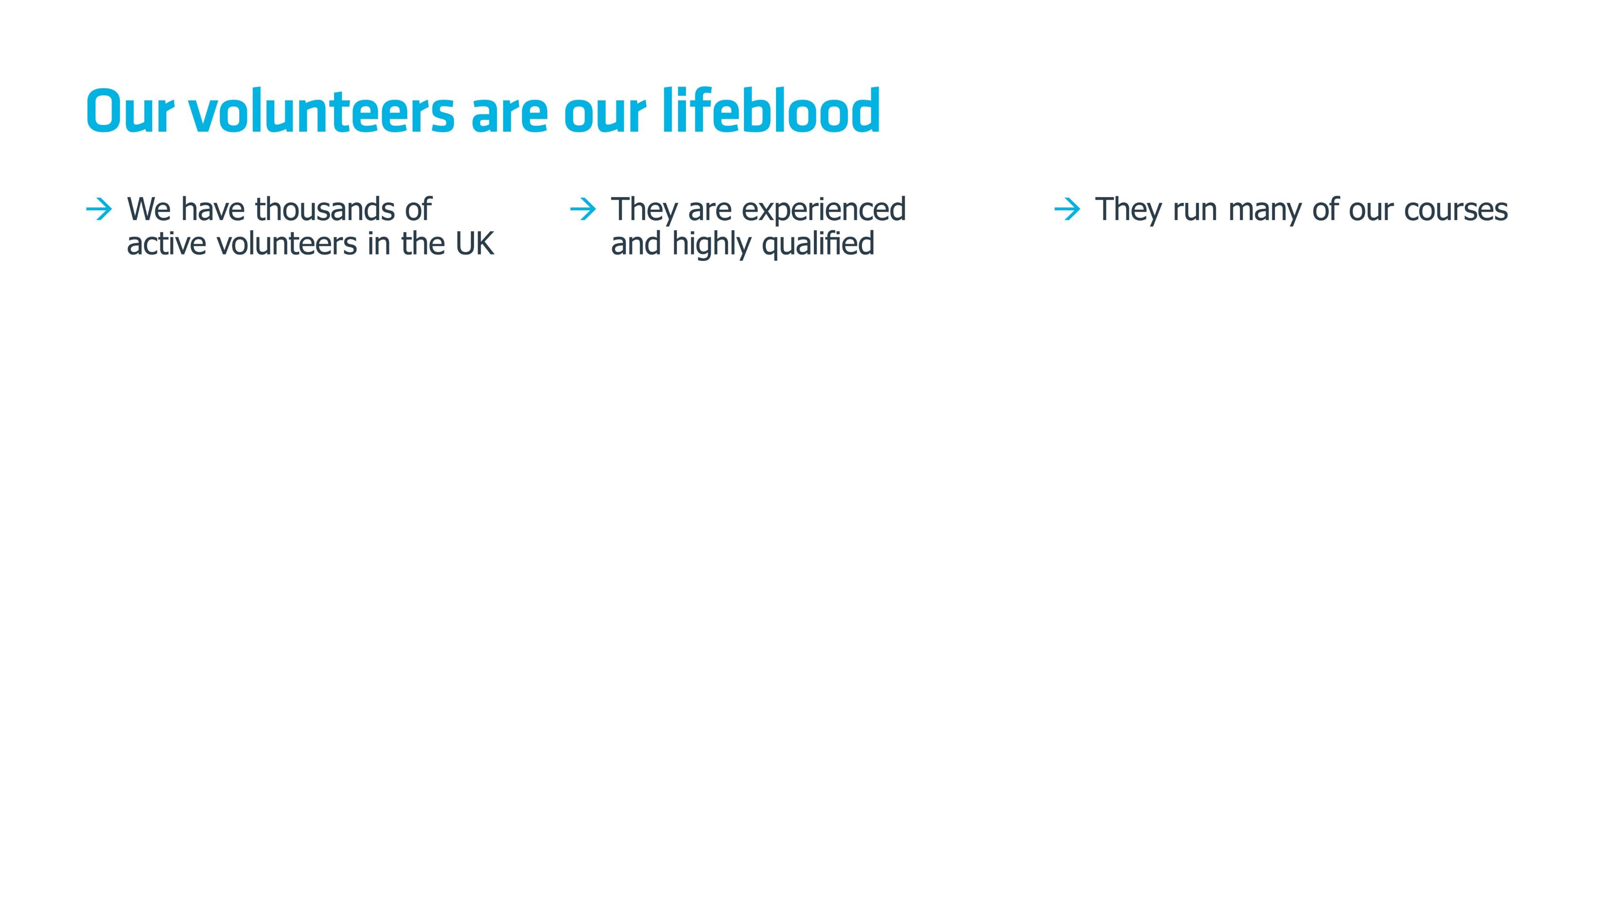
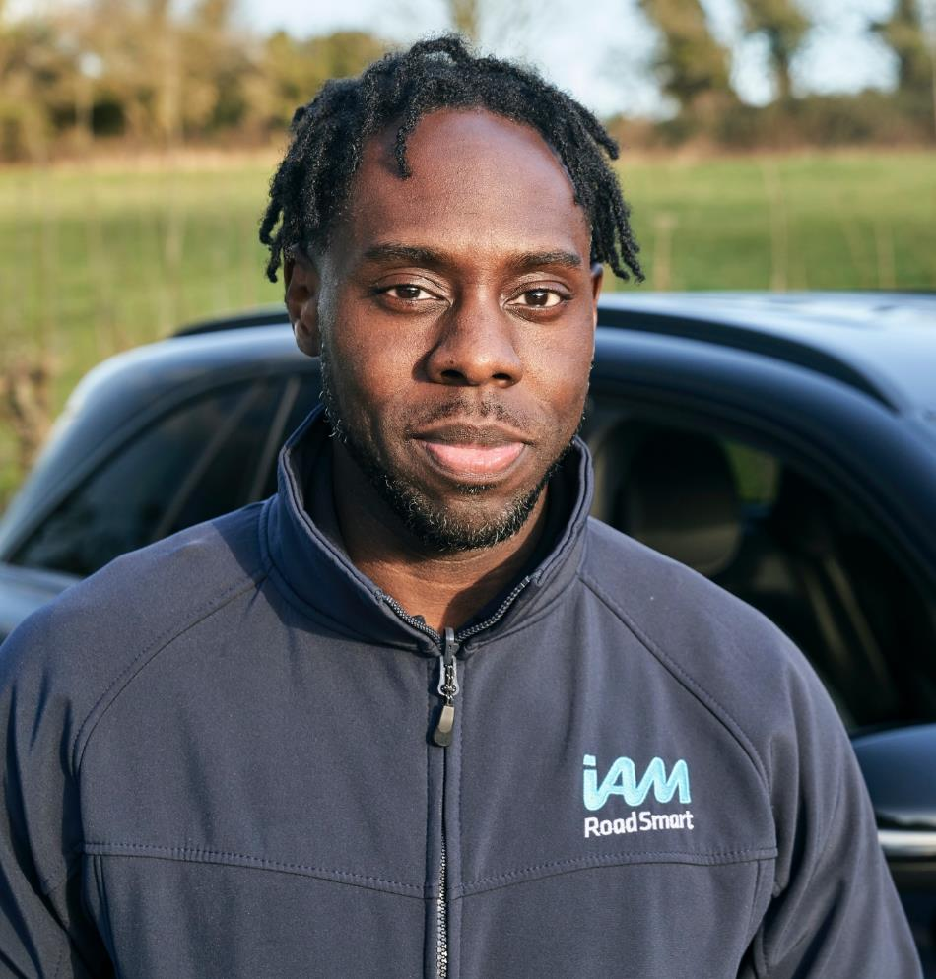
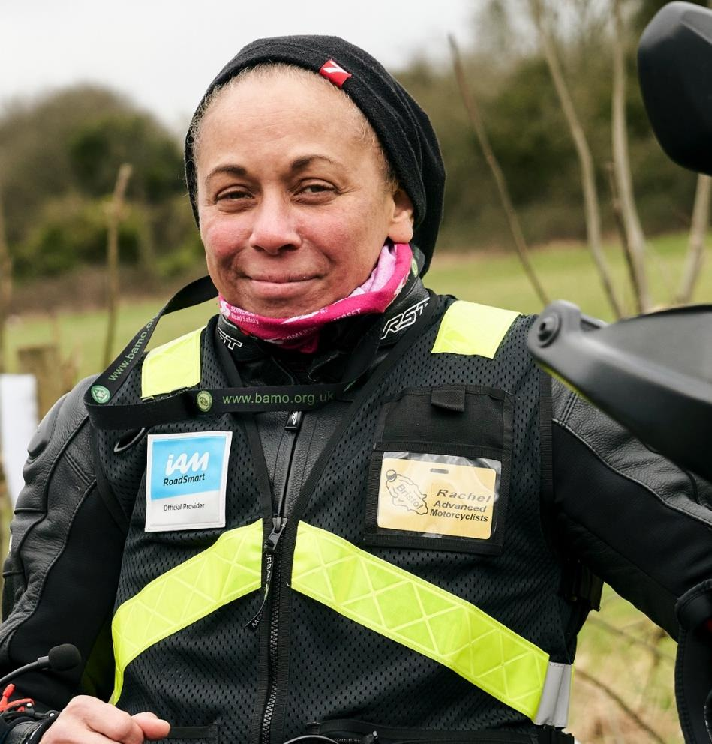
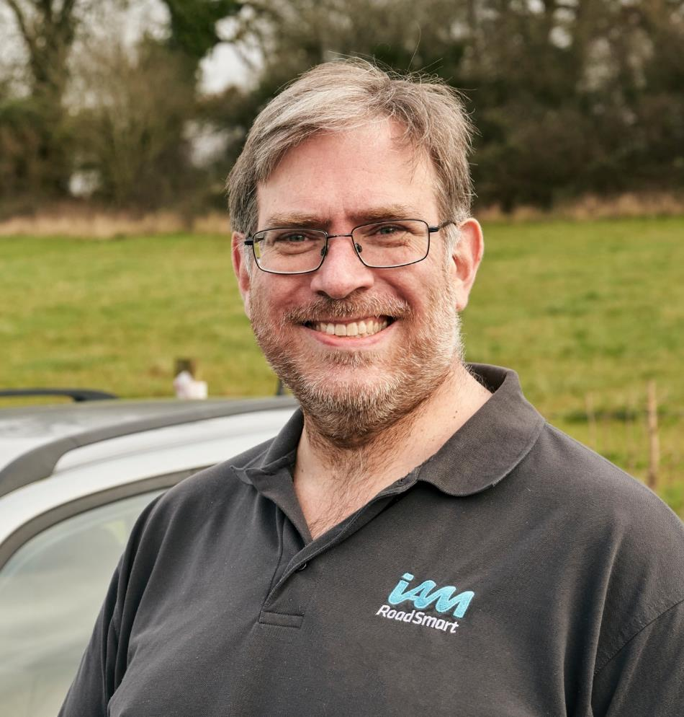
Notes:
In this slide, you will introduce the concept of our volunteer supporters to the audience. It’s important that prospective Associates and/or course buyers etc. understand the way in which IAM RoadSmart operates, and therefore how critical our volunteer network is to the continuing delivery of our services and our collective impact on road safety.
Please run through each of the points above, adding local details to your commentary as necessary. Some additional information you may want include is as follows:
All IAM RoadSmart Advanced courses are delivered by volunteers, or ‘Observers’ as we call them.
We have c. 10,000 volunteers across the country, all of whom are passionate about driving and riding. Many come from professional driving backgrounds.
They are committed to Advanced driving and riding, and passionately believe in the benefits it brings to road safety. That is why they give up their time so freely to deliver our courses, in order to share their expertise and make a real difference to the way in which people drive and ride.
IAM RoadSmart Observers hold an IMI (Institute of the Motor Industry) accredited IAM Local or National Observer qualification and their skills are updated and refreshed, and re-tested, regularly to ensure they remain at the highest level.
Observers use coaching and mentoring skills to help people improve their driving and riding and reach Advanced standard. They do this through providing support, guidance and encouragement and ensuring a positive environment at all times.
Note: We have provided ‘standard’ headshots here, but the pictures can be swapped to show your local team if necessary.

Slide 17
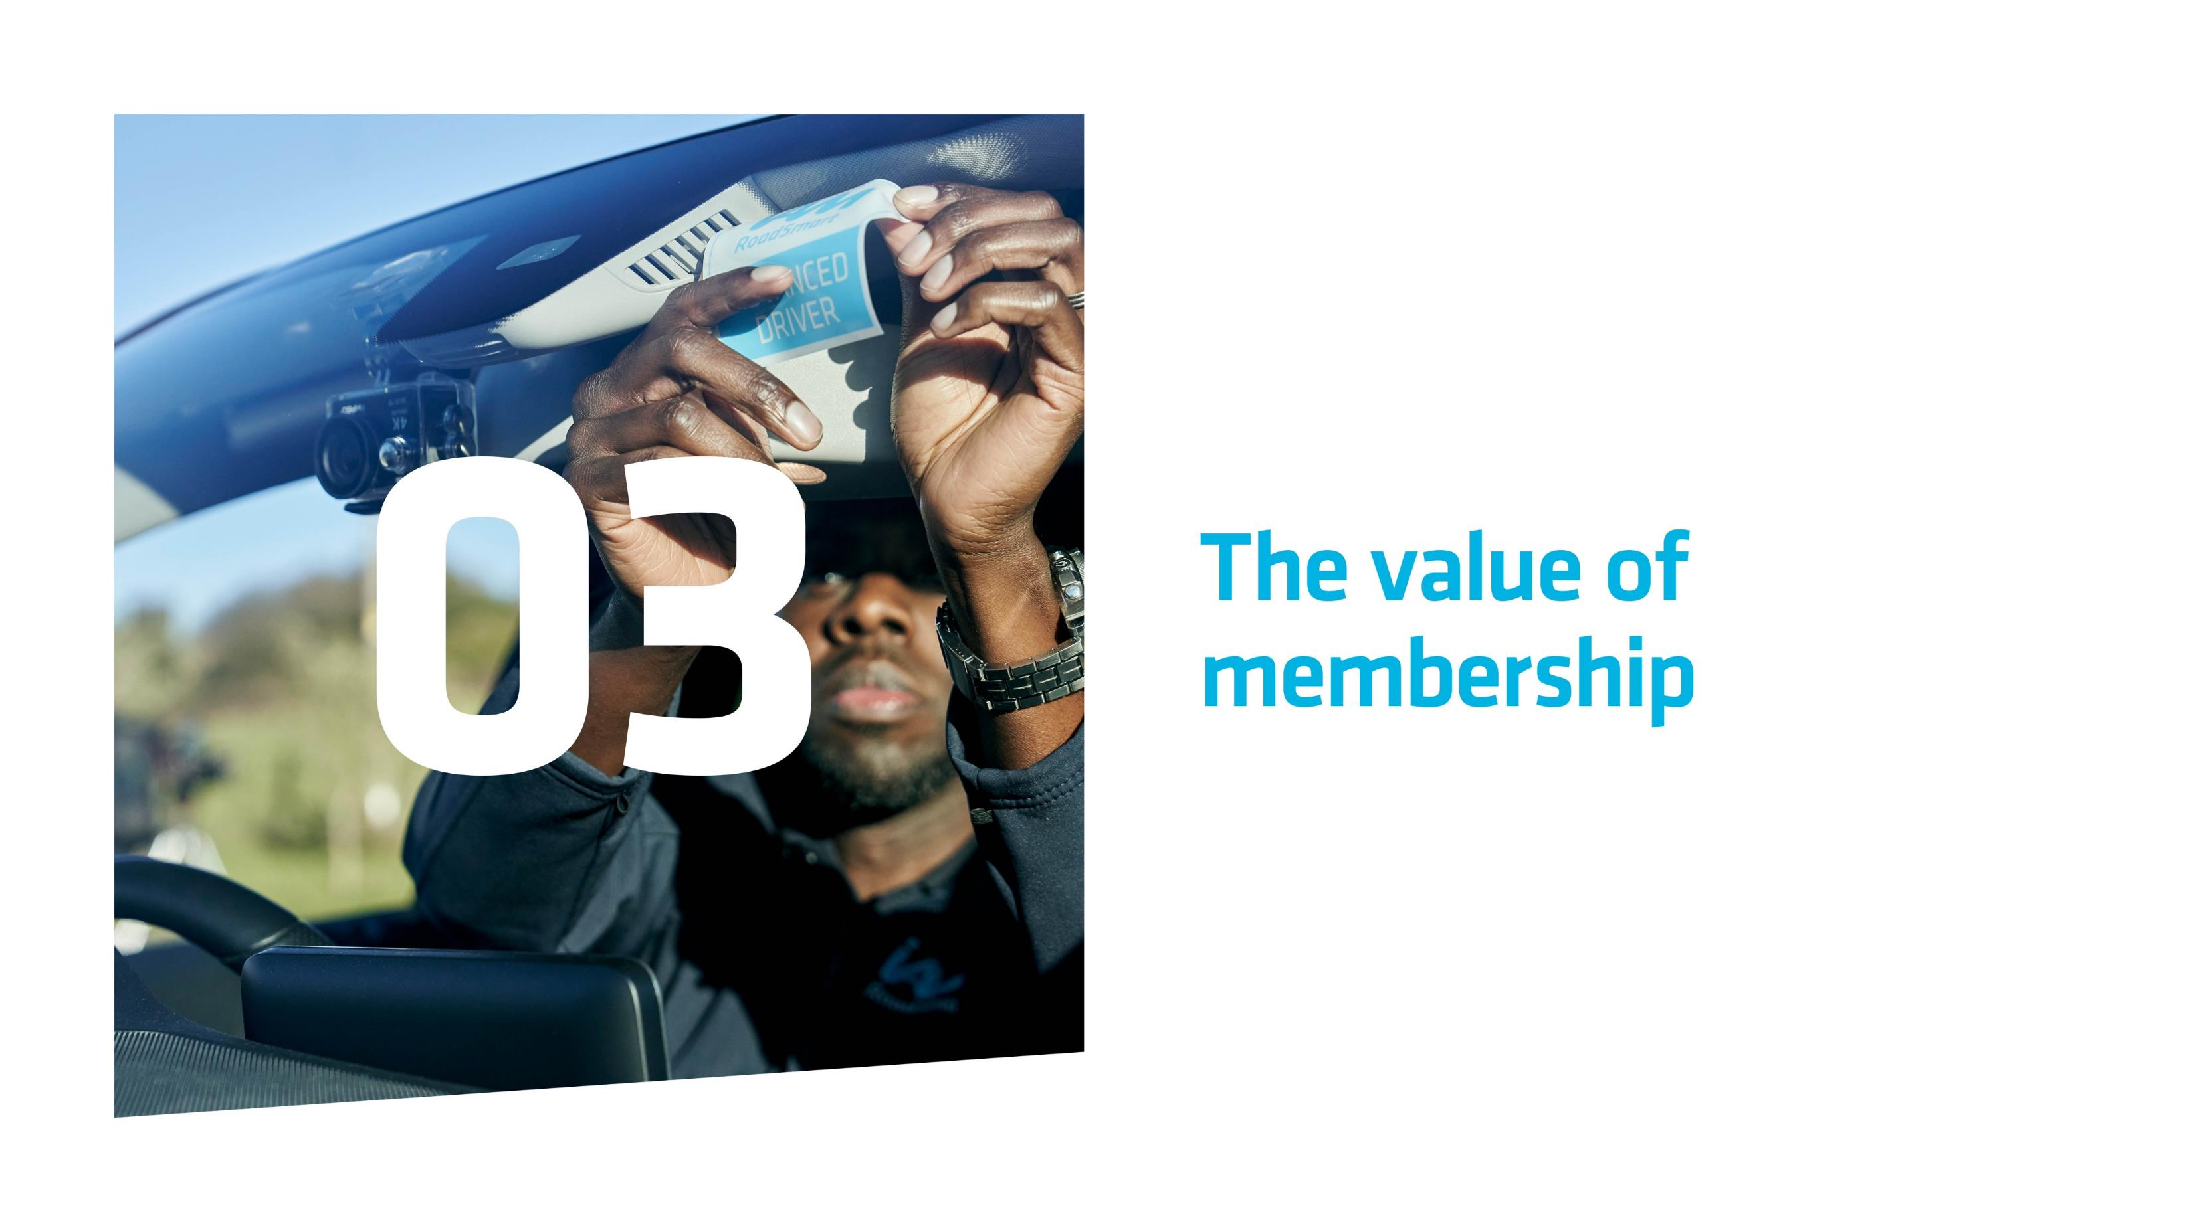
Notes:
Let the audience know that this is the introduction to the third part of your presentation, where you’ll go into more detail about the benefits of becoming and IAM RoadSmart member. As before, there’ll be a short video (if shown/included) and some information about what people can expect if they decide to join.

Slide 18
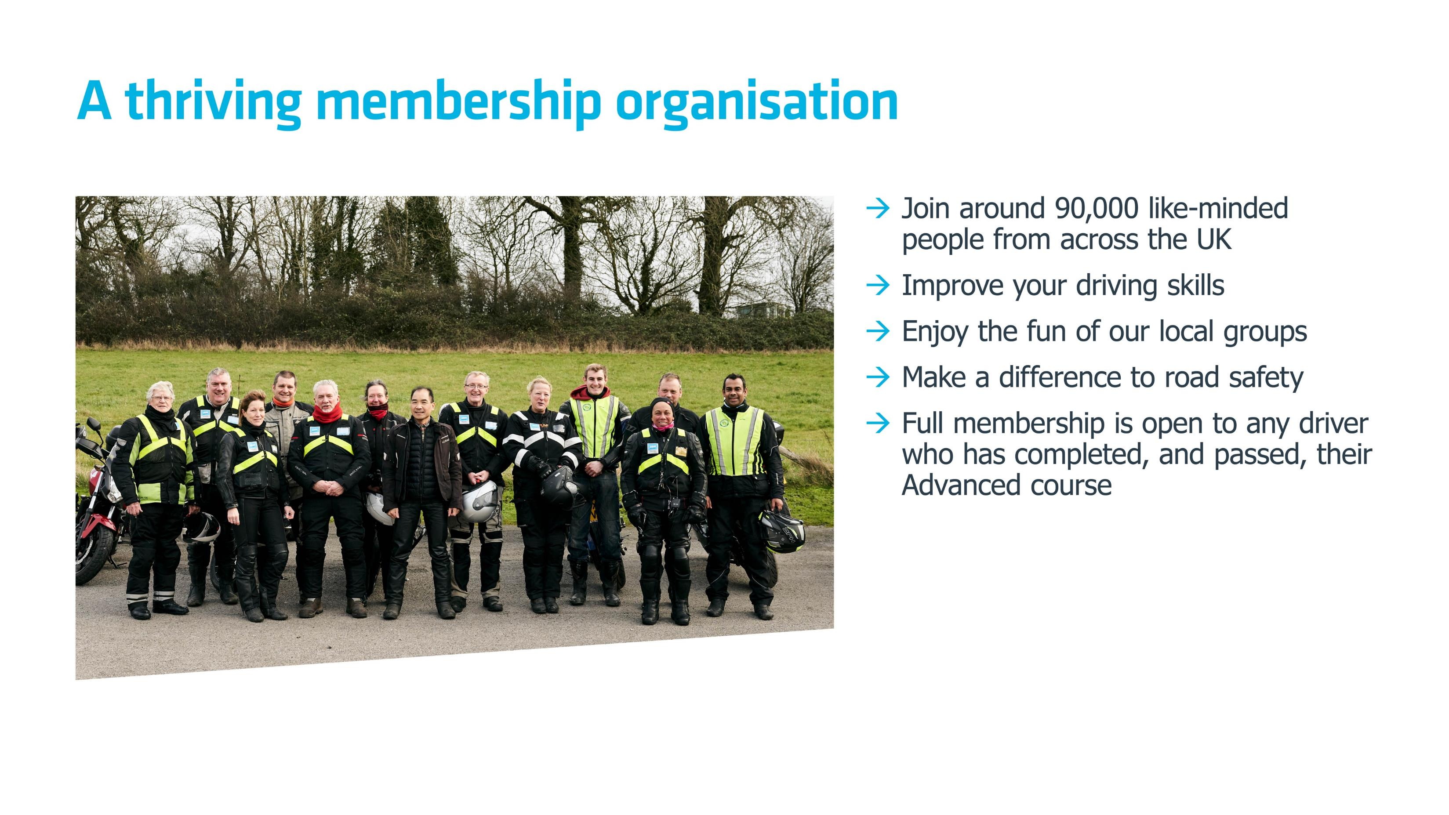
Join almost 85,000 like-minded
Notes:
Here we recap on some of the key features of IAM RoadSmart membership to ‘set the scene’ for the audience about what it would mean to them if they were to take an Advanced course and join our organisation. Please run through each of the bullets in turn.
NOTE: the benefits of membership are described on a later slide.

Slide 19
Notes:
Testimonials video (auto play)
This slide can be skipped if you don’t have facilities (or don’t want) to play the video. If you don’t want to show it, we suggest you delete this slide from the copy of the slide deck before you make your presentation please, so you don’t have to ‘skip’ past anything in front of the audience.
Suggested ‘script’ to explain the video to the audience if you are using it:
“So, what’s it like to be an IAM RoadSmart member? Before we go through some of the benefits of being part of our community, let’s listen to some of the real-life views of our members in this short video, where they talk through why they took an Advanced course and the difference it’s made to their driving and riding.”

Slide 20
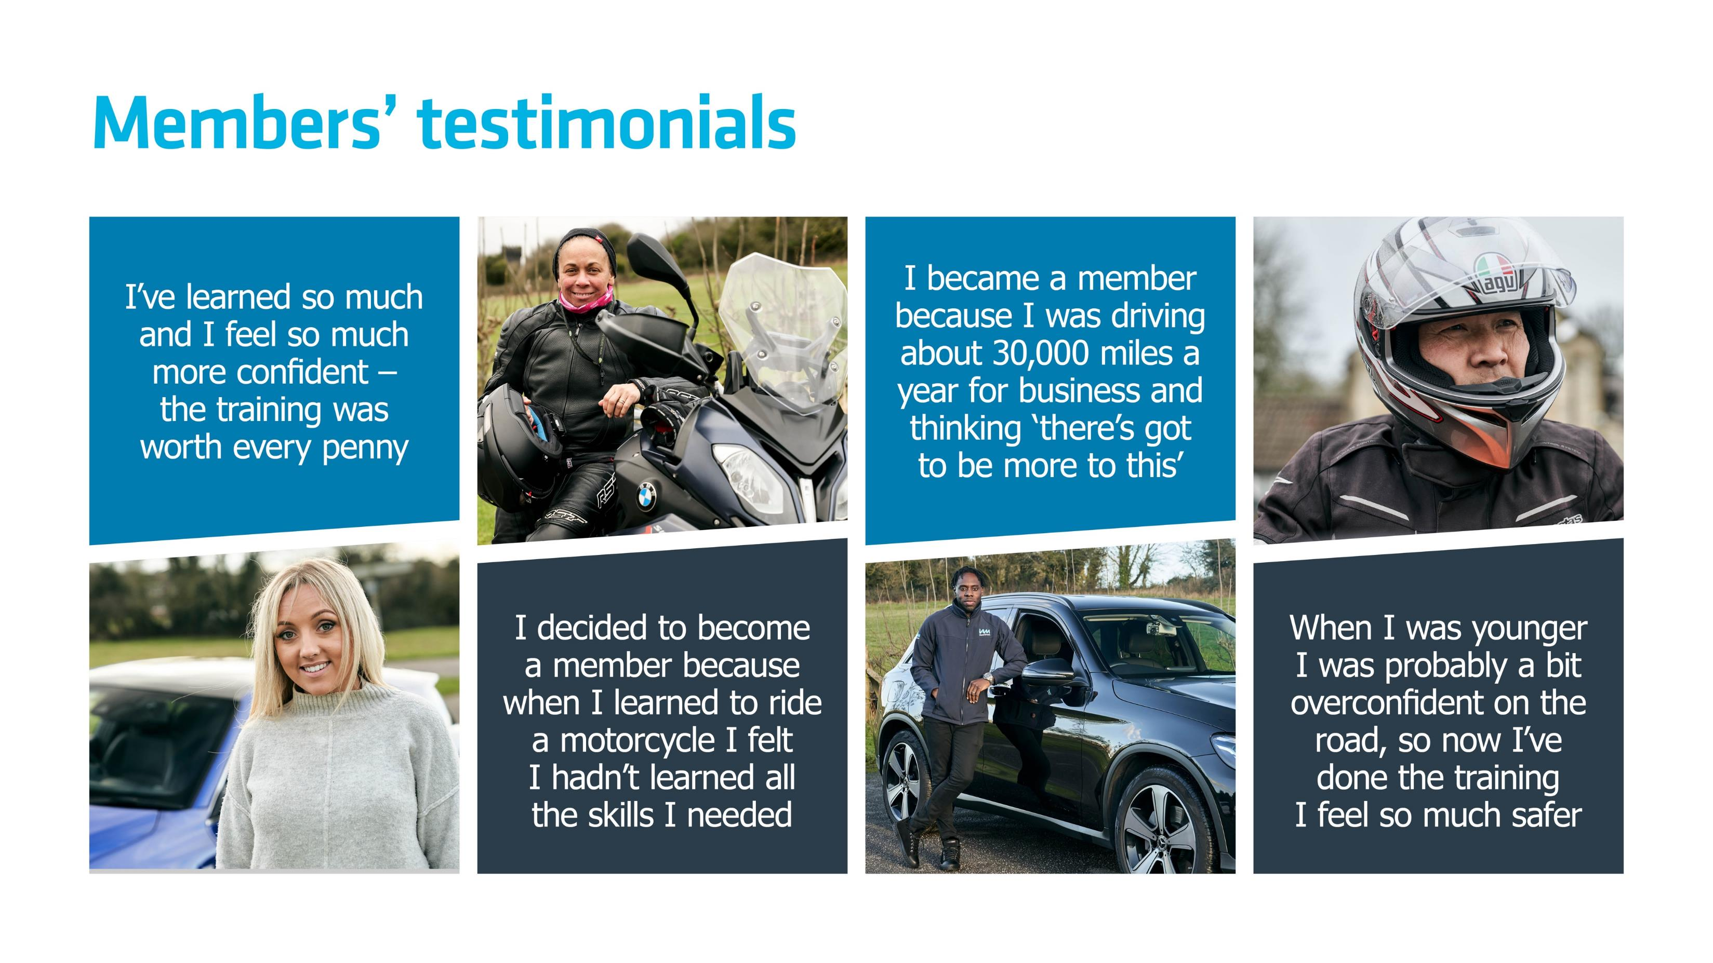
Notes:
If the video has been shown, then please clarify for the group that some of the highlights from the film are shown on this slide, so this is essentially a recap.
Where the video has not been shown, in this slide we show some genuine quotes from members about why they have enjoyed – and feel they have benefitted from – our courses and membership.
You may like to talk about your own story about why you decided to become an IAM RoadSmart member, to add a more personal testimonial to those in the video and on this slide.
.

Slide 21
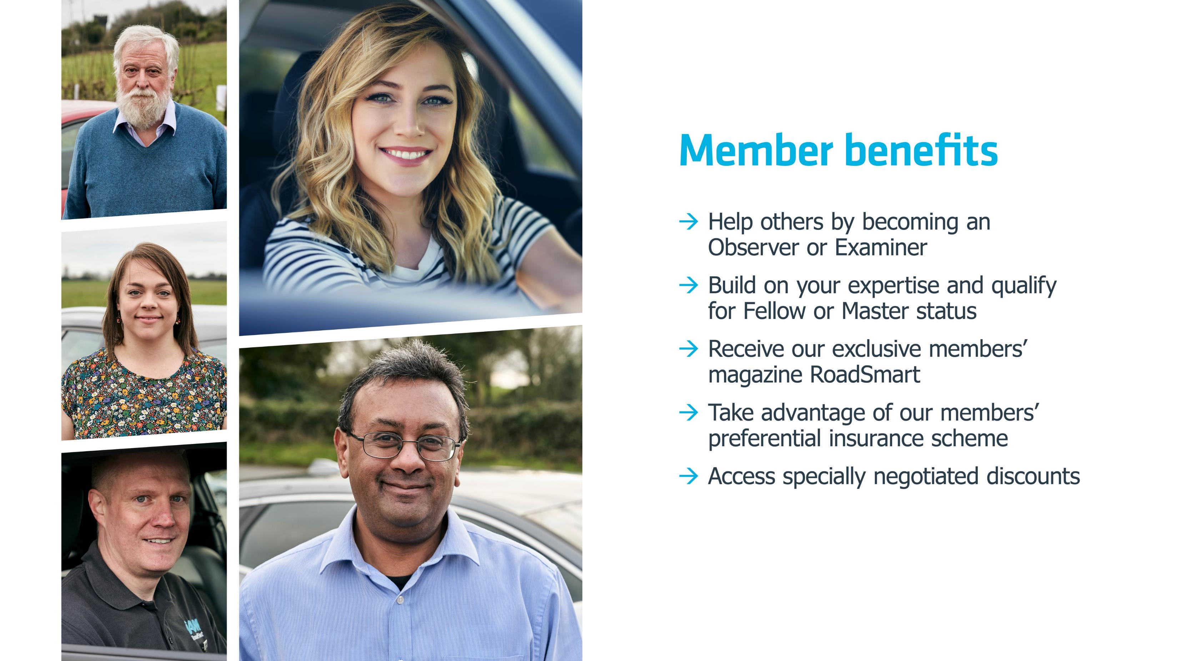
Notes:
In this slide we run through the benefits of IAM RoadSmart membership. Please run through each of the points in turn. You may want to set the scene by using the following suggested intro script or similar:
“In addition to joining a community of almost 85,000 Advanced Drivers and Riders and making a real difference to road safety in the UK by enhancing your skills, by taking one of our courses and joining IAM RoadSmart you could also have access to a number of valuable benefits. These include…”
Please also note the following to handle any ‘Q&A’ on these points:
Insurance: While we cannot guarantee a saving, our members usually get one. Our providers Cornmarket have made a commitment as part of our relationship with them to provide preferential terms to our members whenever they are able. Anyway, members report that the savings they make are not just on their premiums but in the reduction in claims they make by becoming a safer driver or rider – often providing real financial gain each year.
Preferential rates are also available on other types of policy including pet, travel and home insurance and, as a key benefit of our policies, members insured through Cornmarket can access free breakdown cover and legal helpline services.
Discounts: These vary but, at the of going to press, include special deals on car hire, tyres, family days out and new cars and bikes from a range of manufacturers. We have a team of individuals in or head office who are actively seeking relationships to enrich and build this portfolio.

Slide 22
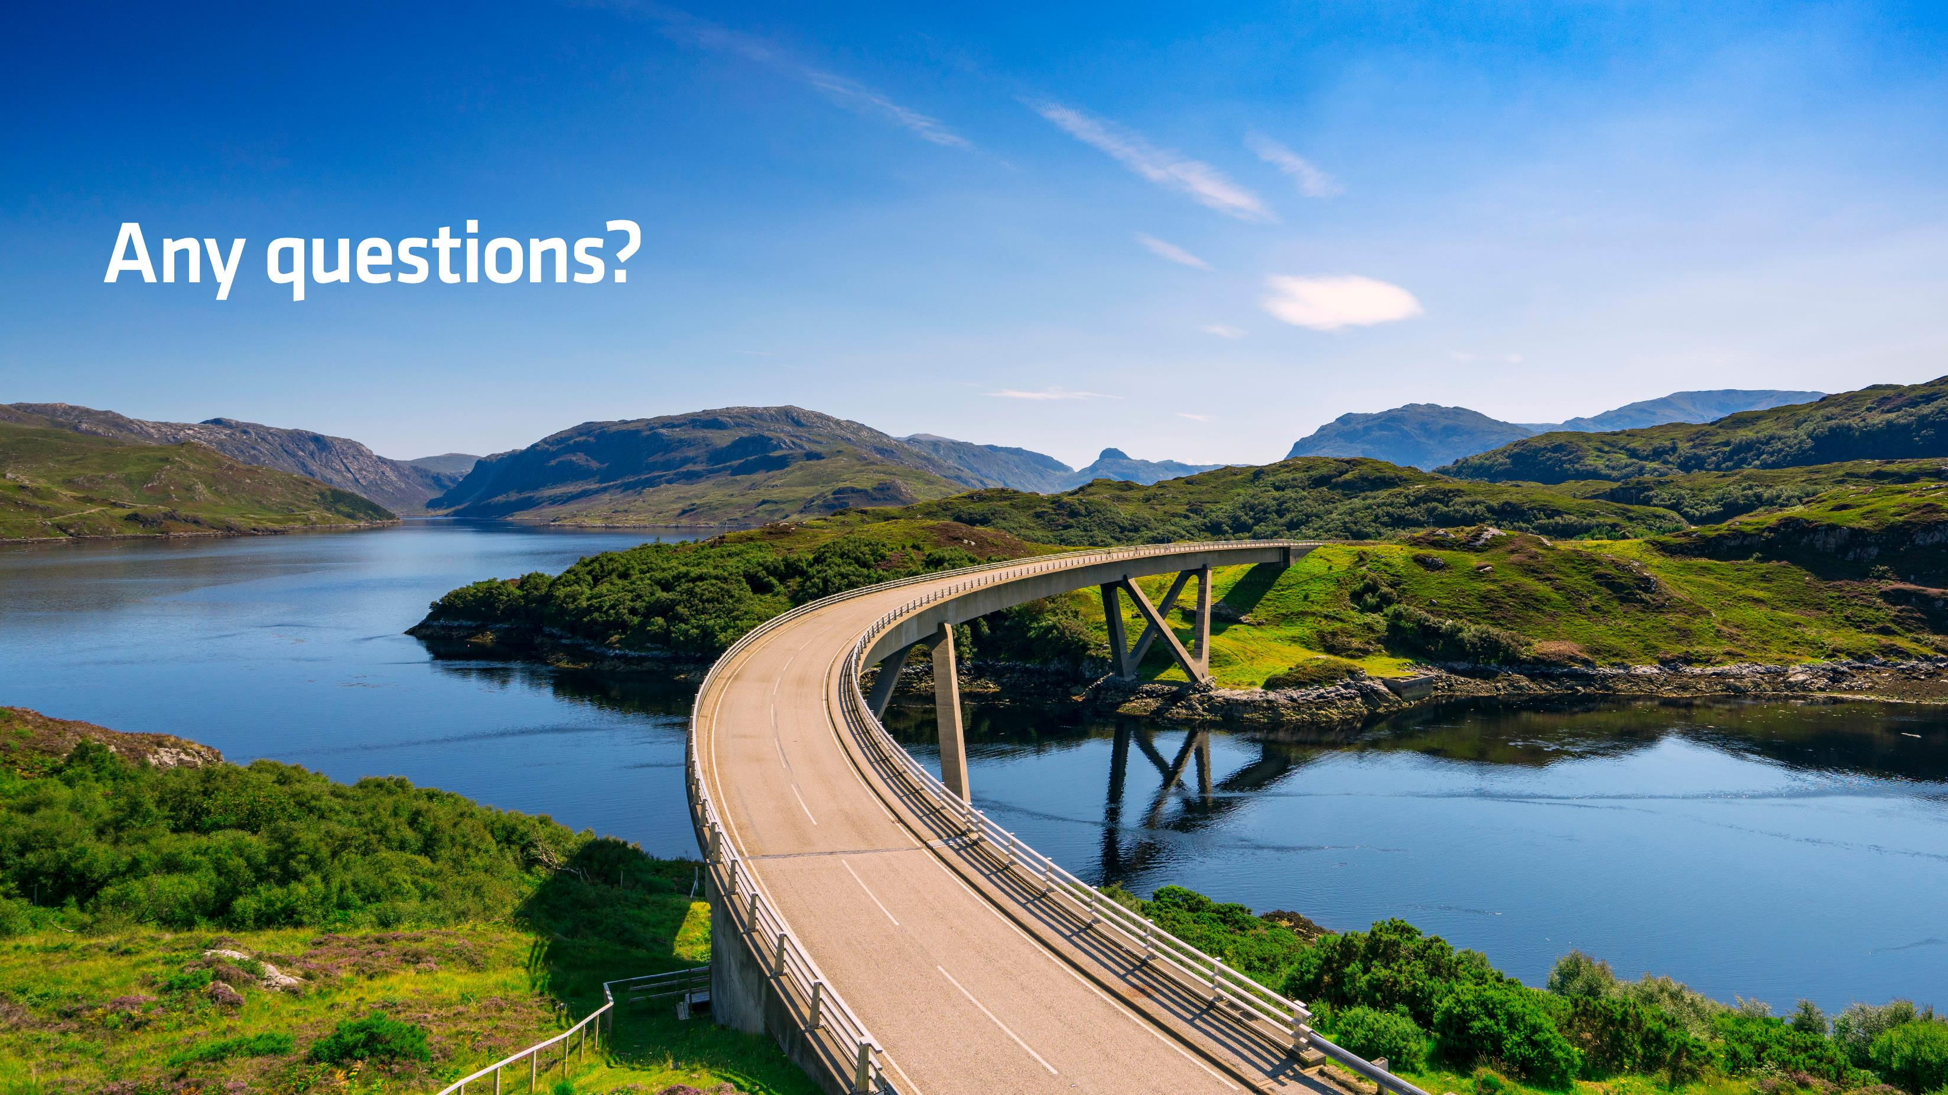
Notes:
Here you open up to questions from the audience.

Slide 23

June 15th 2020
“It’s that time again!”
Scotland Summer Road Trip xxxxxx xxx xxxx
June 15th 2020
“It’s that time again!”
Scotland Summer Road Trip xxxxxx xxx xxxx
June 15th 2020
“It’s that time again!”
Scotland Summer Road Trip xxxxxx xxx xxxx
June 15th 2020
“It’s that time again!”
Scotland Summer Road Trip xxxxxx xxx xxxx
June 15th 2020
“It’s that time again!”
Scotland Summer Road Trip xxxxxx xxx xxxx
June 15th 2020
“It’s that time again!”
Scotland Summer Road Trip xxxxxx xxx xxxx
Notes:
In this slide you can end on an invitation to the audience to come and enjoy a free taster session trial with you where they are available. This is often the most effective way of bringing our courses to life and sparking people’s enthusiasm for advanced driving and riding. Or you can add in other local events to give an illustration of the sort of things you do as a group.
The slide is editable so you can add in appropriate text in the boxes above. You can also delete boxes if you do not want to show all six, or you can delete the entire slide if it is not appropriate.
Please add in your local event dates as appropriate and then run through the options verbally. You will need to advise the audience how they can enrol on any event you have coming up, either by giving them a weblink to go to after your meeting or – even better! – by providing them with a form that you have pre-prepared that they can complete either on paper or on-screen at the end of your presentation.

Slide 24
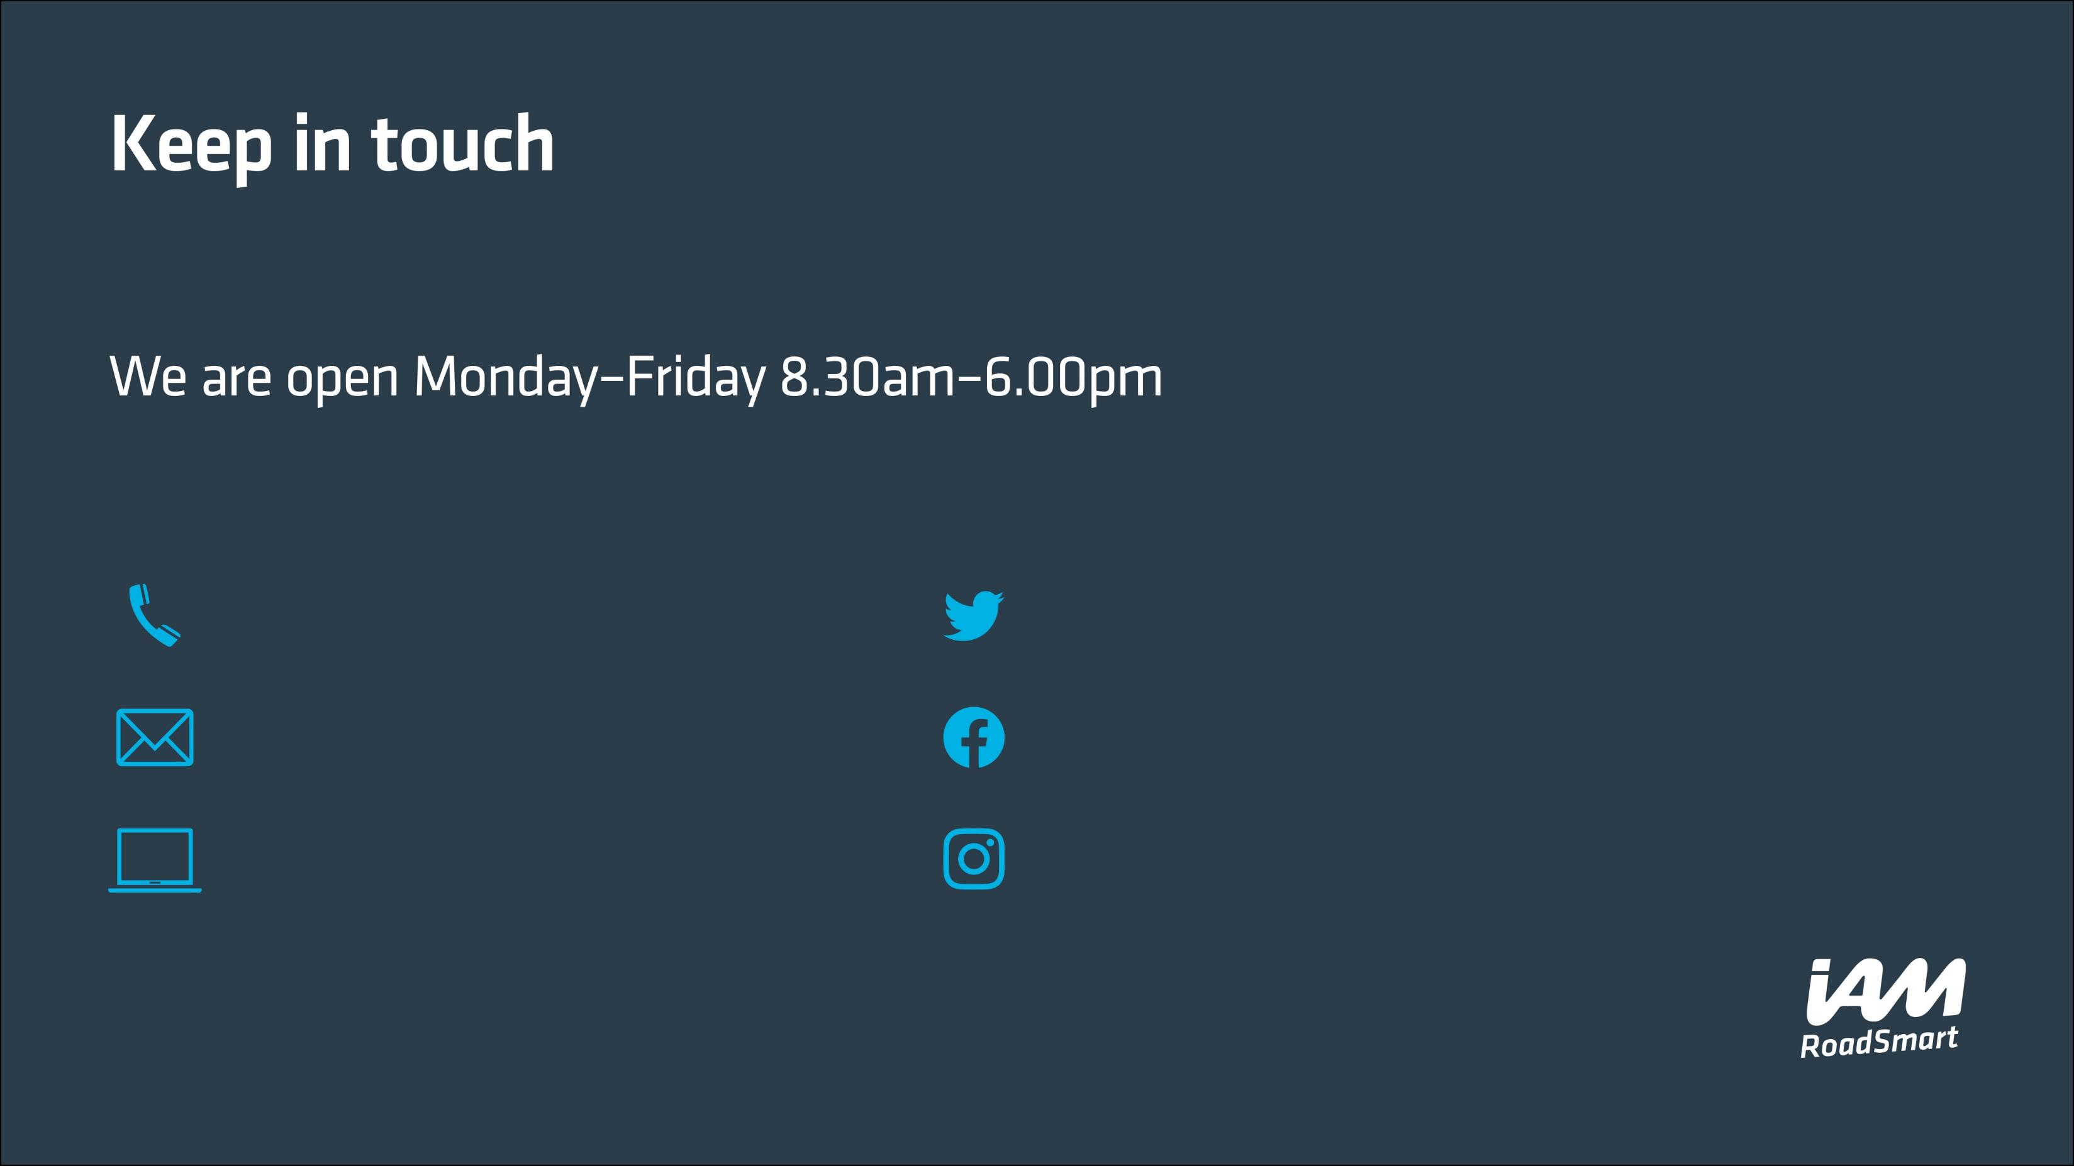
0300 303 1134
support@iam.org.uk iamroadsmart.com
@IAMRoadSmart
@IAMRoadSmart @IAM_RoadSmart
Notes:
Here you can advise the audience about how they can keep in touch with us after your meeting and/or find out more information any of our courses/services. They can also book online via www.iamroadsmart.com.
Please feel free to add in your local details in place of the national ones on this slide as appropriate.

