Slide 1





Notes:
There are six possible opening slides to choose from. You’ll need to choose the picture that’s most appropriate for the audience to whom you’re talking, or to the location where the presentation is taking place. Please then delete the others, that you don’t want to use, so you don’t have to skip past any slides when presenting to your audience.

Slide 2
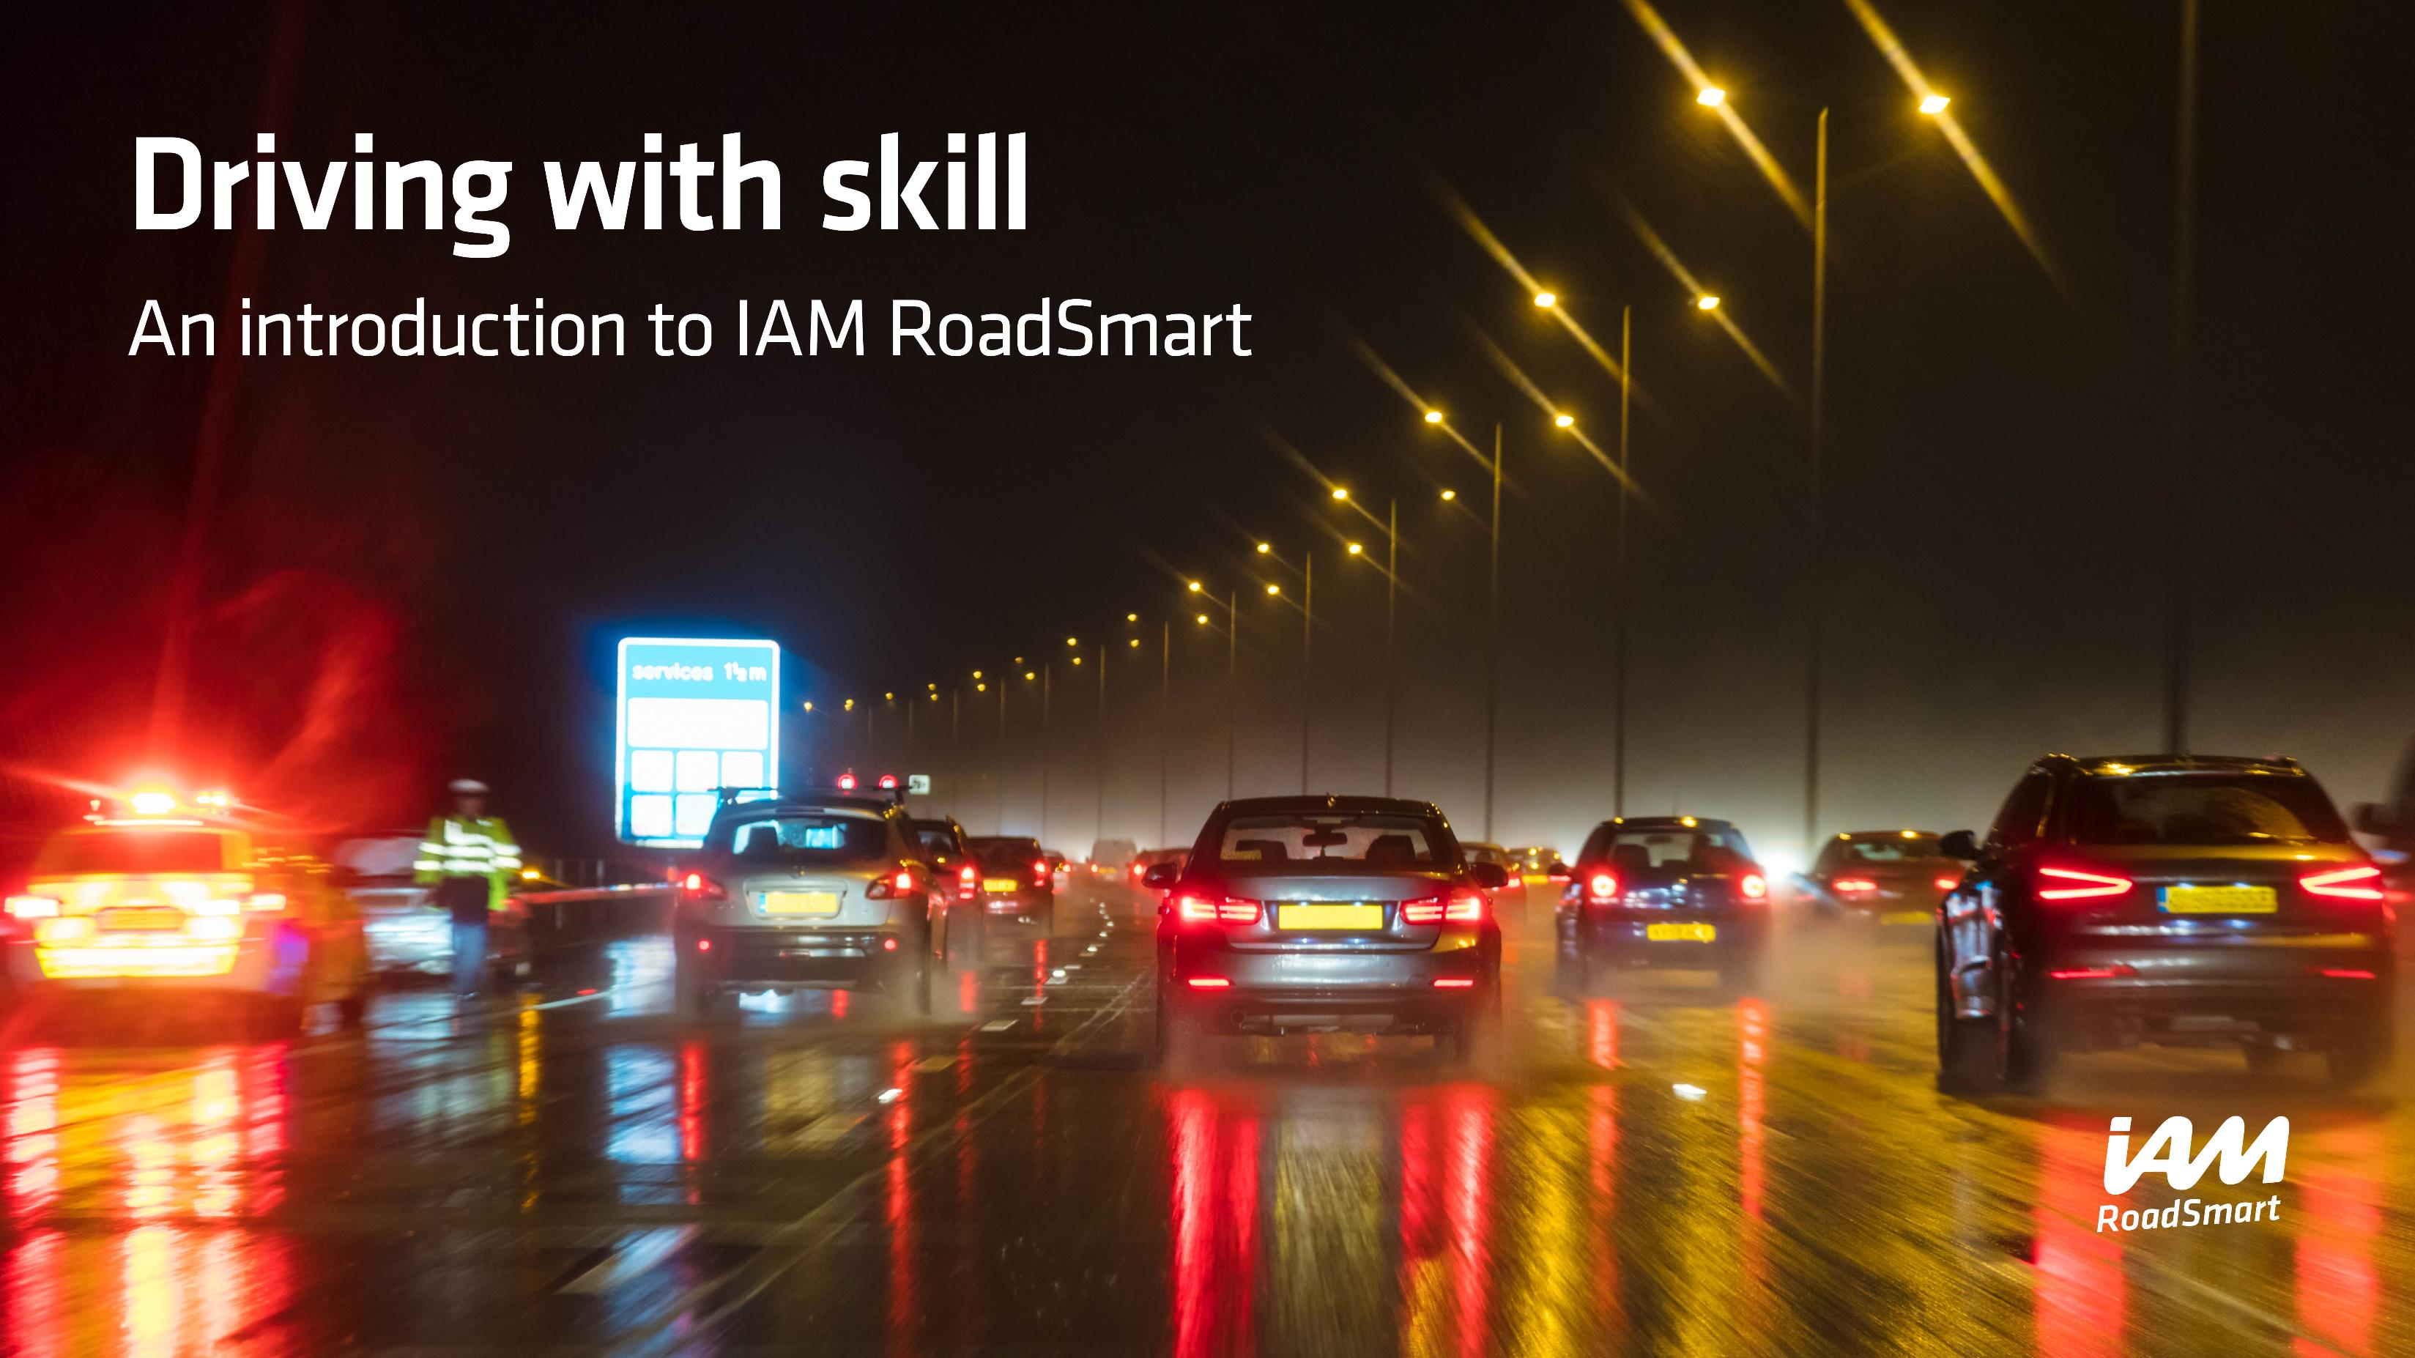

Slide 3


Slide 4
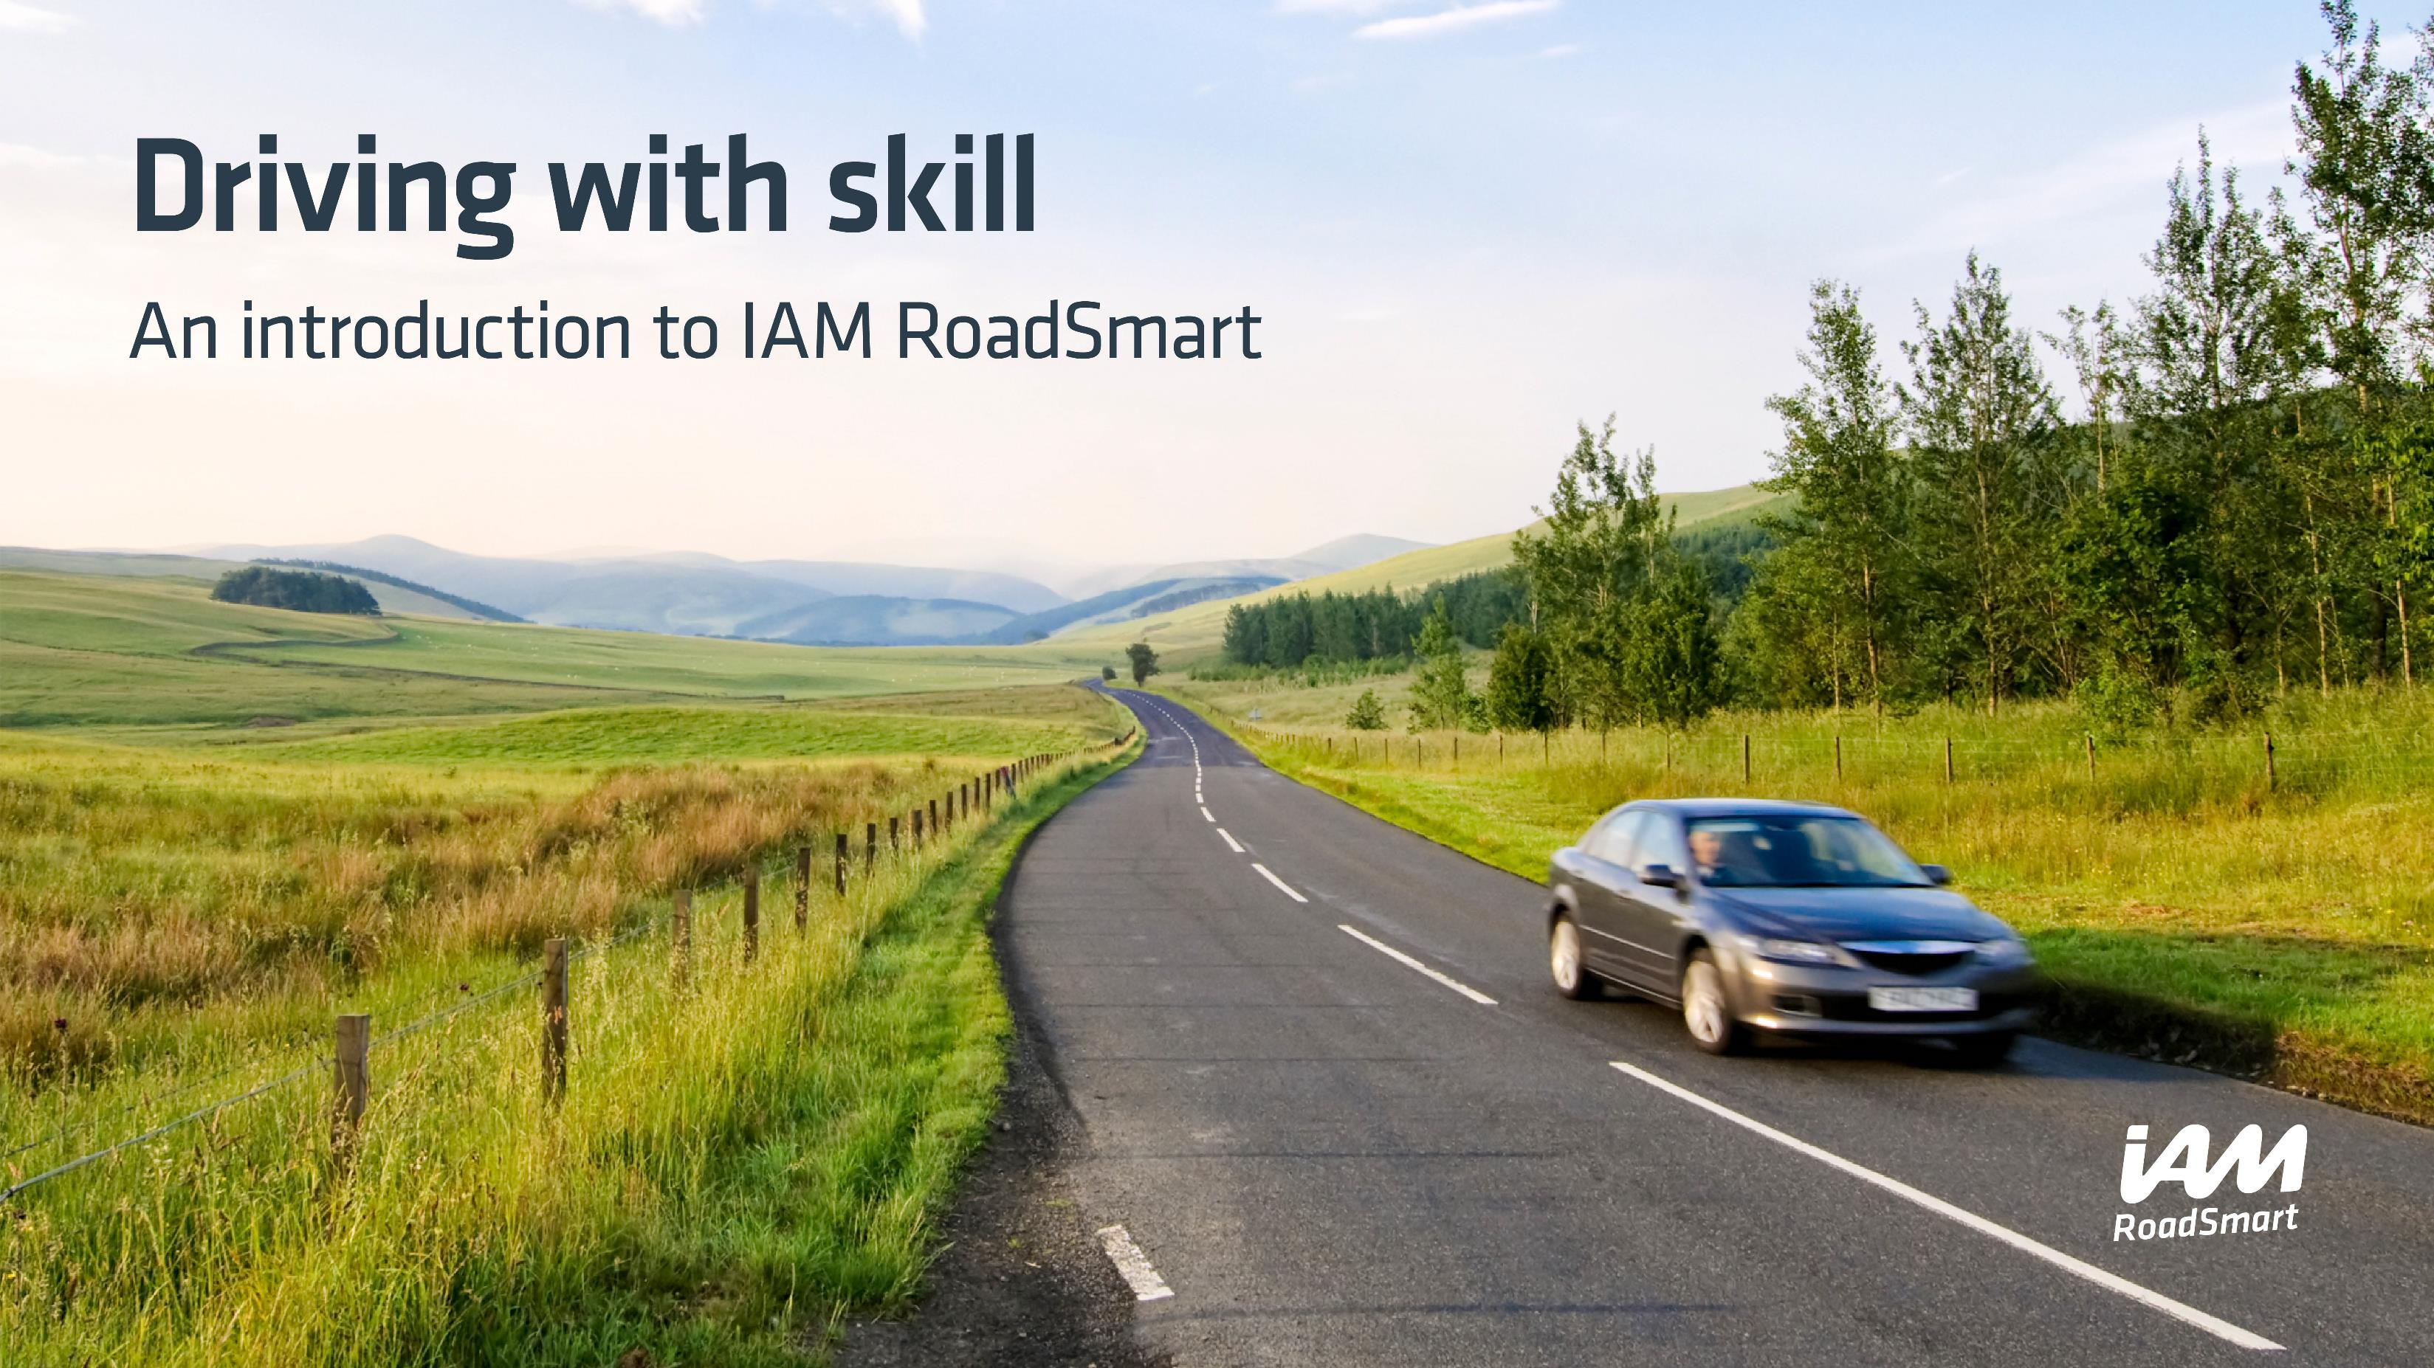

Slide 5


Slide 6

Driving with skill
An introduction to IAM RoadSmart

Slide 7


Slide 8
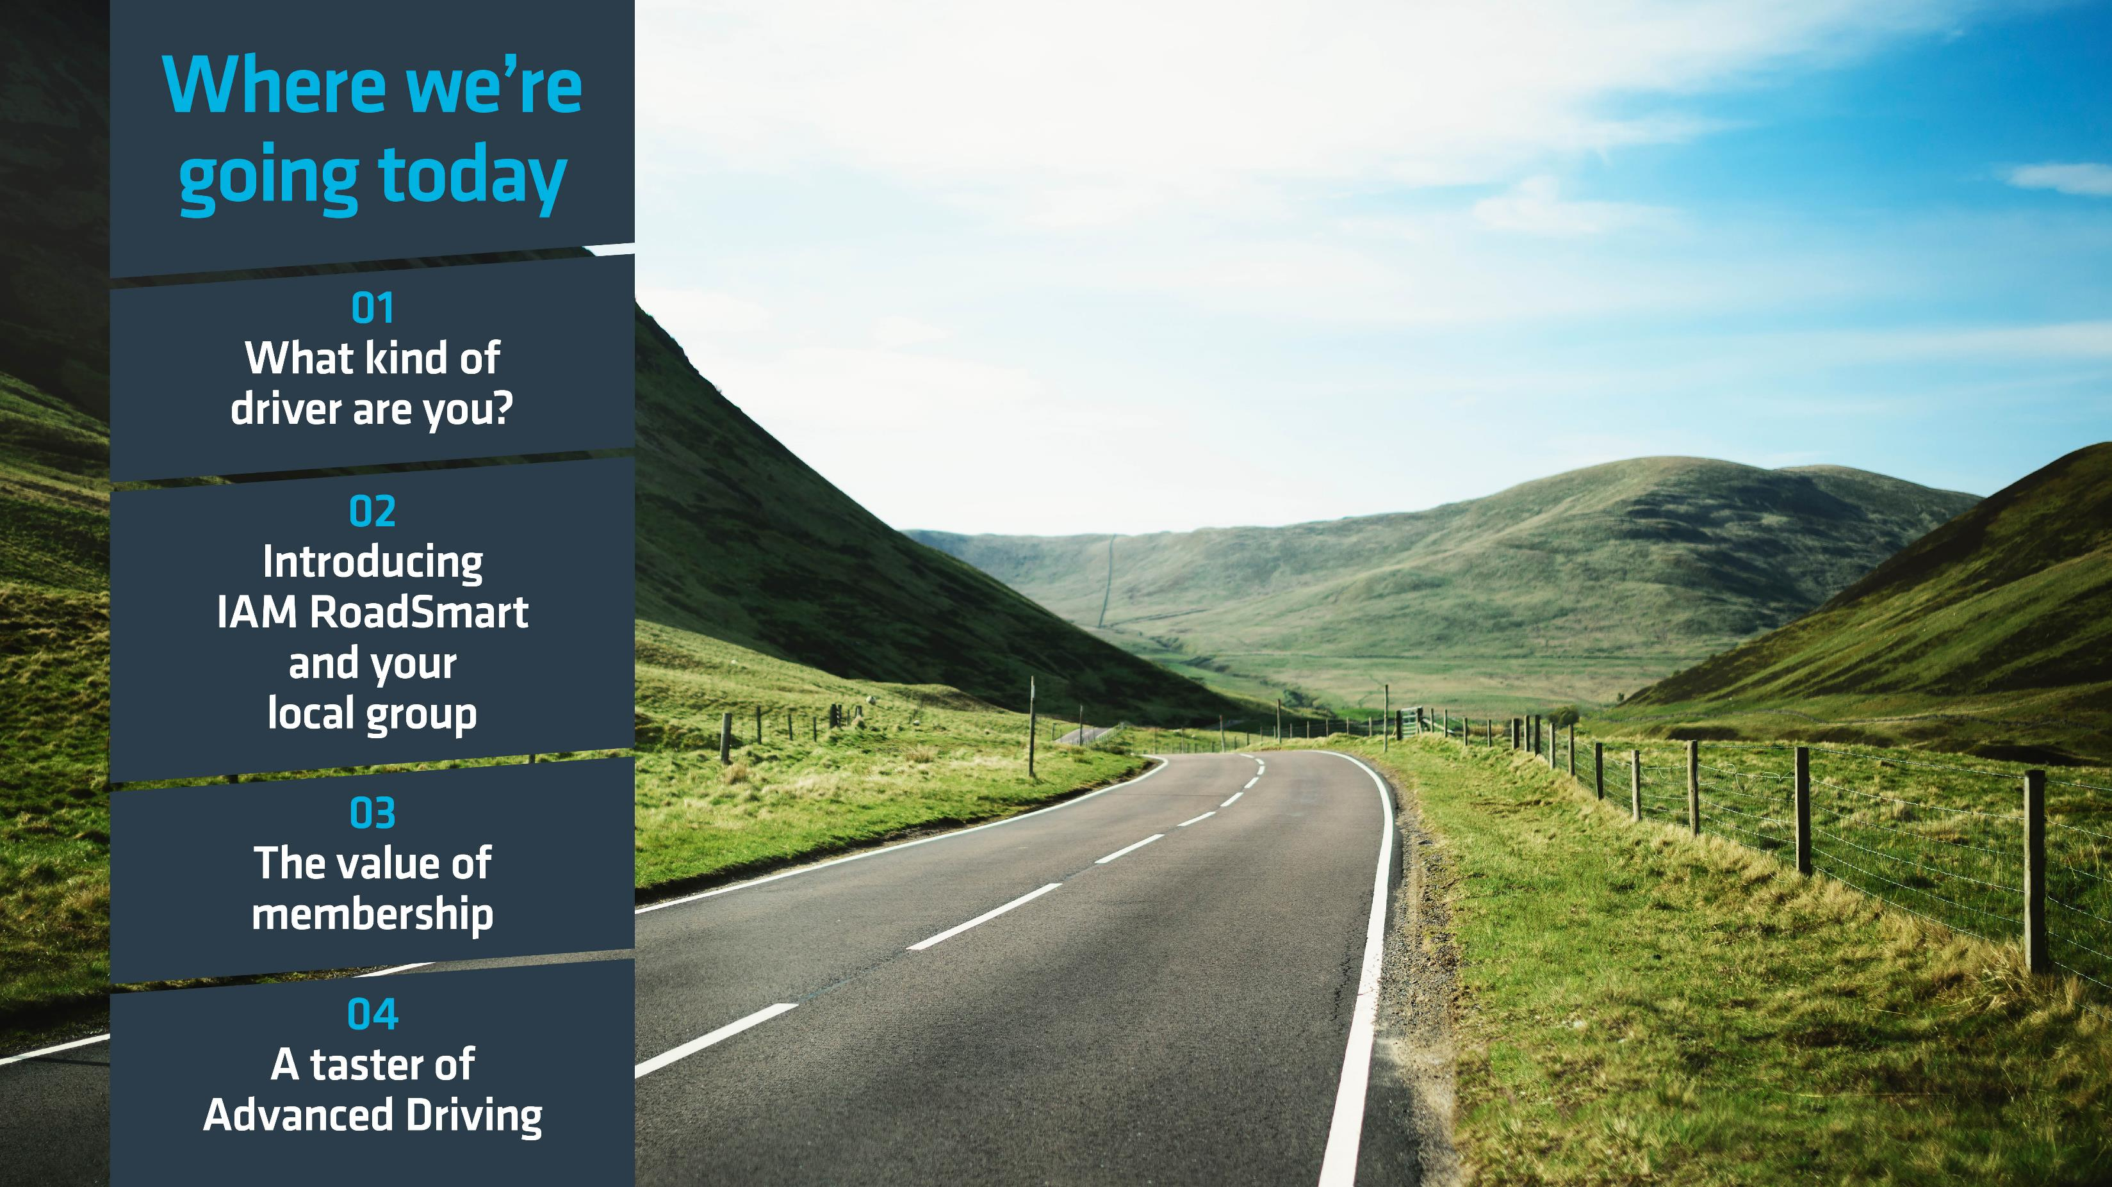
Notes:
These are the areas you’ll be covering during the presentation so you can advise the audience on what they’ll hear about in the next 30-45 minutes. First you’ll invite the audience to think about what sort of driver they are, then you’ll explain a bit about RoadSmart nationally and locally. Next is an explanation of the benefits of membership, and finally some information about how people can get involved – upcoming events and contact details.

Slide 9

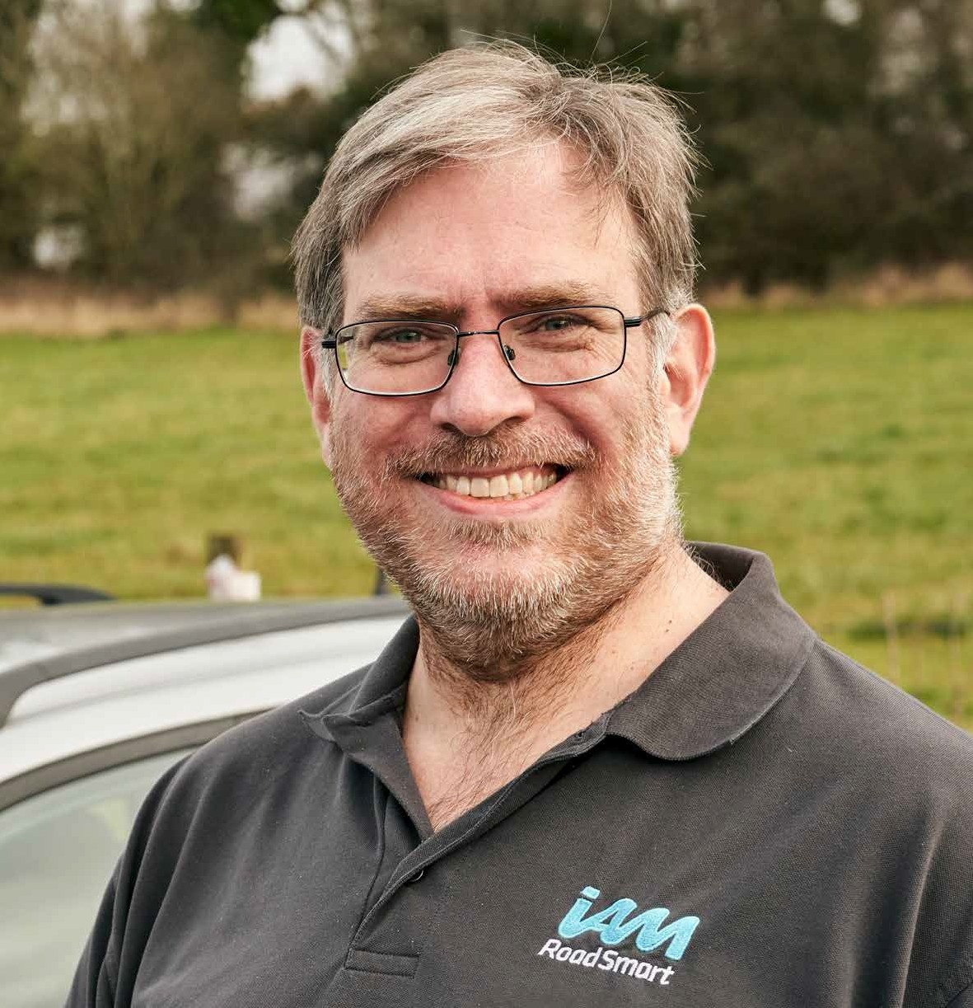
Name
Name – replace copy
IAM RoadSmart role
Your role within IAMRS – replace copy
Focus should be on role with IAM RoadSmart and background and experience with us– replace copy, replace copy, replace copy, replace copy, replace copy, replace copy, replace copy, replace copy.
Notes:
This slide allows you to introduce yourself as the presenter. Please add any relevant details into slide where shown. You can also add in your own photo, to replace the one included here.
You should briefly mention any relevant background and experience that you have. Why did you decide to volunteer with IAM RoadSmart, for example? Why do you believe Advanced Driving/Riding is so important? Do you have any connection with the group of people you are talking to? Are you from the local area? Please be as personable and open as you can, while limiting the time you spend on this slide to only 30-45 seconds. The audience will be hoping to hear a few key snippets about your relevant experience, rather than your full biography please.

Slide 10

Notes:
Explain that this slide is an introduction to the part of the presentation where you’ll be asking your audience to consider what sort of driver they are. They’ll see a short video, and then get an overview of modern driving and how people have adapted to it.

Slide 11

Notes:
What kind of driver/rider are you video (auto play).
This slide can be skipped if you don’t have facilities (or don’t want) to play the video. If you don’t want to show it, we suggest you delete this slide from the copy of the slide deck before you make your presentation please, so you don’t have to ‘skip’ past anything in front of the audience.
Suggested ‘script’ to explain the video to the audience if you are using it:
“We’ll start by watching this short video that will explain a bit about the challenges facing drivers and riders today, and hopefully get you thinking about how you’ve adapted to changes in driving technology over the years. It will also set out some of the reasons why you may feel that an IAM RoadSmart Advanced Driving course may be right for you.”

Slide 12
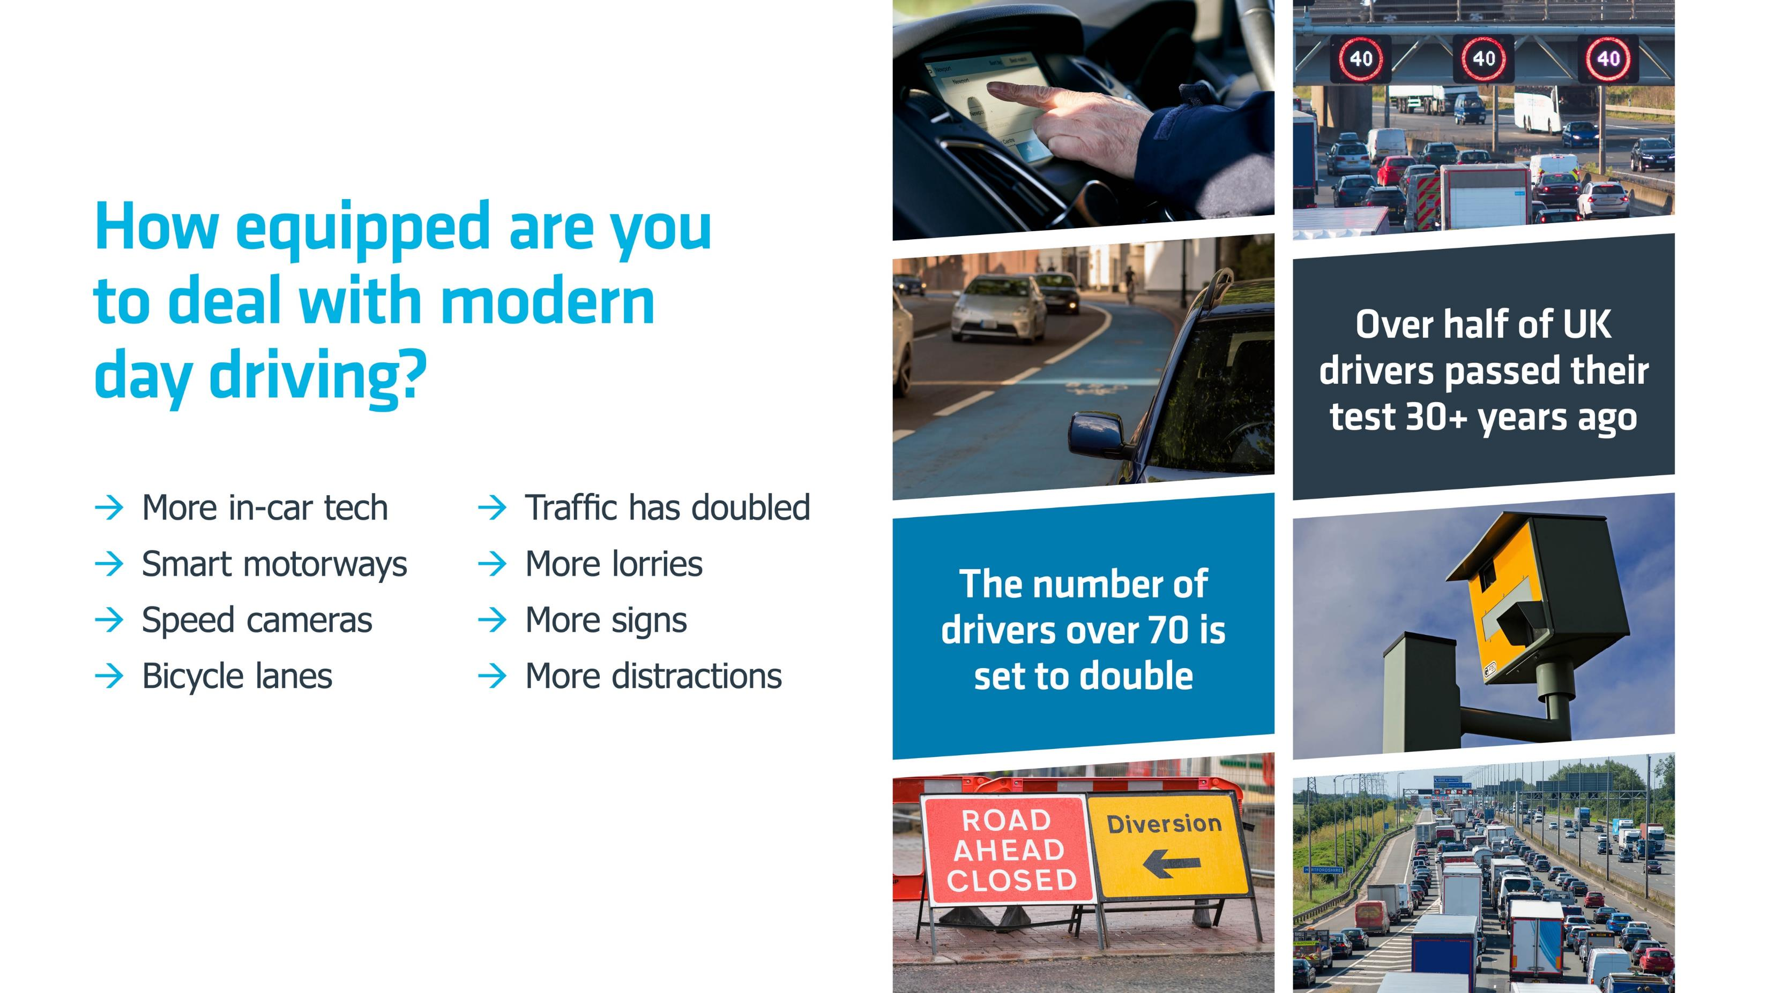
Notes:
If the video has been shown, then please clarify for the group that some of the highlights from the film are shown on this slide, so this is essentially a recap.
Where the video has not been shown, this slide is designed to highlight how much the roads have changed and are changing, to remind the audience that the way in which they learned to drive originally may not still be sufficient, and that a refresher/upskill maybe beneficial for them.
On this slide, try and engage the audience in a discussion around the challenges of driving on today’s roads. Ask about their experiences of driving since passing their test – have they noticed any changes? Here are some examples of questions that could be asked:
-Were you surprised by any of the modern-day driving challenges shown in the video? (Only if video has been shown)
-What new innovations have you encountered on the roads?
-What do you find the most challenging?
-What new tech does your car feature? How do you find driving with it?

Slide 13
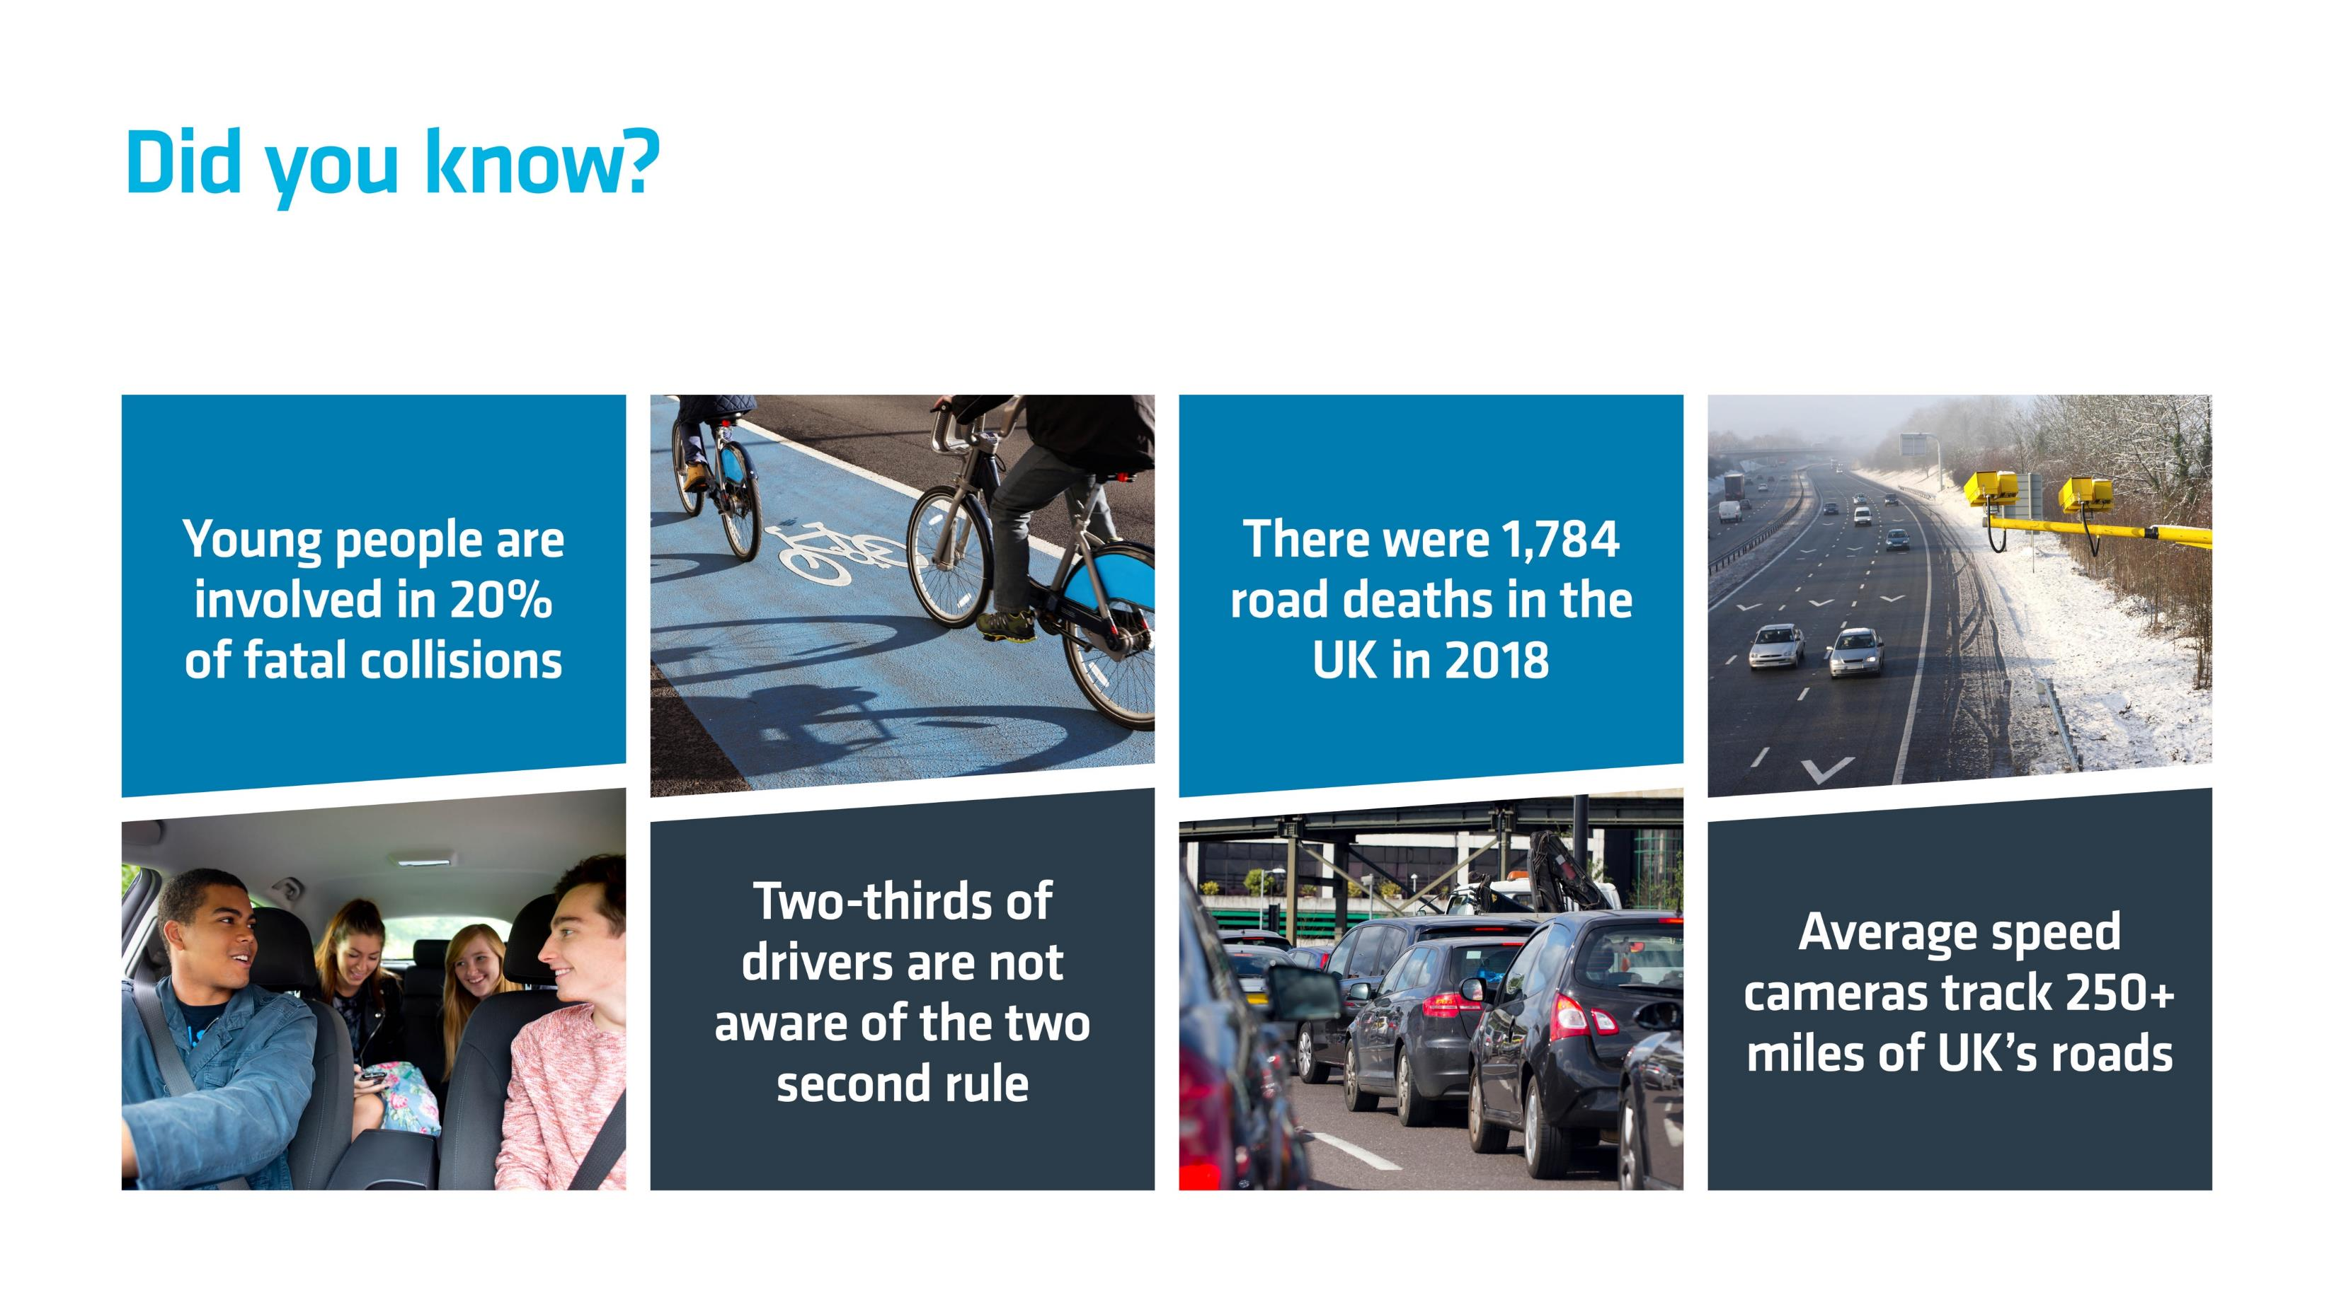
There were 1,748
Road deaths in the
UK in 2019
Notes:
This slide provides some evidence points to emphasise the slide before. Please pull out the stats one by one and talk through the context below where necessary (from left to right):
- Young drivers aged 17-24 account for seven percent of the UK’s driving licence holders but are involved in 20 percent of fatal and serious collisions. They are a significantly ‘at risk’ group and one which IAM RoadSmart is committed to helping.
- Although they have all passed the relevant licence tests, awareness of key driver and rider safety rules among the general driving and riding public is often very poor. For example, a recent IAM RoadSmart survey showed that two-thirds of drivers are not aware of the two second rule (where drivers are advised to keep two seconds’ distance between themselves and the car in front, in order to be sure of a safe stopping distance in the event of an incident, rising to four seconds in the wet and 10 in freezing conditions). You may want to ask at this point, for example, which of the audience know of the two second rule, and/or the increase in different conditions, in order to maintain audience engagement.
- Road deaths in the UK have plateau’d at around 1,748 over the last eight years. Reducing this figure is a core mission for IAM RoadSmart and one which are members and staff are fully committed to. Road safety is at the heart of everything we do.
- Average speed cameras track over 250 miles of Britain’s roads – this has more than doubled since 2013. This helps evidence the point that the roads are changing, but it also indicates the fact that many people routinely – and unsafely – speed on our roads, hence the need for cameras to reduce or prevent this behaviour.

Slide 14
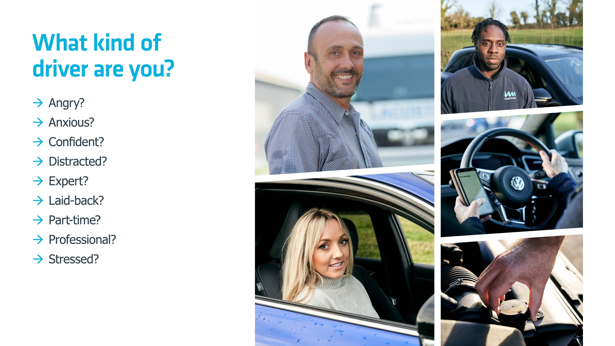
Notes:
There many different ‘types’ of drivers on the road, each with their own challenges. This slide is designed to get the audience thinking about their own driving style. Ask the group if they recognise any of these qualities in themselves, and open it up to discussion.
Ask any drivers in the group who say they’re confident, how sure they are of their skills. Studies have shown that up to 90% of drivers rate themselves “above average” – which of course is statistically impossible. It’s known as “illusory superiority”.
Ask the group about any specific areas of driving that make them feel nervous? eg. Driving on motorways, in city centres, at night. Do they feel this negatively affects their driving? Have they/would they seek out advice on how to deal with/improve in these conditions?
At the end of the discussion, emphasise the point that being skilled behind the wheel is not just about improving your own capability and safety, but also giving you the skills to manage the people around you – many of whom may be driving when negatively affected by any of the moods/styles listed.

Slide 15

Notes:
In this slide, we remind the audience that although there is a lot to process and a lot to be aware of on today’s roads, the more driving skills you have, the safer you will be and the greater your confidence will be.
To emphasise this, please run through each of the bullet questions in turn to prompt in their minds the ways in which our courses could help them.
Everyone has different areas they find more or less challenging, so we provide on-road Advanced Driving courses that are tailored to each individual taking part. Each course focuses on the specific areas of driving that the person taking part needs that extra bit of time and attention on. It is unique to you.

