Slide 1
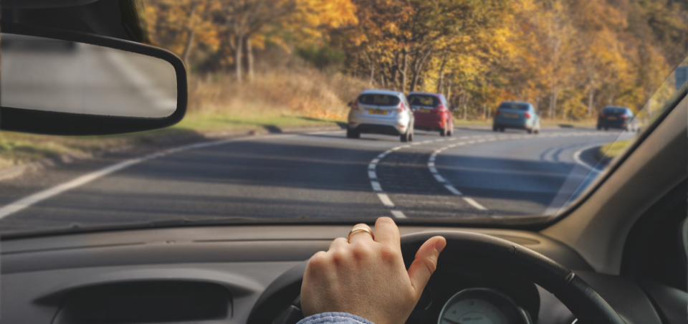
Northampton Advanced Motorists
IAM RoadSmart
Welcome to our Associate Classroom Session

Slide 2
Before we start
Fire alarm
Drinks
Toilets
Mobile phones

Slide 3
By the end of this session you will:
Know about IAM, volunteer observers and local groups
Understand the basic principles of advanced driving and it’s basis in Roadcraft
Be able to articulate the elements of the system (IPSGA)
Be aware of the different types of hazards
Have an understanding of the importance of observation and observation links
Understand what limit point means
Have a basic theoretical knowledge of overtaking
Be aware of the how Human Factors play a big part in driving

Slide 4
Learning Outcomes - Place Holder
Know about IAM and how training is carried out by volunteer observers in local groups
Brief who is who

Slide 5

Welcome to our local group

Slide 6

IAM Road smart - Structure
HQ
Northampton
Advanced
Motorists
Local
Group
Local
Group
Observer
Observer
Observer
Observer
Observer
Observer
Observer
Observer
Observer
HQ Staff
Examiner
Examiner
Notes:
IAM is one of the countries biggest road safety charities
You have joined IAM road smart as an associate member, until you pass your test, then you become a full member.
You also have joined NAM, a local group – membership is included for the 1st year.
The local groups are separate entities from HQ, we have a committee and observers
You have been allocated an observer from our pool of trained observers. We are looking to recruit more observers.
They will work with you until they think you are ready for test (or you have got what you want out of the sessions).

Slide 7
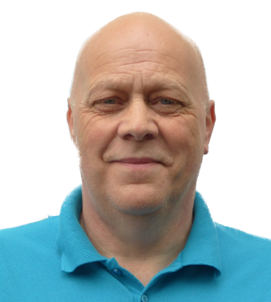
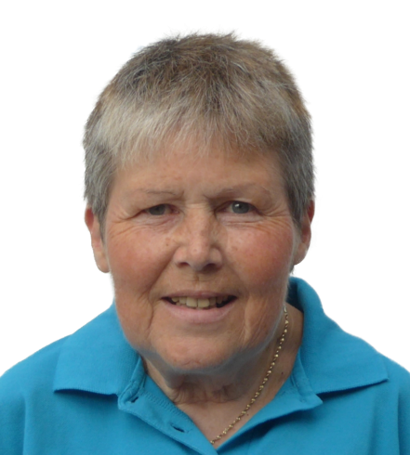
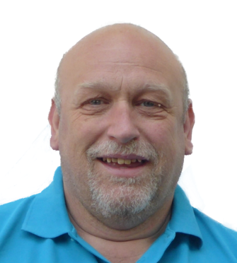
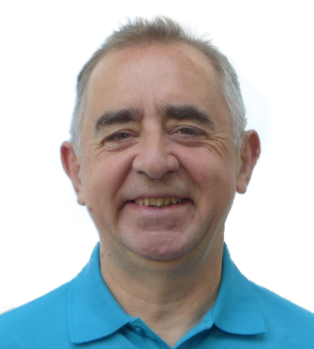
Some of the committee
Chairman
Steve Groves
Treasurer and
Newsletter Editor
Henny Cameron
Secretary
Howard Main
Observer Development
Team Leader
David Reeves

Slide 8
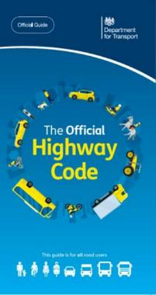
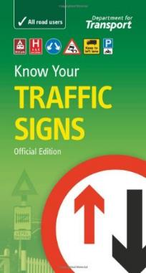
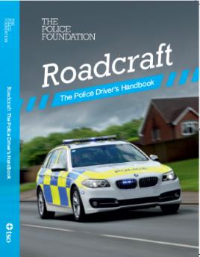
What is it based on?
Highway Code
Rules of the road
Traffic signs
Is this law or just advice?
Roadcraft
Police driver’s handbook
Basis for all Police/IAM RoadSmart driver training
System of Car Control
IAM RoadSmart Associate Log Book

Slide 9
What is Advanced Driving
Being a safer driver: decreasing the risk of a collision
Skills you need:
  Critical self awareness
  Taking action to identify and minimise risks
  Good observation and concentration
  Adjusting speed and position according the road and traffic conditions
  Precise and smooth use of the car’s controls
Using system of car control

Slide 10



The system of car control
IPSGA
Information
Take/Use/Give
///
//
/
Position
Speed
Gear
Accelerate
Notes:
IPSGA. – the acronym no one can remember
Information
Taking in information, Processing that information and giving out information (signals etc.)
It largely happens in our heads
Position, then speed, then gear – all about controlling the car.
Before accelerating (driving) the car through the hazard.

Slide 11

When do we use the system?
For every hazard
It provides methodical approach
Can and should be used flexibly

Slide 12

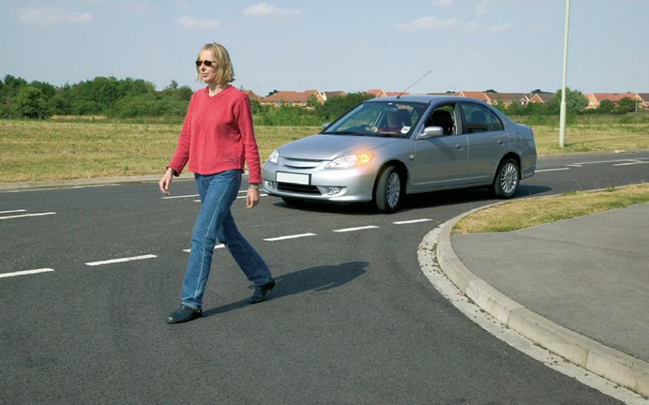
What is a hazard?
Anything that is an actual or potential danger

Slide 13

Categories of hazard
Physical features
Other road users
Weather and road conditions
Notes:
Click for: each feature (three of them)
Ask Associates what they are before clicking
Slide to get Associate to identify what a hazard could be as need to apply system to each hazard!

Slide 14
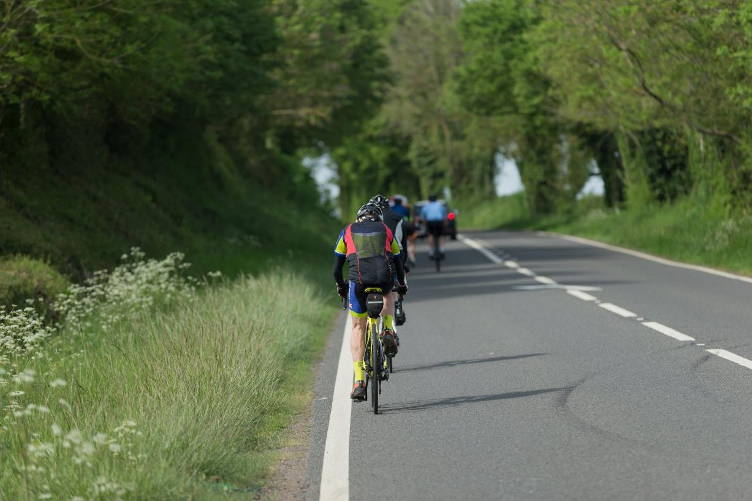
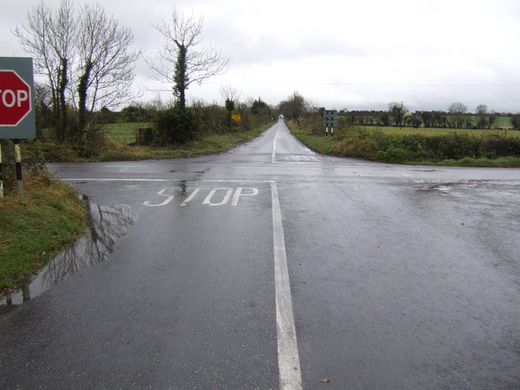
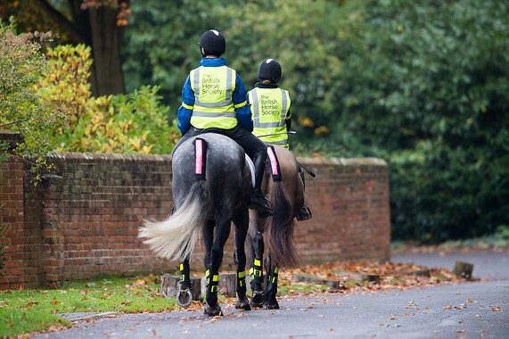
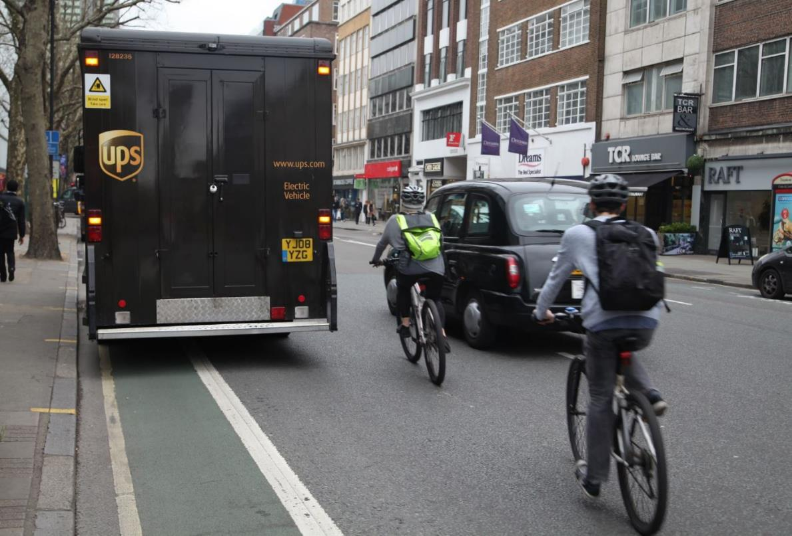
What sort of hazard?

Slide 15
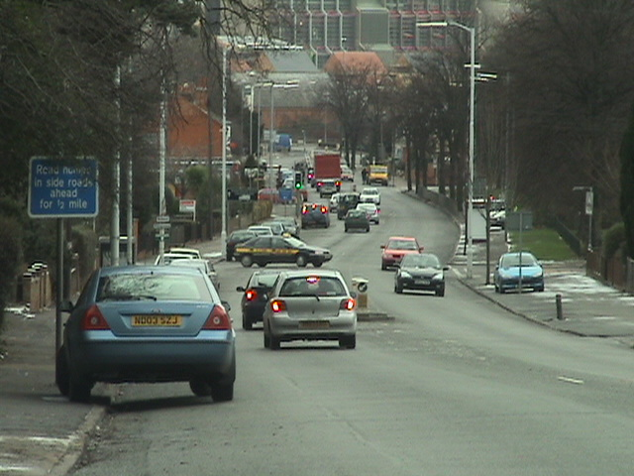
What hazards can you see here?
Notes:
What information can be got here: far distance etc,
What is the biggest hazard that cannot be seen – He’s behind you

Slide 16
Safe, methodical: leaves nothing to chance
Information
Continuous Process
Information
position
speed
gear
acceleration

Slide 17

The System: Why?
It gives you more time to react

Slide 18
Information is vital
Information
  The information phase runs all through the other phases of the system.
  Continue to take in new information, use it to re-assess your course of action.
  Give information at any moment if it is needed, e.g. horn warning / signals.
Information
Continuous Process
position
speed
gear
acceleration

Slide 19
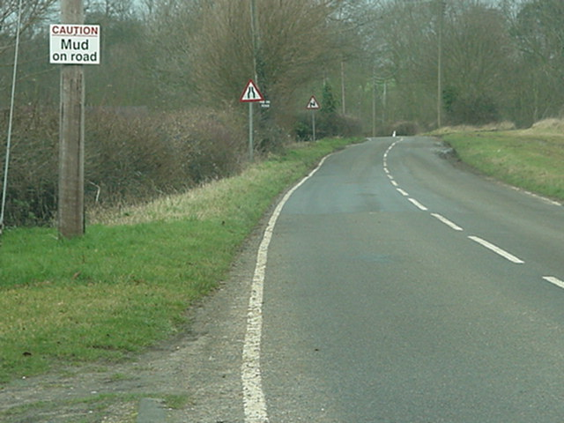
WHAT INFORMATION
IS AVAILABLE HERE?
Notes:
Where do we get information
Pick up:
Signs
road surface
Mud
Edge of road (right hand)
Double bend first to right (photo has left)

Slide 20
INFORMATION
Take
Look all around you.
Scan to front and sides
Use your mirrors
  before and after every hazard
  before you consider any action with the vehicle
  At least every 7 seconds
Use
To make a driving plan to deal with each
Decide on next actions
Plan for the unexpected.
Give
Give signals that would help or warn all other road users

Slide 21
Information
Use
Give
Take
Scan
Mirrors
Process
Driving Plan
Signals
Position
Hearing

Slide 22
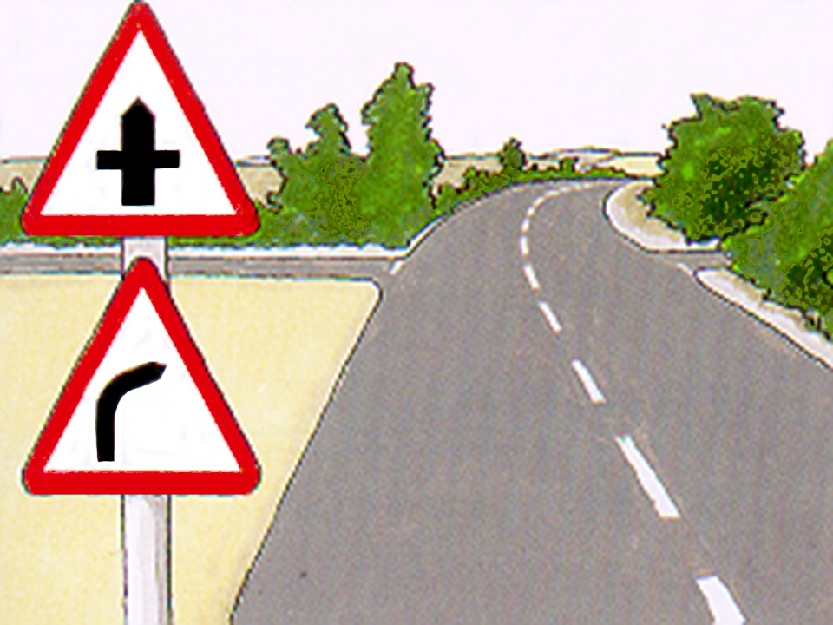
Sight
Hearing
Smell
Feel
Observation

Slide 23
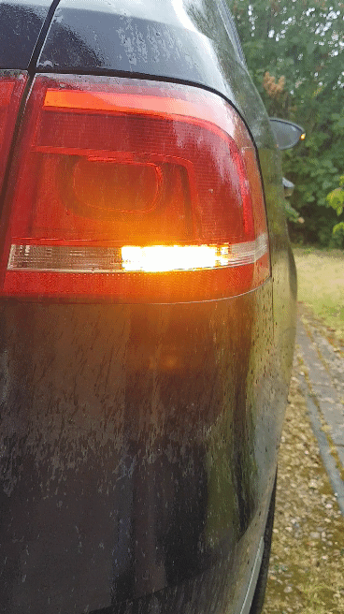
TYPES OF SIGNAL
  Indicators
  Arm Signals
  Position
  Brake Lights
  Courtesy signal
  Hazard Warning Lights
  Horn Signals
  Headlights

Slide 24
PLANNING
Driving plans are devised from:
What can be seen
What cannot be seen
The circumstances that might reasonably be expected to develop
Have a contingency plan – what if?

Slide 25
OBSERVATION & PLANNING
The system of car control relies on planning
To plan you must observe
Observation means to look, see and understand

Slide 26
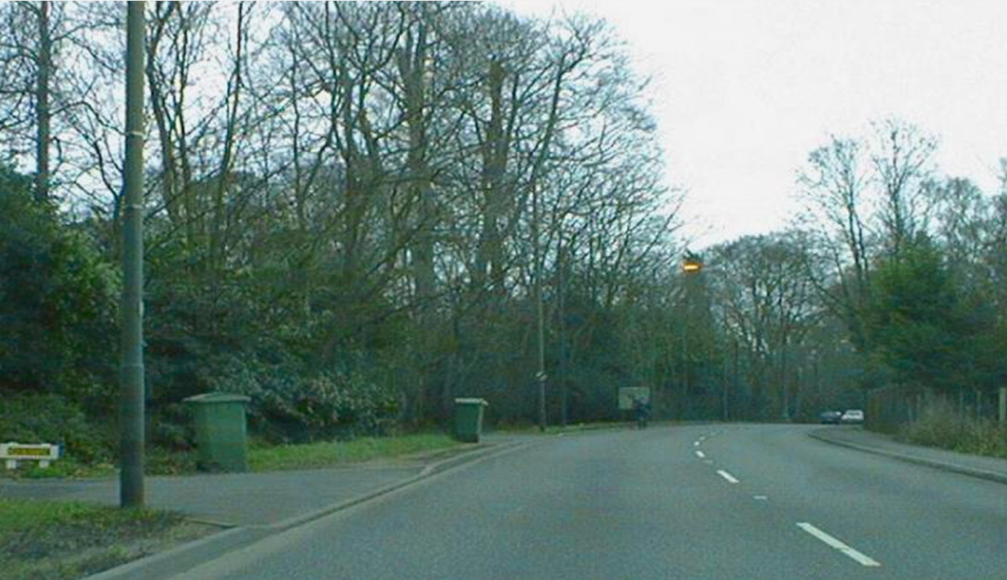
PLANNING – WHAT CAN BE SEEN
Notes:
What can be seen ….

Slide 27
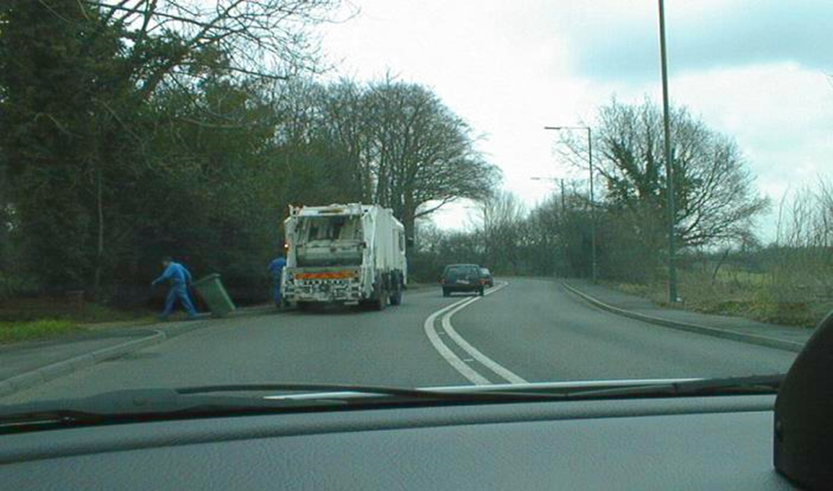
PLANNING – WHAT CAN BE EXPECTED
Notes:
What can reasonably be expected

Slide 28
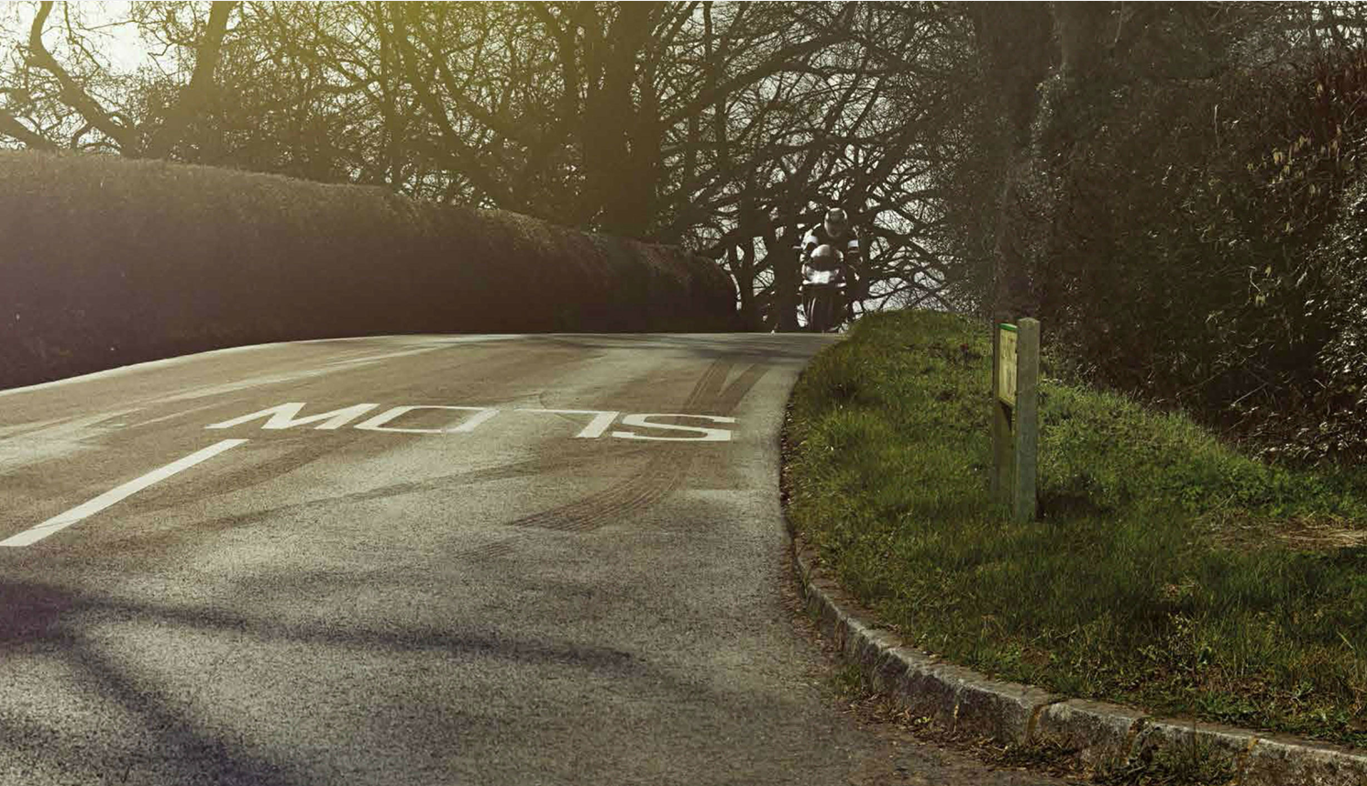
PLANNING – WHAT CAN BE SEEN (2)
Notes:
motorcycle

Slide 29
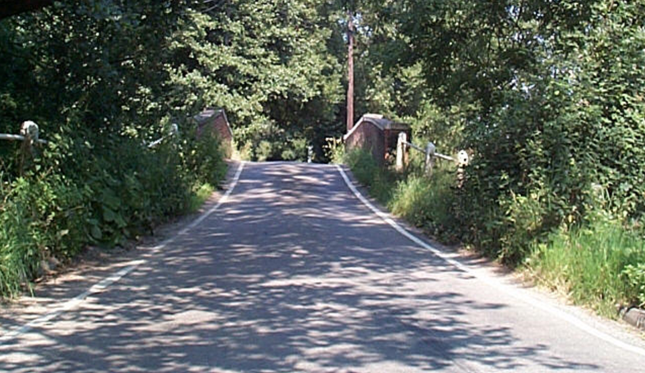
PLANNING – WHAT CANNOT BE SEEN
Notes:
What cannot be seen ……

Slide 30
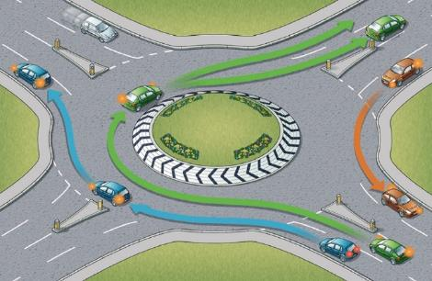
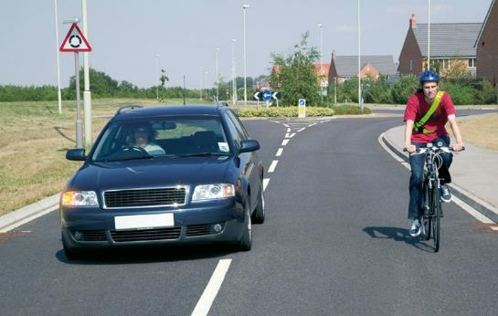

Position
For the hazard
For safety
For a better view

Slide 31
POSITIONING
Position so that you can negotiate any hazard safely and gain the best views of the road ahead, linking hazards together where possible
Use correct positioning for turns
Take note of markings and position accordingly

Slide 32
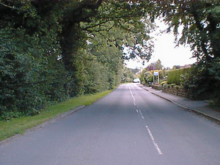
Position
Opposite
Carriageway
Nearside Centre Offside
Notes:
Only to show what Observers mean when say ‘take off side position’
Do not dwell on this slide

Slide 33
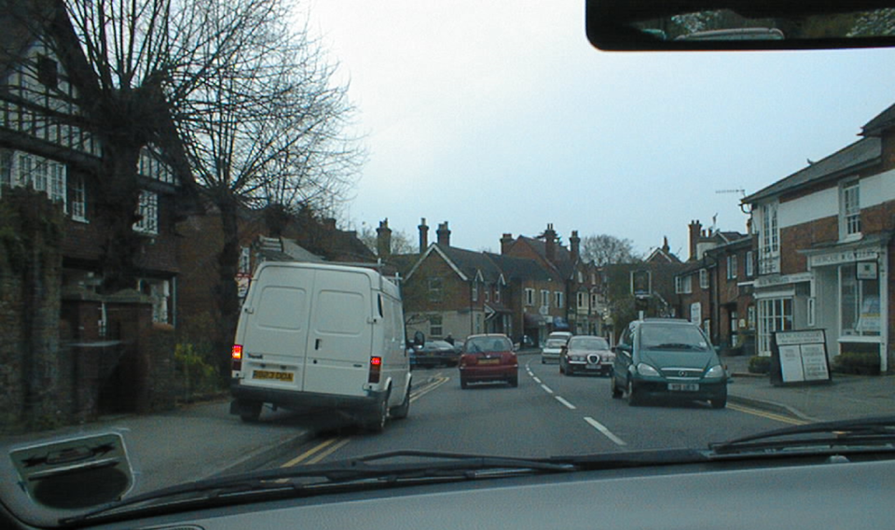
POSITIONING
To pass hazard safely
To increase view

Slide 34
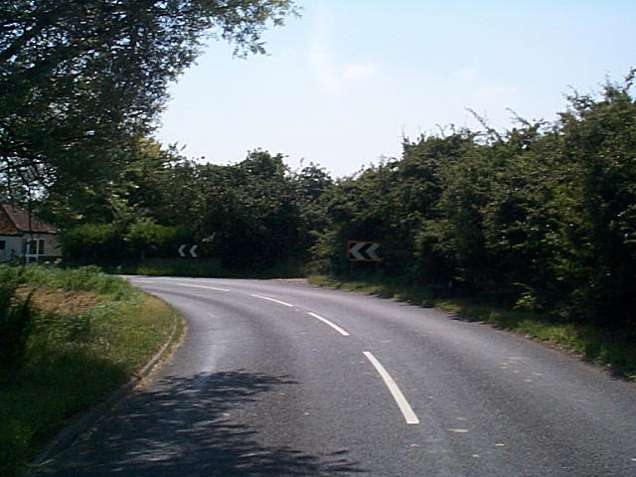
POSITIONING FOR BENDS
move to the
offside to
increase the
view around
a left hand
bend

Slide 35
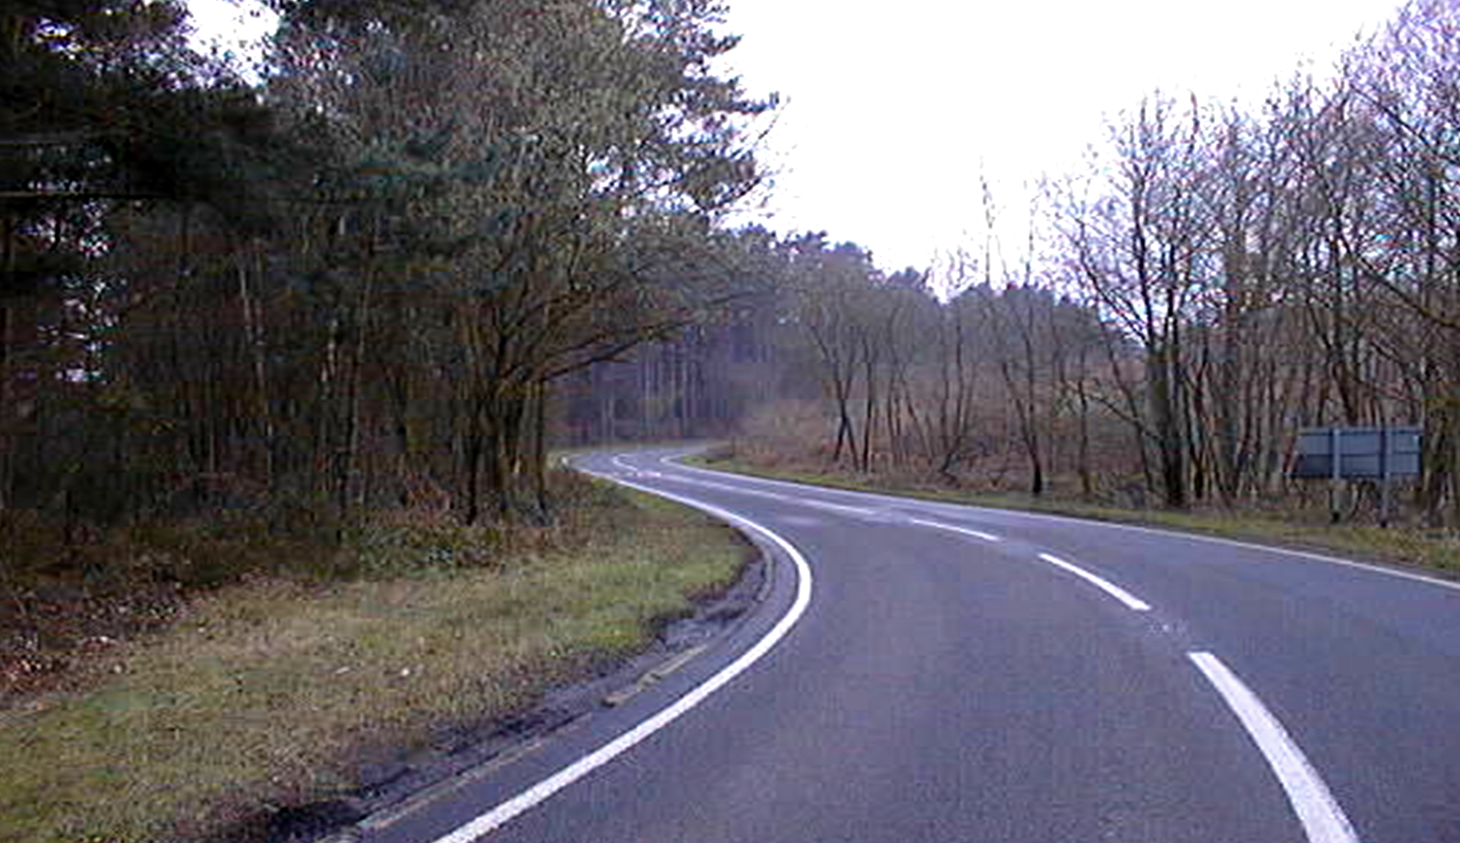
POSITIONING FOR BENDS
Link bends & hazards together
move to
nearside to
increase the
view around
a right hand
bend

Slide 36
SPEED
Adjust speed as necessary.
Brakes are to slow - gears are to go
The brake pedal is not an on/off switch.
(Braking should take min 4 seconds to find/firm/feather brake action)
Make good use of acceleration sense.
Always have the correct speed for the circumstances or to negotiate the hazard.
Use the brake and/or acceleration sense to adjust speed.

Slide 37

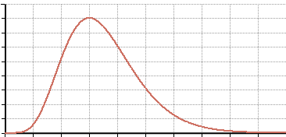
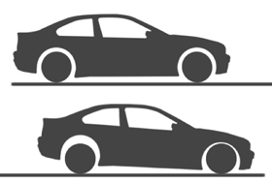
Speed – how do you reduce speed?
Acceleration Sense
Braking
  Tapered: progressive braking
  Smooth weight transfer
The ability to vary vehicle speed in response to changing road and traffic conditions by accurate use of the accelerator; so that you use the brakes less or not at all

Slide 38
STOPPING DISTANCE
30mph
0mph
80ft – 24.4m
40mph
28mph!
0mph
120ft – 36.6m
Notes:
Clicks: 7
Ice breaker
Make Associates guess

Slide 39
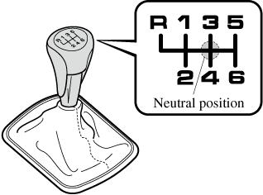
GEAR
ONCE YOU HAVE THE RIGHT SPEED
Between 1 and 2 seconds
Avoid late braking and snatched gear changes
Correct hold of the gear stick
Match engine to road speed
Plan ahead
Notes:
Demo how to hold gear stick

Slide 40
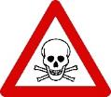
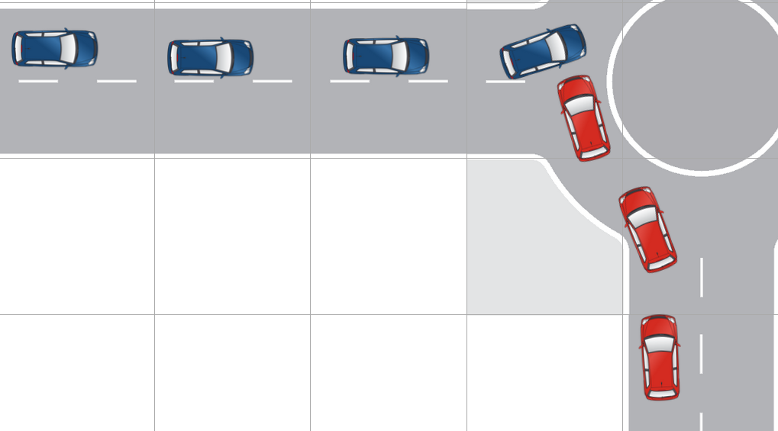
Accelerate (i.e. drive)
HAZARD
Danger Zone
///
//
/
Position
Speed
Gear
Acceleration
By the time we get to the hazard we need to be in full control:
Hands back on the wheel
Correct gear
Correct speed
Correct position
Notes:
Hazard – actual or potential danger
The Danger zone – with a zone boundary – it’s a minefield after that
Maximum control by the zone boundary

Slide 41
ACCELERATION
Accelerate smoothly, appropriate to circumstances. The accelerator is not an on/off switch
Use the accelerator to maintain speed and stability through the hazard. Make good use of acceleration sense
Use acceleration to offset loss of speed due to cornering forces.

Slide 42
APPLYING THE SYSTEM

Slide 43
THE SYSTEM - JUNCTIONS
gear
speed
position
Information
acceleration
Notes:
Clicks: 5
Include use flexibly
Consider all, may not use all

Slide 44
THE SYSTEM - ROUNDABOUTS
acceleration
gear
speed
position
position
Information
acceleration
Notes:
Clicks: 8

Slide 45
We will now take a short comfort break

Slide 46
The Limit Point
Judging the tightness of a bend

Slide 47
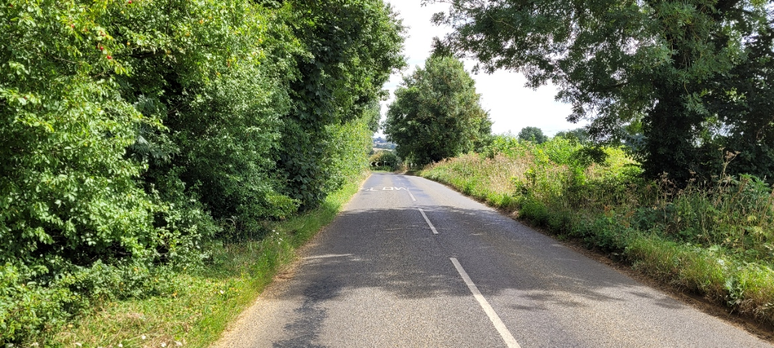
Limit Point
Where the two sides of the road appear to meet
This is the distance you can see to be clear.
You must be able to stop in this distance

Slide 48
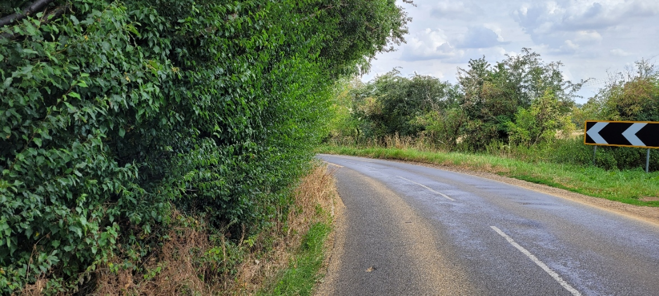
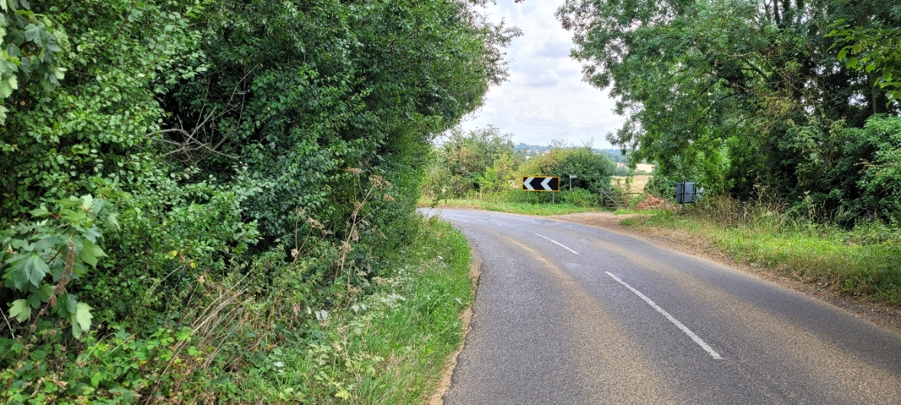
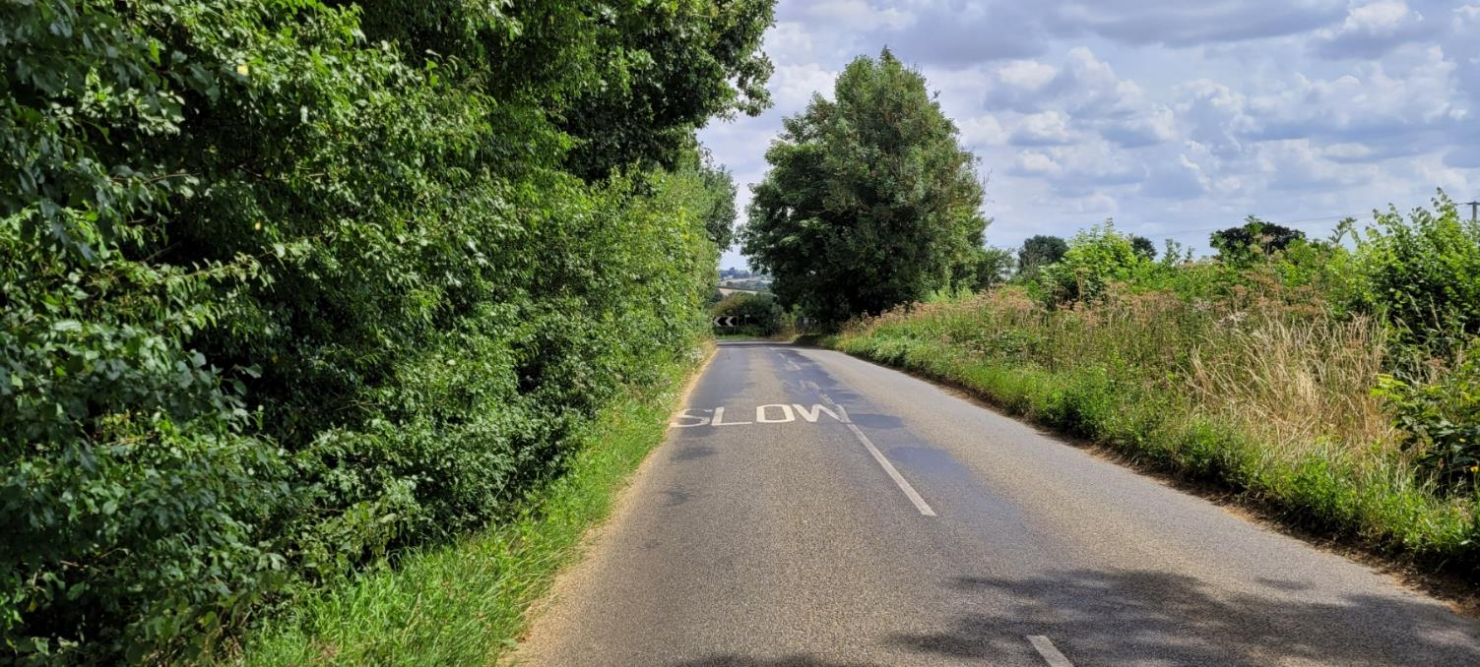
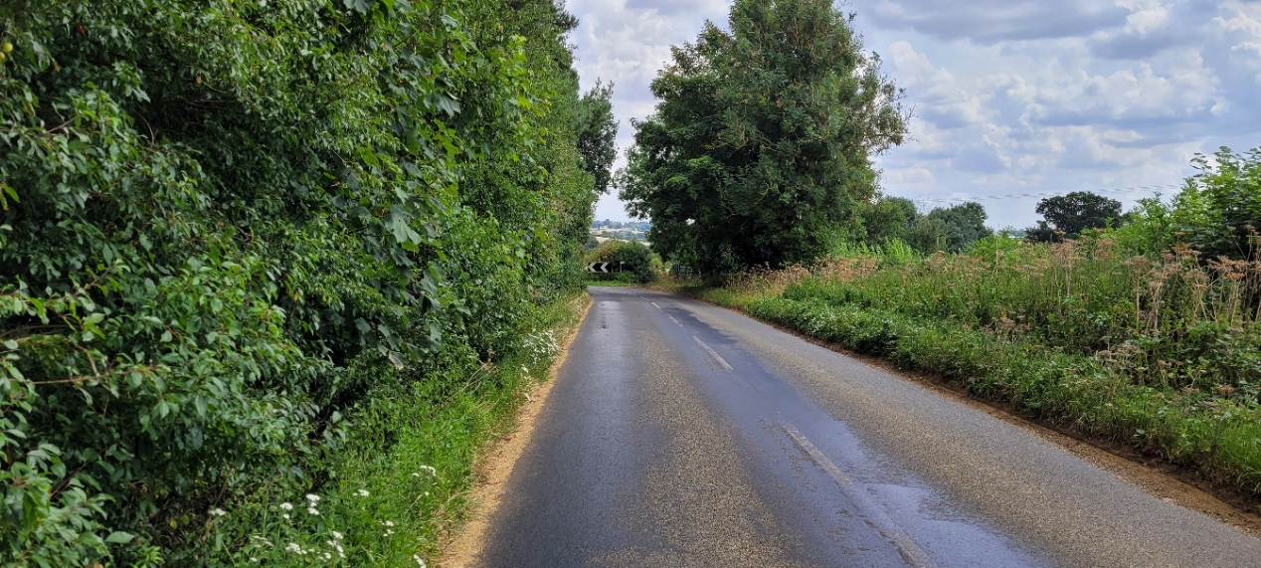
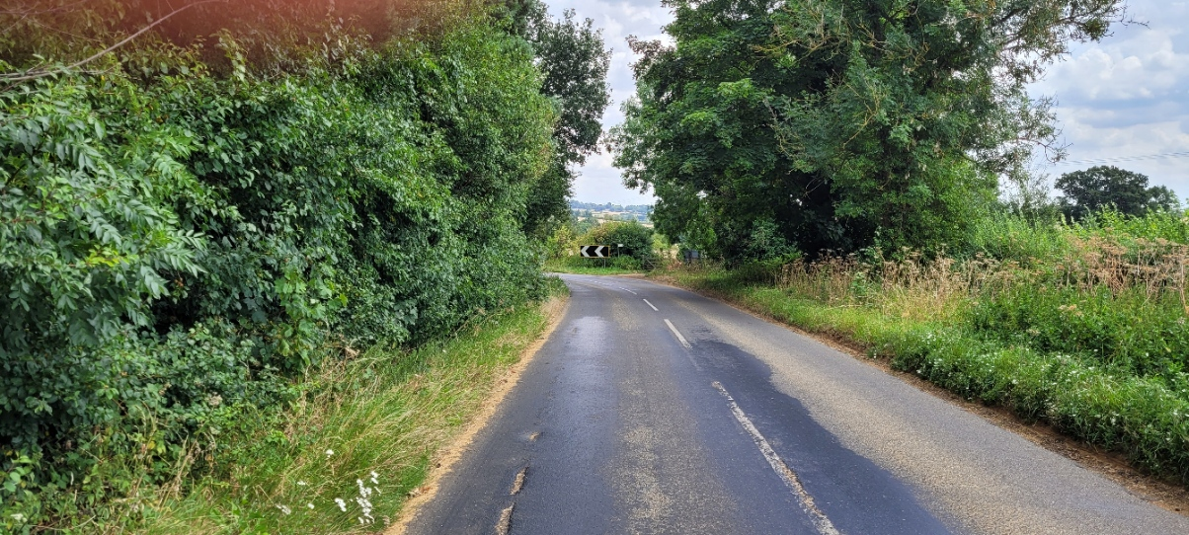

Limit Point getting closer: slow down

Slide 49
OVERTAKING METHODS
Single Carriageways

Slide 50
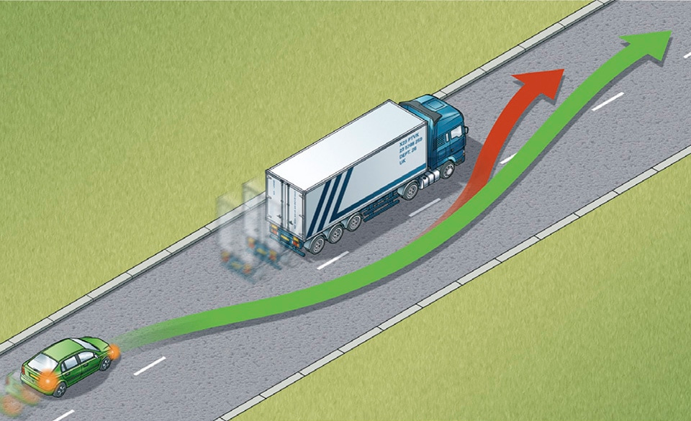
Technique 1 – Rolling overtake
Can overtake immediately
Minimal change of speed
Consider lower gear
Check mirrors
Move out early for view
Notes:
From Highway code – for all overtakes
My conjecture is that’s its really only suitable for a rolling overtake
Now this is essentially the same as overtaking on a dual carriageway.

Slide 51
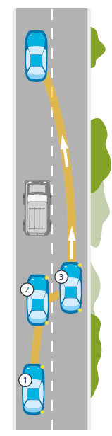
Technique 2 – Staged overtake
The following position
The overtaking position
  Prepare
  Gear
  Mirrors
The overtake
  Out for a look
  Accelerate
  Pass
  Back in to the gap

Slide 52
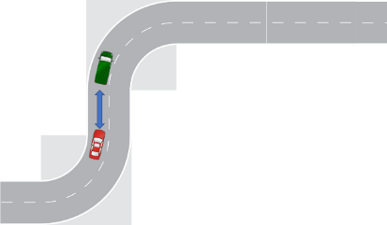
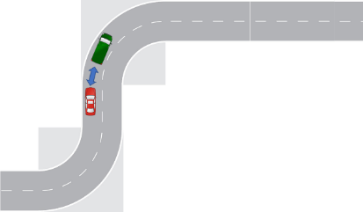
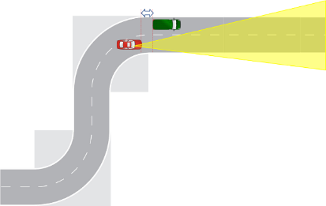
The secret is in the planning
Anticipation of an opportunity
  Local knowledge
  After a bend
Preparation
  Position (nearside) for view
  Anticipation – actions other drivers
  Gear – for acceleration
  Mirror
Observation
  Other road users
  Junctions/turnings/entrances
  New hazards
Notes:
As with a lot of Advanced Driving
Anticipating and planning is key

Slide 53
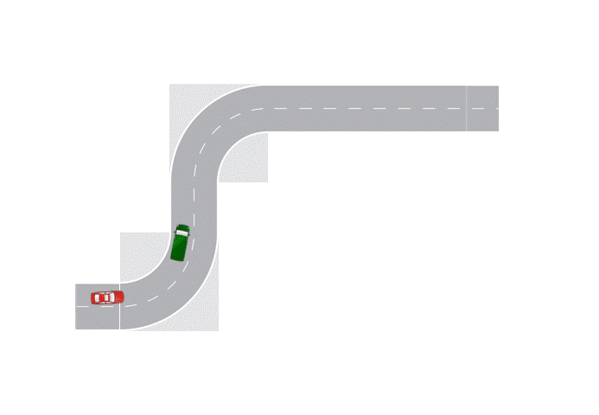
Technique 2 – Staged overtake

Slide 54
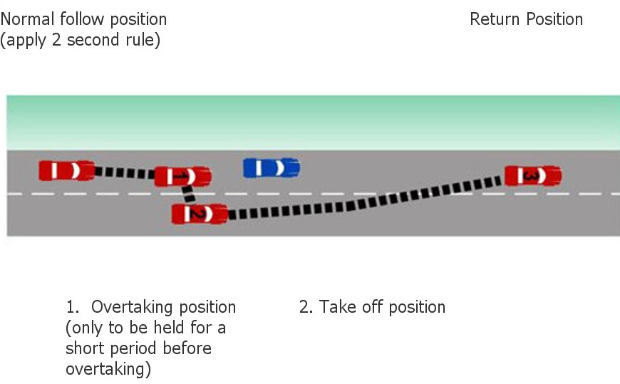
STAGED OVERTAKE

Slide 55
Staged overtake – not on
Notes:
Clicks: 5

Slide 56
Staged overtake - go
Notes:
Clicks: 5

Slide 57
Above all, don’t forget the golden driving rule

Slide 58
You must always be able to
STOP safely within the distance you can see to be clear on your own side of the road

Slide 59
Learning Outcomes - Place Holder
Human factors

Slide 60
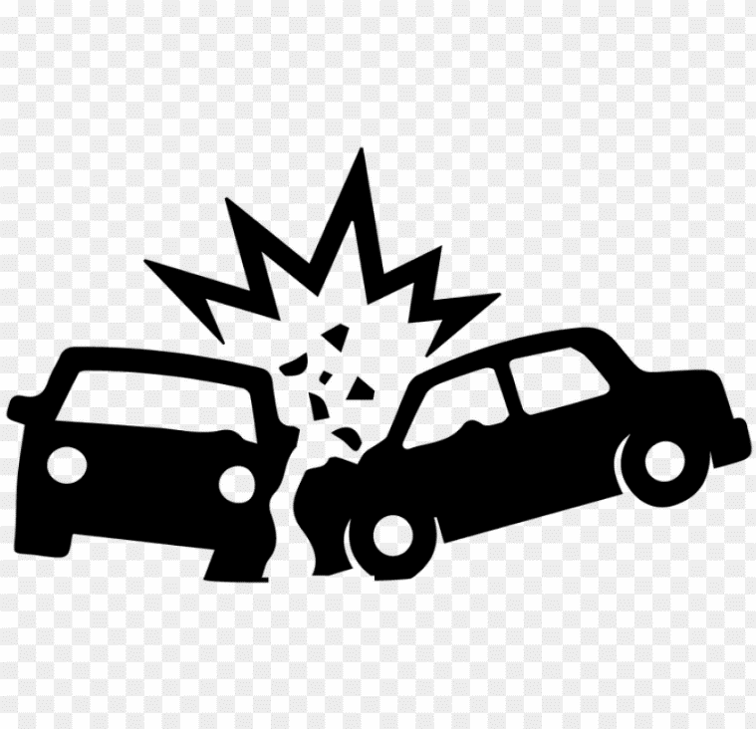
Human Factors -- Why are Humans so accident prone?
Notes:
So why are Humans so accident prone. A term that was only invented about 100 years ago.
6M years of evolution, 150 years driving – perhaps we are just not evolved to go faster than walking pace!
Lets step back.
What do we need to do to drive a car.
Stage 1: Make it go faster , slower and turn Stage 2: When to do it.
Driving decisions.

Slide 61
Humans and driving
We take in information via the senses: sight, sound, smell etc.
  This relies on functioning sensors: eyes, ears, nose etc
  These sensors each have an operating range
We process that information and decide to:
  Continue as we are i.e. no change
  Steer
  Decelerate
  Accelerate
Humans have limited information processing abilities
Requires mental functions:
  perception
  attention
  memory
Notes:
We have to perceive things in our environment.
We must register with sensors we have. If the sensors don’t work properly (poor eye sight) or conditions outside their operating range. Low light, very high contrast etc we never get the information
We need to make driving decisions. Based on inputs from the sensors.
We must attend to them i.e. we must give them our attention. Needs appropriate brain software/ wet wear.
Humans cant really do multi tasking, so we need to switch our attention
We need to remember what we have just seen and use this with new information.
perception
attention
memory

Slide 62
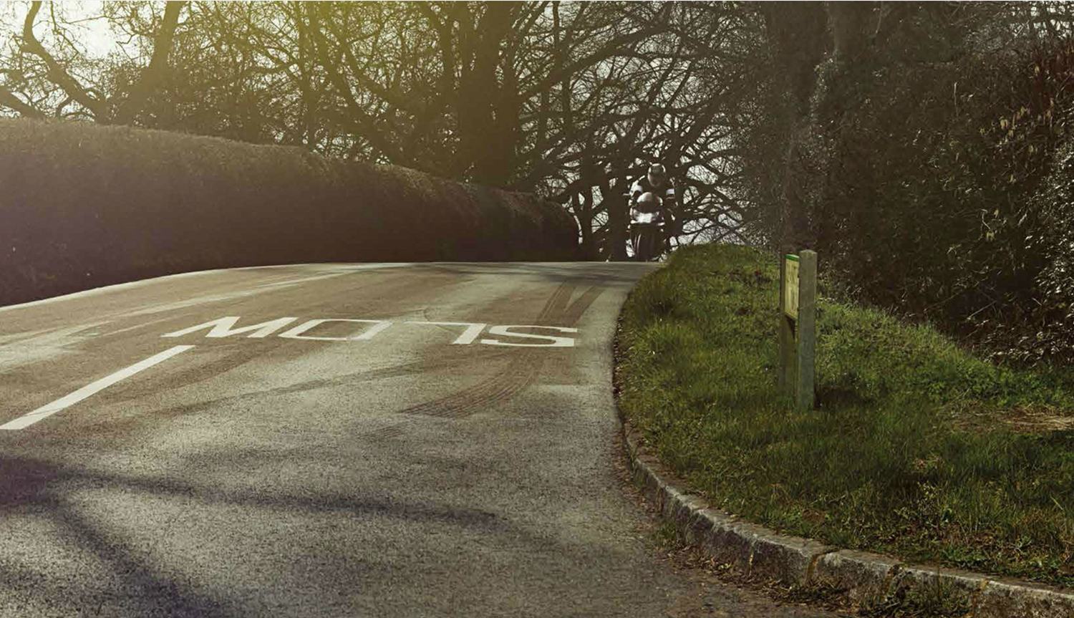
Perception
Notes:
We can see the bridge, shadows, narrow road, ice. Do we actually see a motorbike?

Slide 63
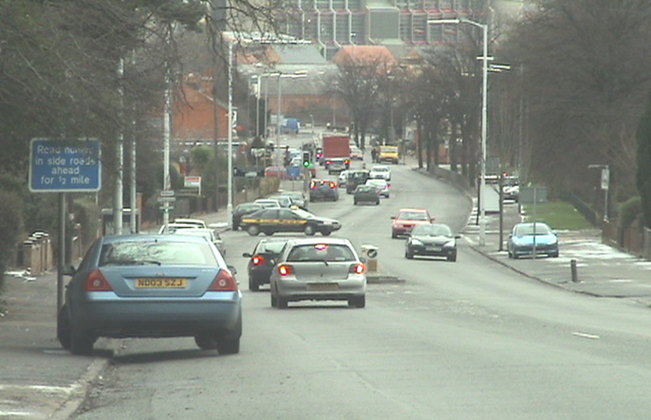
Attention
Notes:
Imagine. You are driving down here and you are looking for a particular side road.
Where do we apply our attention. Multiple hazards. Multi task
At this moment some nearby sounds their horn – where is your attention now,

Slide 64
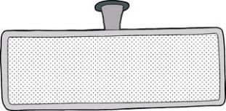




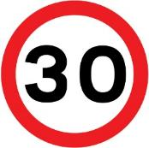
Memory
Notes:
You need to use short term (working) memory, medium and long term to inform driving decisions

Slide 65

Yerkes-Dodson Performance/Arousal Curve
Arousal is a function of:
alertness,
situational awareness/vigilance,
level of distraction,
stress and
direction of attention.
Habituation – when sensory stimulation is constant and unchanging
One characteristic of over-arousal is a tendency to narrow attention and focus, other information is ignored
Notes:
Arousal – is about all the things (stimuli) you need to react to. There is an optimal point. Your brain is being stimulated, and can respond appropriately.
What about under arousal: brain not stimulated enough? When might that occur? What could you do?
And over arousal too may things happening. Brain focuses on one thing. Ignores others like mirror check
From aviation. Aviate / Navigate/Communicate / 1st fly the plane – then get the checklist
Make it right thing. Focus on IPSGA

Slide 66
Information Processing
Requires mental functions:
  perception
  attention (multi-tasking) and
  memory
Can be impaired
  Poor eyesight
  Illness
  Alcohol/Drugs
  Distractions – mobile phone, passengers
  Long term stress – work/relationships etc
  Short term stress – too hot, late for work, uncomfortable, traffic/road situation
Remove the cause or
remove yourself (i.e. don’t drive)
Be self aware
Notes:
Obviously, don’t drink and drive. Be very aware of medicines. Be very aware of the stresses you are under.
These compete for brain bandwidth

Slide 67
Why humans get it wrong
All can be improved with advanced driver training and practice
Actually couldn’t see the hazard
  Hazard hard to see: dim, glare, low contrast.
  Tightness of a bend or
  Another car's speed
Critical information was detectable but that the driver failed to register it
  Mental resources were focused elsewhere
  “I just didn’t see the car/bike/pedestrian”
Correctly process the information but fail to choose the correct response i.e. makes a poor decision
Limit-point
Linked Observation
Prediction
Better observation
TUG
Systematic approach
Better driving decisions
Recognising lack of information
Self monitoring
Notes:
For these purposes then humans take in information, process it and make decisions. Why do we get it wrong?
Impossible to see with the human eye
Focused else where – the car behind, mobile phone, what's for tea
Processed the information but made a bad decision (or no decision)
How could we do to improve each of these?
Now consider for a moment how our training maps on to this
New ways of thinking: What can we reasonably expect to happen. Predict before our senses detect. Limit point analysis. Linked observation.
Improving observation, focussing on appropriate things
Making better decisions, and recognising when we don’t have the information.

Slide 68

Sharing the road
The New Driver
8% First time driving alone
42% Never been in this much traffic
15% What does that sign mean?
22% Which lane?
1% Sheer panic
Unlicensed Driver
14% No driver training
7% No licence
54% No insurance
9% No car maintenance
16% Bad attitude
The Unfit Driver
26% Poor eyesight
17% No test taken
9% The shakes
36% Panicking
12% Drowsy on medication
Distracted Parent
28% Doing make-up
11% Brushing hair
27% Moaning children
9% Late for school
7% Shoes in footwell
18% Exhausted
Pressurised Business Driver
41% Late for an appointment
11% Been up since 5am
9% Bad day
13% On the phone
6% Road-rage
20% Thinking about tomorrow’s presentation
The Fiddler
21% Eating fast food on his knee
24% On the phone
5% Fiddling with Sat Nav
13% Changing CD
21% Getting cigarettes out of jacket (on back seat!)
16% Admiring reflection

Slide 69
What we encourage?
New skills
  Prediction
  Observation
  Decision making
  Physical Controls
Mental Attitude
  Desire and willingness to improve
  Self evaluation
  Increased awareness external factors
Notes:
Yes we will teach some actual skills
I think a large chunk of it is a mental attitude.

Slide 70
Questions?
?

Slide 71
Any questions?
Thank you for your attention so far
We will now go to the car for the demonstration drive, expanding on what we have covered today

