Slide 1

2022/2023
Deliberate
Fire Setting
Notes:
Good morning / afternoon
I am …. and I work with ….. I am here talking to you today as part of the County Schools Challenge.
We want you to help us tackle deliberate fire setting

Slide 2
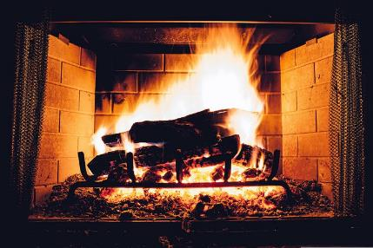
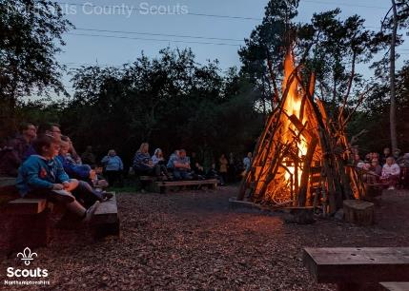
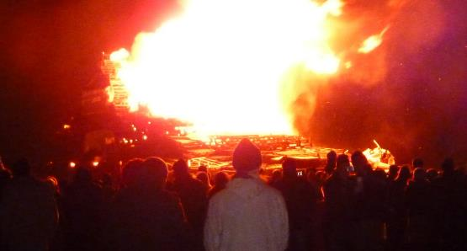
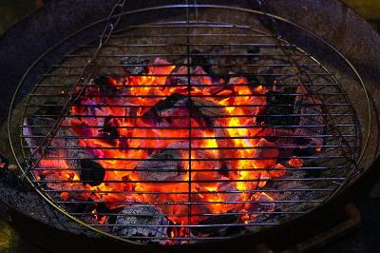
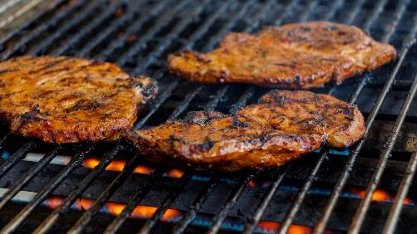
Safe Fires
Natural Home Fire
Scout/Guide Camp Fire
Bonfire Night
Patio Fire Pit
BBQ
These are all Controlled Fires
Notes:
6 clicks, one per image plus controlled fire text
Not all fires are bad. There are many safe fires – these are controlled fires organised by responsible persons or organisations

Slide 3
What is deliberate fire setting?
Fires where the motive was ‘thought to be’ or ‘suspected to be’ deliberate.
This includes fires to
  an individual’s own property,
  others’ property
  property of an unknown owner
Notes:
Arson – Where property is destroyed or damaged by fire, arson should be charged - see Section 1(3) CDA 1971. Section 1(1) and (3) provides that arson is committed if a person without lawful excuse destroys or damages any property by fire, intending to destroy or damage any such property or being reckless as to whether any such property would be destroyed or damaged.
a maximum penalty of life imprisonment for aggravated criminal damage and aggravated arson
[definitions from CPS]

Slide 4




Types of Fire
Dwellings
Houses, flats, houseboats, caravans
Other Buildings
hostels/hotels/B&Bs, nursing/care homes, offices, shops, factories, warehouses, restaurants, public and religious buildings
Road Vehicles
cars, vans, buses/coaches, motorcycles, lorries/HGVs
Outdoors
aircraft, boats, trains, post boxes, bridges, grassland, refuse, fields, derelict buildings
Notes:
4 clicks – one per Type
Most deliberate fires occur outdoors

Slide 5








Young People
Northamptonshire
307
161
2021
2022
Notes:
Click once per year – once white number appears above matches this is the end of the animation
Note 2022 figures is the final one for 31/12/2022
These are all the deliberate fires in Northamptonshire set by young people (under age of 18). The majority are secondary age young people.
Highest number of fires this year were in July/August with over 150

Slide 6
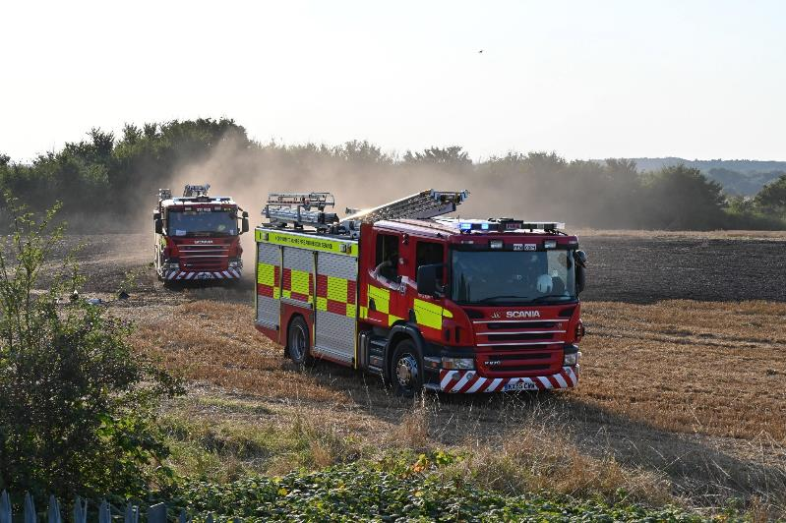
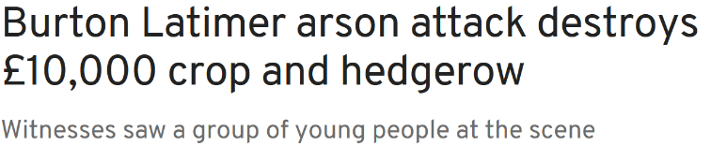
Incidents
Notes:
Click for newspaper headline
Photo: Fire engines in field; Kings Heath 2021
Headline: 7 acres of wheat destroyed worth £10,000.
400 metres of hedgerow
5 fire engines involved
Farmer livelihood – cannot sell grain or straw (no profit for year work),
no grain to sow next year (will have to buy-in grain)
Hedgerow – birds and small animals displaced,
bird nests with young birds destroyed
A6 closed in both directions due to drifting smoke (all evening) –
additional journey times/costs for motorists,
more pollution from queueing traffic,
missed appointments due to additional journey time
Police involved in road closure – less police available for emergencies etc

Slide 7
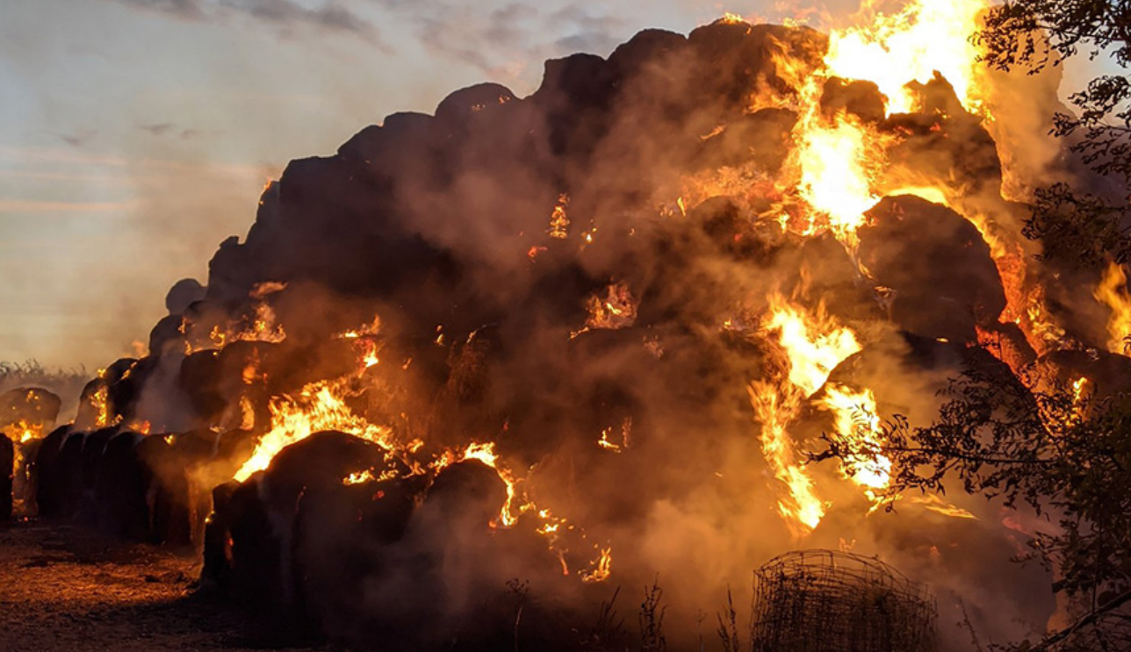
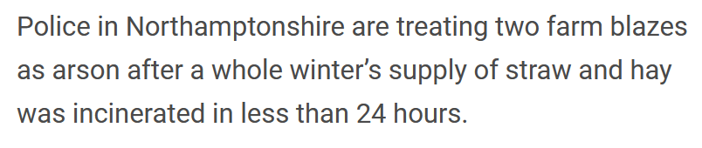
Incidents
Notes:
Click for newspaper headline
Photo: Hannington, Northants 2020 [image is one of the farm fires]
Headline: Two farm blazes treated as arson, winter supply of hay and straw destroyed.
Farm one (Little Oxendon, Northants) – barn full of straw (3,000 bales - £54,000) +barn +equipment (£0000s)
Farm Two (Hannington, Northants) – mixed hay/straw stack (1,500 bales - £27,000)
8 fire appliances involved / 50 fire fighters
same consequences as before:
Farmer livelihood – cannot sell straw (no profit for year work),
no straw/hay for animal bedding/ food
barn also destroyed
farm trailer and other equipment in barn destroyed
one farmer ‘heartbroken’
Environment – small animals in stack died
No arrests made

Slide 8
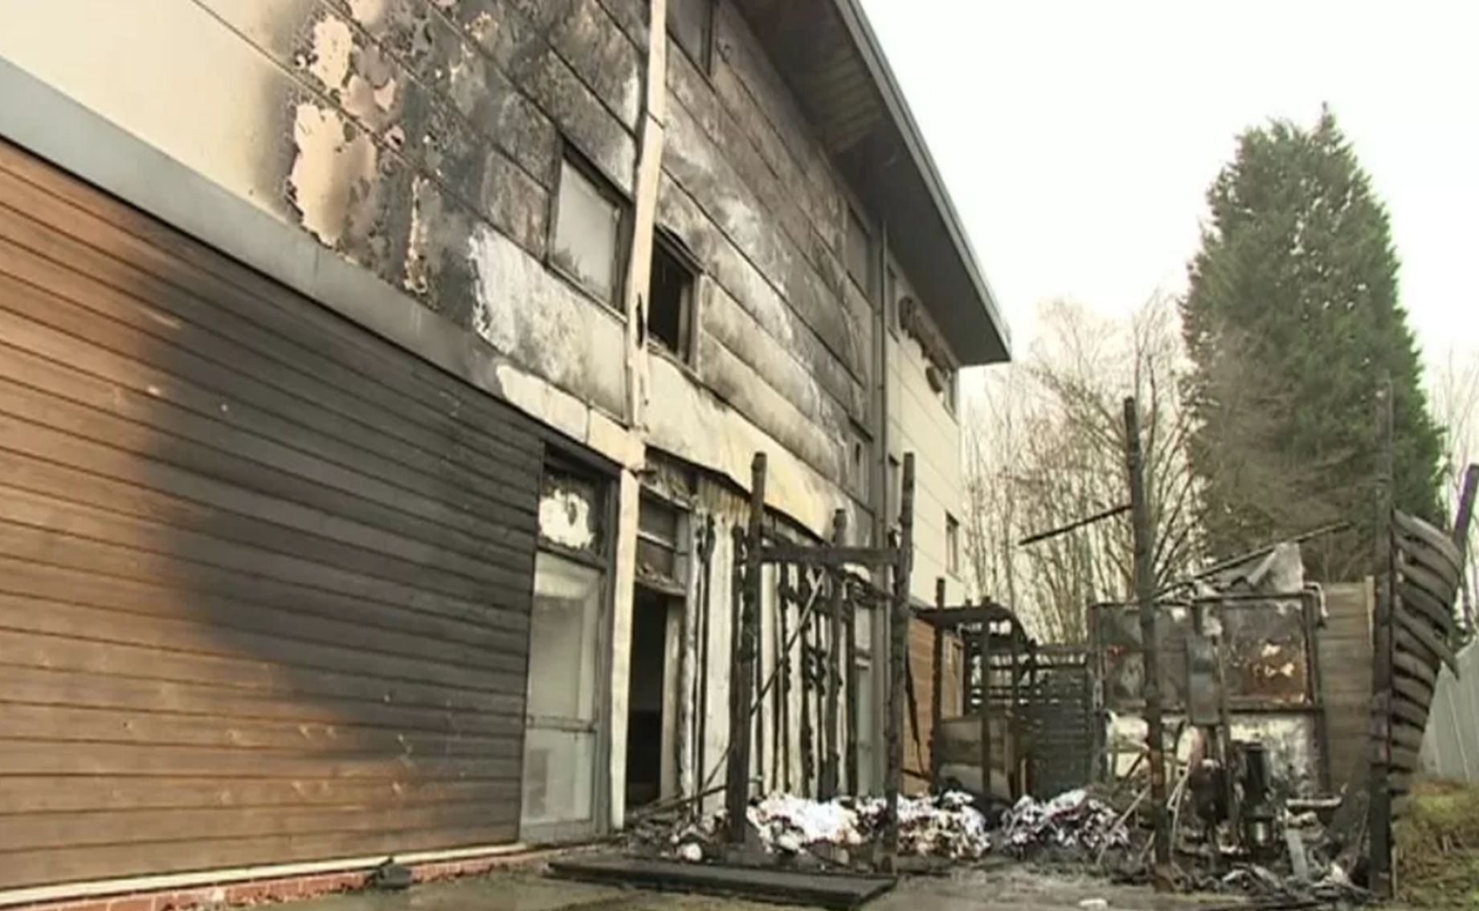
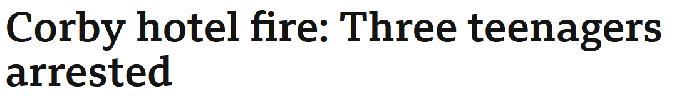
Incidents
Notes:
Click for newspaper headline
Photo: Corby hotel fire [Hampton by Hilton Hotel in Corby]
Headline: Corby hotel fire: three teenagers arrested
fire in outside bin spread to building
3 floors evacuated – 140 guests
four people were treated at the scene after breathing in smoke
hotel closed due to fire – loss of revenue
evacuated guests - loss of personal possessions (clothes, computers etc)
- had to find alternative accommodation
unable to honour future bookins (weddings etc that have been panned for years)
hotel rebuilt – cost £££
8 fire appliances/50 firefighters
Fire control
Police (entered building risking their own lives)
onsite approx. 8 hours
after fire investigations next day to check
2 boys, 1 girl arrested for arson

Slide 9
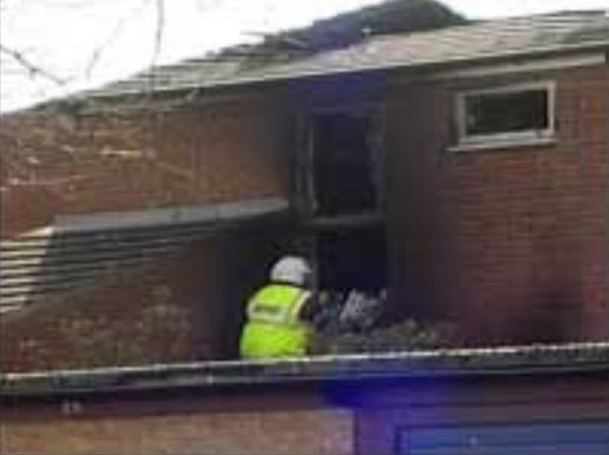
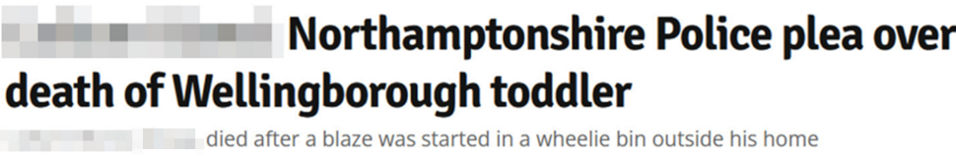
Incidents
Notes:
Click for newspaper headline
Photo: the actual house, Fulmar Lane, Wellingborough
Headline: Northants Police plea over death of Wellingborough toddler
Wheelie bins set alight and pushed against house
Fire spread to house
Parents and three children escaped
3 year old boy died from smoke inhalation when a roof collapsed and he became trapped inside the burning
building – body recovered following day
This tragic event resulted in County Schools Challenge being set up (originally just for Wellingborough)

Slide 10
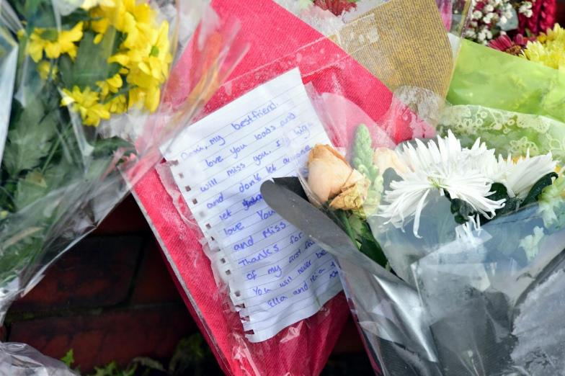
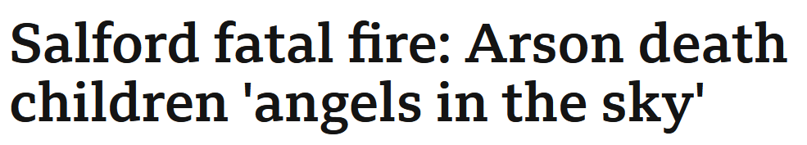
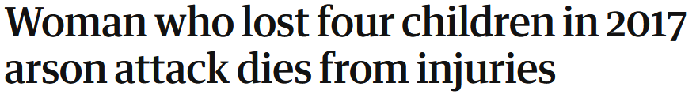
Incidents
Notes:
Click for first newspaper headline, talk about four children dying, then click to reveal mother dies as well
Photo: Floral tributes and messages left a scene
Headline: Salford fatal fire: Arson death children ‘angels in the sky’
Woman who lost four children in 2017 arson attack dies from injuries
headline 1 Four children died in fire – 15 year old girl, 8 year old boy, 7 year old girl and 3 year old girl
Mother severely injured – 75% body burnt
16 year old boy escapes
Mother unable to attend funerals as still in hospital
Coffins were each themed with the children's interests - music, the Avengers, My Little Pony and Peppa Pig.
Two men in their 20s given 4 life sentences each for murder
Headline 2 Mother dies 20 months after the fire of her injuries

Slide 11
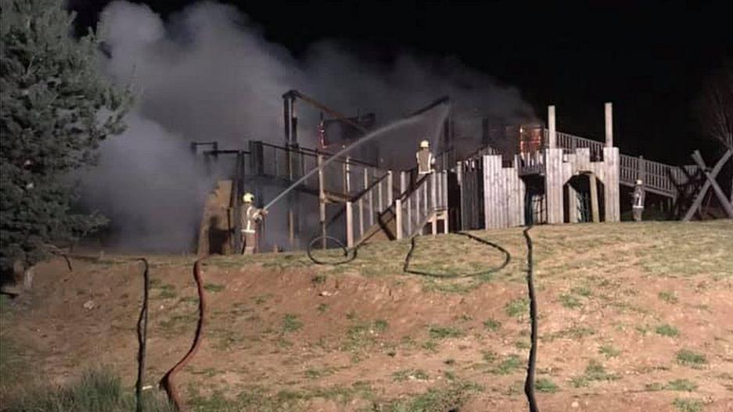
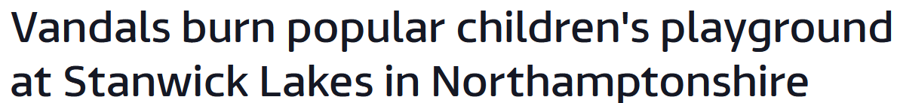
Incidents
Notes:
Click for newspaper headline
Photo: Stanwick Lakes fire 2021
Headline: Vandals burn popular children’s playground at Stanwick Lakes
Run by a charity (Rockingham Forest Trust)
Playground 4 years old, only refurbished 2019
Described as "devastating and a massive blow"
Had to remove damaged play equipment – cost
Loss of visitors = loss of revenue
Stanwick Lakes a nature reserve – smoke affected wildlife inc birds
Cost over £300,000 to rebuild

Slide 12




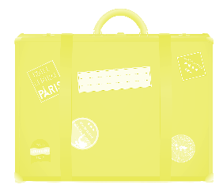





Consequences
Potential to
Cause Harm
Cost to Victims
Emotional Impact Family, Victims
Unable to
Travel
Unable to get Housing
Large Fines
Emotional Impact
Unable to get
a Job
Loss of
Liberty
Notes:
7 bullet pints – click for each
Consequences to others:
Potential to cause harm: injury, death, pollution (climate change)
Cost to Victims: Property destroyed, income, job (if company goes bust), farmers needing to buy in grain, straw etc
Emotional impact to family, victims and community (family targeted)
Consequences to self
Unable to get housing (landlords not happy for conviction for arson – don’t want an arsonist in their property)
Unable to travel to places such as the US on holiday with family due to criminal record
Unable to get a job due to criminal record
Large fines
Loss of liberty – prison – breakdown of relationships as in prison
Emotional impact to self (people will respond differently to you – family, friends etc)

Slide 13
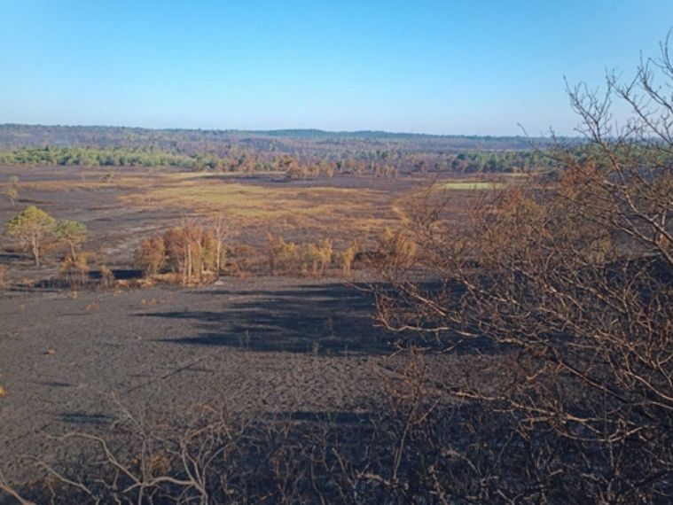
The Environment
Pirbright Ranges, Surrey
one of the largest areas of lowland heath in Surrey
home to many rare and threatened species
patches of ground continue to burn for three weeks
over 650 hectares of pristine heathland has now been severely burnt, at great cost to wildlife
No food for red deer herd
Air pollution (smoke, fumes) – increase greenhouse gasses (climate change)
Water pollution (from Firefighting foam and additives)
Devastation to vegetation (home and food for animals)
Devastation to species through loss of habitat
.
Notes:
Click for each bullet point (each appear on click - 4)
Click for photo
Click for each of Pirbright bullet points (4)
Bullet point: Air pollution - smoke/fumes, increase greenhouse gasses therefore increase climate change
Water pollution - from firefighters foam and additives
Devastation to vegetation - loss of homes and food for wildlife
Devastation to species - loss of rare species through direct fire or resultant loss of habitation
Photo: Pirbright after fire July 2022
Pirbright Ranges – home to many rare and threatened species
- home to red deer herd (200 animals)
650 hectares destroyed = approx. 910 football pitches in size
Fire burned hundreds of recently fledged rare ground-nesting birds including European nightjars,
Dartford warblers and woodlark which were too young to fly away from the fire
Parent birds unable to have second brood as fire destroyed habitat for nests
Habitat will take 8-12 years to recover, therefore still nowhere for birds to nest
Reptiles like slow worms, grass snakes and adders died, unable to escape the fire

Slide 14
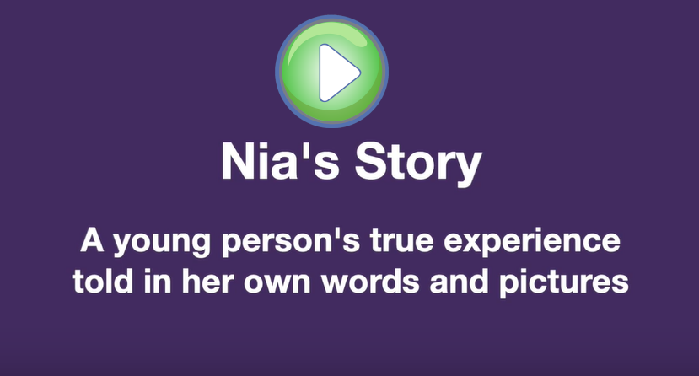
Nia’s Story
Notes:
Click image to play
Nia was a convicted fire setter sent to Onley Young Offenders Institution and came to Northants Fire (Arson task Force) for firesetter intervention prior to being released.
Nia now works for London Fire Brigade delivering fire setter intervention to other young people.

Slide 15







Help is available
Notes:
Different organisations for help

Slide 16
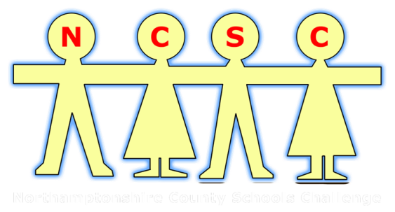
We want your help
Notes:
So, we want your help and this is where you come in and the challenge we want you to take on as a school.
Lets help young people in this County understand the consequences of deliberate fire setting and help prevent young people from setting deliberate fires.

Slide 17

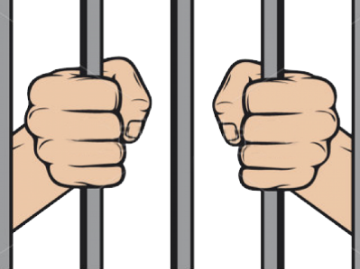

What’s the Challenge?
To reduce deliberate fire setting by young people
Help the young person understand the danger of deliberate fire setting and the potential consequences
Reduce preventable accidental fires such as barbeques not being extinguished
Notes:
3 bullet points on individual clicks
What’s the challenge?
Your challenge is to :
(Read the bullet points on the slide)

Slide 18
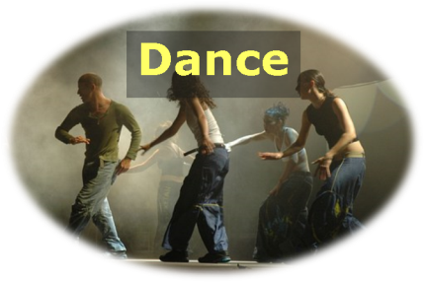






Your ideas
?
A product or service using a business approach
Notes:
[single click this page when see first question mark, 7 images will float in
This is a team based task – choose your team mates wisely! Need creative person, organiser, finance person etc
Its about coming up with a business idea, which could be a product or a service – this can be based around Dance, the internet, art, games, films, music, adverts
Then you need to decide how much the product/service will cost to produce, how much it will sell for (or how you will fund it if free), who it is aimed at and why your product/service is better than anyone else's (its unique selling point)
Finally develop a prototype

Slide 19
Previous Winners
Card Game
Graffiti Art
Snapchat filter
Primary school story booklet
Purple Bow Day
Talking Lampposts
One Punch Kills t-shirt
Wheelie bin stickers
Think bigger and better
Notes:
Some of our previous winners:
STALK card game (Knife crime, Corby technical school) –launched 2022
RoadArt Graffiti Art (Road Safety, Southfield School for Girls) – Large graffiti on end of Fire Station in Kettering
Snapchat filter (Drugs ad Psychoactive Substances, Kingswood Secondary Academy) – clickable balloons with drug facts (note, most apps and technology solutions are too expensive to implement)
Frank and Timmy Primary school story booklet (Healthy relationships, Lodge Park Academy) including short stories with different relationship problems (bullying etc), lesson plans etc
Purple Bow Day (Cyber bullying, Guilsborough Academy) – wear a purple bow to support anti-cyber bullying
Talking Lampposts (Alcohol abuse, Magdalen School) – to give out messages to people loitering under them – too expensive to implement
One Punch Kills t-shirt (Weavers School) – very successful campaign, people wore t-shirts stating one-punch kills
Wheelie bin stickers (Arson, Weavers School) – the initial challenge, prompted by the tragic death of a 2-year old caused by a deliberate wheelie bin fire.

Slide 20
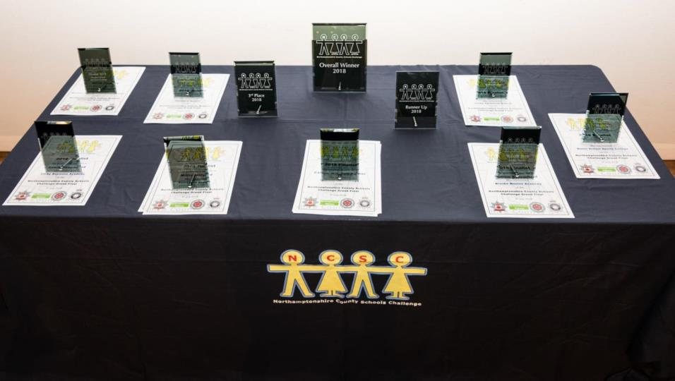
What’s in it for me?
Gain Personal Skills
product design, teamwork, business development, research, add to CV
Valuable Life Skills
to stay safe and protect others
increased understanding and awareness
Have Fun!
Contribute to the safety of our County
World of Work Experience
And semi-finals Police Headquarters
Dragons Den Grand Final
Best 8 teams countywide
Notes:
6 clicks, each bringing up a bullet point [have fun is last one]
There’s lots of other benefits in being involved in the challenge.
You gain skills which will help you with other parts of school or life, it will help you to keep yourself and others safe.
If your schools enters the challenge semi final you could come and experience a world of work at FHQ and if you make it through to the final present on stage in a local theatre.
But most importantly you will be helping those in Northamptonshire live happier and safer lives.

Slide 21
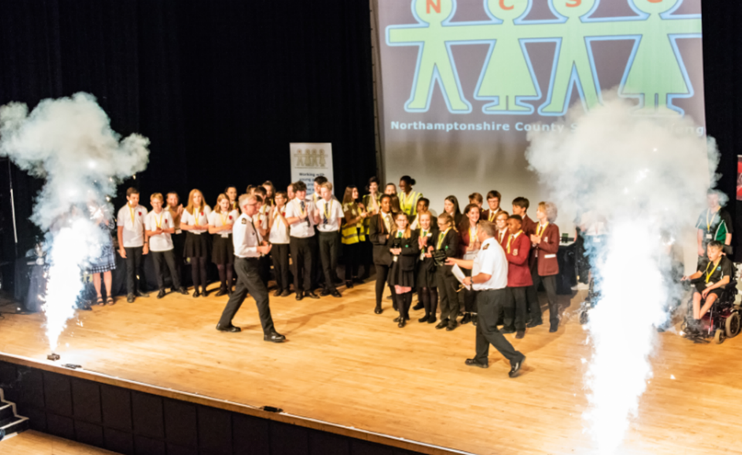
Get involved
Take up the challenge!
Be imaginative
You will be given support and guidance
Have a good time
Contribute to the safety of our County
We have up to £2,000 to make your idea happen
Notes:
We want:
Original idea
On theme
On budget
As the slide says….
Take up the challenge!
Be imaginative
You will be given support and guidance
Have a good time
Contribute to the safety of our County
We have up to £2,000 to make your idea happen

Slide 22

2022/23
Deliberate
Fire Setting

